Slide 1
New Approaches to Energy Development in Indian Country: The Trust Relationship and Tribal Self-Determination at (yet another) Crossroads
Monte Mills
Assistant Professor and Co-Director, Margery Hunter Brown Indian Law Clinic
Alexander Blewett III School of Law at the University of Montana

Slide 2

“…real self-determination has not been - and cannot be- achieved until tribes can determine for themselves what is right and what is wrong on their own reservations … [i]n the absence of this power, Indian people must conform their actions to rules and value judgments imposed on them by outsiders. Such a scheme is a tremendous obstacle to true self-determination. … Increasing meaningful tribal self-determination almost necessarily requires restoring a greater measure of tribal autonomy and reducing federal control on Indian reservations.”
Kevin K. Washburn, Tribal Self-Determination at the Crossroads, 38 Con.. L. Rev. 777, 786 (2006).

Slide 3
Why a Crossroads?
History of Federal Indian policy
  Legacy of Allotment (checkerboard ownership, allotment)
  Indian Mineral Leasing Act of 1938 (IMLA), 25 U.S.C. §§396a-396g
  Indian Mineral Development Act of 1982 (IMDA), 25 U.S.C. §§2101-2108
Resource Availability
  “traditional” energy – coal, oil and gas, etc.
  Renewables – solar, wind, biomass
Need for Economic Development
Impacts of Federal Oversight and Approval

Slide 4
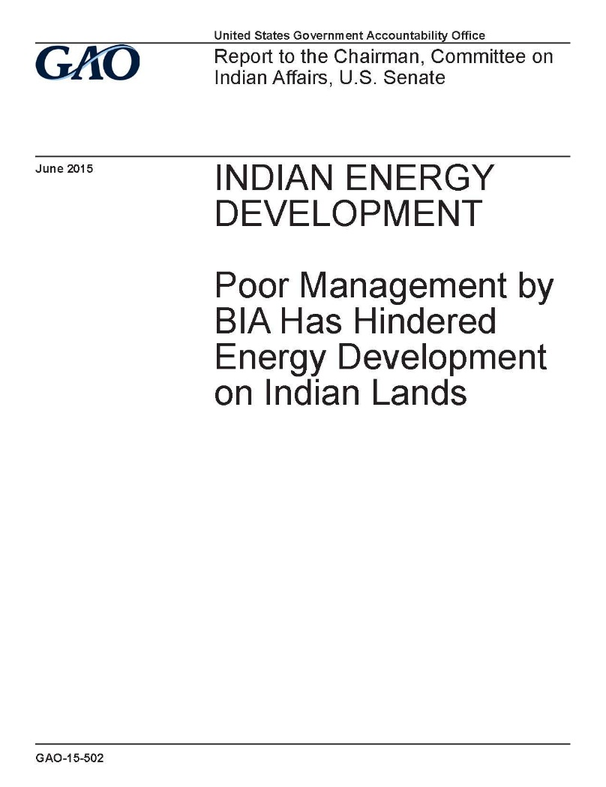
June 2015 GAO Report
Commissioned by Senator Barrasso (R-WY), Chairman of the Senate Committee on Indian Affairs
Documented missed development opportunities, lost revenue, and jeopardized viability of projects on tribal lands
Faulted BIA Management shortcomings
  Lack of data to verify ownership
  Staff limitations
  No tracking of review and response times
Also, complex regulatory framework
  NEPA, ESA, BLM, APD fees, etc.
And other factors
  Tribal capital, infrastructure and capacity
Why no Tribal Energy Resource Agreements (TERAs)?

Slide 5
A Decade of New Approaches?
Indian Tribal Energy Development and Self-Determination Act (ITEDSA), 25 USC §§3501-3506, with regulations at 25 C.F.R. Pt. 224
  Enacted as Title V of the Energy Policy Act of 2005
  Enables the negotiation of Tribal Energy Resource Agreements (TERAs) between the Secretary and a tribe
  Under a TERA, no subsequent Secretarial approval is required for certain leases, business agreements or rights-of-way related to energy development on tribal land
  BUT a TERA must include a tribal environmental review process allowing for public review of comment on proposed leases, agreements or rights-of-way (NEPA-lite).
  AND the United States is not liable for “any negotiated term” of or any loss from “any negotiated term” of a lease, agreement or right-of-way.

Slide 6
A Decade of New Approaches?
GAO Study – Why no TERAs?
TERA Regulations:
  25 C.F.R. 224.52(c): A TERA may “include assumption by the tribe of certain activities normally carried out by the Department, except for inherently Federal functions.” See also 25 C.F.R. 224.53(e)(2).
  Also, unclear whether a tribe would have to follow federal regulatory requirements under a TERA
No funding for additional responsibilities and liability
Complex capacity determination and application process

Slide 7
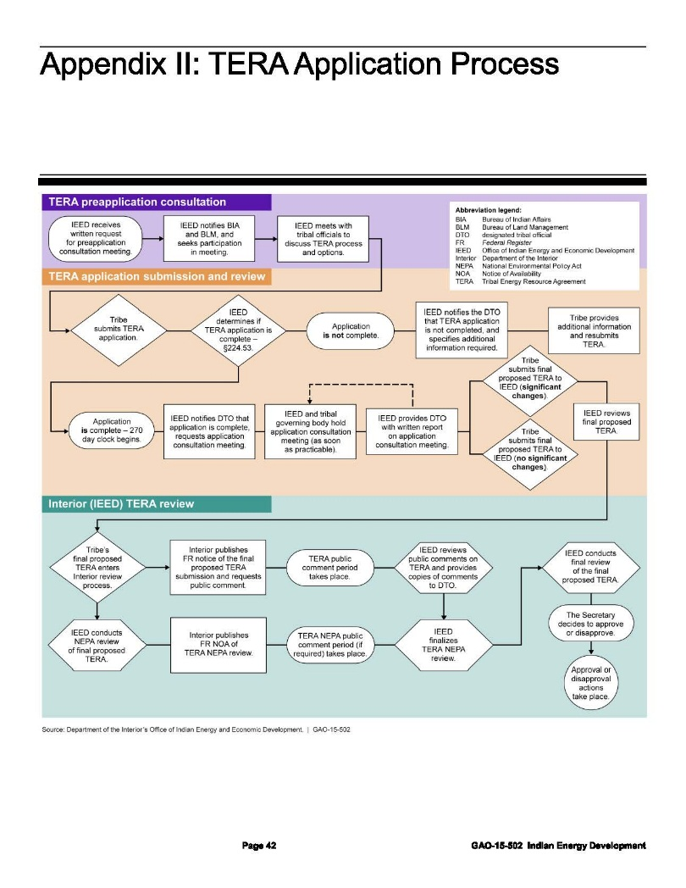

Slide 8
A Decade of New Approaches?
Helping Expedite and Advance Responsible Tribal Homeownership Act of 2012 (HEARTH Act), 25 U.S.C. §§415(h).
  Based on earlier tribe-specific amendments to Indian Long-Term Leasing Act (e.g., Navajo, Tulalip)
  Includes surface leases for residential and business purposes (including wind/solar projects) but NOT sub-surface leases or rights-of-way
  Removes Secretarial approval requirement for each lease, provided Secretary has approved tribal leasing regulations that are “consistent with” federal leasing regulations and include an environmental review process allowing for public comment (NEPA-lite)
  United States not liable for losses from any lease approved by a tribe
  An “interested party” may petition the Secretary to review tribal compliance and Secretary can provide remedy (subject to hearing and right to cure).

Slide 9
A Decade of New Approaches?
HEARTH Act a success and TERAs not?
  20 tribes with approved business leasing regulations under HEARTH Act
  0 tribes have entered a TERA
Still:
  GAO Report findings on BIA issues, complex regulatory framework, TERA concerns
  According to GAO, only one utility scale wind facility on Indian lands (as of March, 2015), with one more and one solar facility under construction.
  Without a TERA, Secretarial approval still required for mineral leases (IMLA), development agreements (IMDA), and energy-related rights-of-way

Slide 10
What’s Next?
Current Proposals:
Amend ITEDSA to address TERA issues
  S. 209 – ITEDSA Amendments of 2015
Apply HEARTH concept to leases
  Authority for Navajo Nation included in S. 209 and H.R. 538
Target specific aspects of Federal approval process
  H.R. 538 – Native American Energy Act
  Federal Service Center Proposal (Testimony of Larry Roberts, Principal Deputy Assistant Secretary – Indian Affairs)
Broader proposals (trust asset demonstration projects)
  S. 383/H.R. 812 – Indian Trust Asset Reform Act

Slide 11
Next stop: real self-determination?
First, self-determination contracting/compacting
  Negotiation of agreement for assumption of federal programs, services, functions or activities
And, IMDA
  Greater flexibility for energy development BUT still federal approval and a waiver of federal liability
Then, recent approaches (TERAs/HEARTH Act)
  Expanded tribal authority, but still federal oversight (e.g., environmental review processes, “inherently Federal functions”, “consistent” regulations) with varying waivers of federal liability.
Trust asset management demonstration projects?
  Negotiated arrangement, based on tribal proposal, for management of trust resource (but with limited tribal approval authority – only HEARTH Act) and limited waiver of liability (only where tribe decides to manage trust assets “at a less stringent standard”).

Slide 12
Thank you!
Monte Mills
406-243-2544 ~ monte.mills@umontana.edu

