Slide 1
Lawsuit by Agua Caliente Band of Cahuilla Indians
The American Indian Records Repository
Presented by Catherine Munson
Kilpatrick Townsend

Slide 2
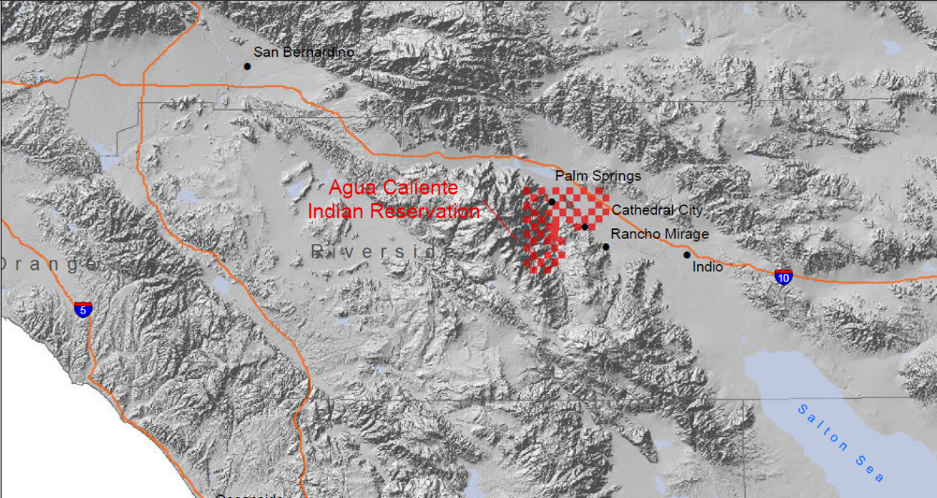
Reservation

Slide 3
Agua Caliente’s Lawsuit
Agua Caliente filed the lawsuit against CVWD and DWA in May 2013 seeking a declaration and quantification of its federally reserved rights to groundwater and a declaration of its rights to pore space underlying the Reservation.
The Tribe also seeks injunctive relief to stop the water districts from infringing on the Tribe’s rights to groundwater by overdrafting the aquifer and degrading water quality.
The United States intervened in support of Agua Caliente in June 2014.

Slide 4
Water Districts’ Claims in Response
Water Districts claim that tribes have no federally reserved rights to groundwater.
Under U.S. v. New Mexico, federally reserved rights to groundwater are not “necessary” for Agua Caliente because it has state law rights that are sufficient to meet the Tribe’s needs.
The Tribe does not need or use groundwater.
The equitable doctrines of laches, balance of the equities and unclean hands bar the United States and Agua Caliente’s federally reserved rights to groundwater.

Slide 5
Agua Caliente’s Response
The Ninth Circuit has held that U.S. v. New Mexico is not directly applicable to Indian Reservations. U.S. v. Adair, 732 F.2d 1394 (9th Cir. 1983).
State law rights cannot be used to supplant federally reserved rights under the Supremacy Clause and Property clause of the Constitution. Cappaert v. U.S., 426 U.S. 129 (1976); Winters v. U.S., 207 U.S. 564 (1908).
Current use not relevant. In any event, Agua Caliente may not currently pump groundwater, but it needs the groundwater it purchases now from the water districts.
The Surface adjudication the US contested jurisdiction and groundwater was excluded.
Equitable defenses cannot be used to defeat federally reserved rights.

Slide 6
District Court’s March 24, 2015 Order
Phase I Ruling in favor of Agua Caliente:
When President Grant and Hayes withdrew land for Agua Caliente “they also reserved by implication, the right to appurtenant water in the amount necessary ‘to fulfill the purposes of the reservation.’”
“Any attempt to limit appurtenant water resources to surface water fails as a matter of law and logic.”
“With one exception, every court to address the issue agrees that Winters rights encompass groundwater resources.” citing U.S. v. Washington, No. C01-0047Z, slip op. (W.D. Wash. Feb. 24, 2003), Tweedy v. Texas, 286 F.Supp. 383, 385 (D. Mont. 1968); In re Gila River Sys, 989 P.2d 739, 747 (Ariz. 1999); Confederated Salish and Kootanai Tribes v. Stults, 59 P.3d 1093, 1099 (Mont. 2002)

Slide 7
District Court’s Opinion (cont.)
“The California Legislature acknowledges the supremacy of federal water rights and acquiesces in their priority.”
California Water Code Section 10720.3 (“[I]n the management of a groundwater basin or subbasin by a groundwater sustainability agency or by the board, federally reserved rights to groundwater shall be respected in full. In case of conflict between federal and state law . . . federal law shall prevail.) (emphasis in Opinion).
“Winters does not entail a ‘balancing test’ of competing interests to determine the existence and scope of rights.”
“The Court concludes that the federal government impliedly reserved groundwater, as well as surface water, for the Agua Caliente when it created the reservation.”

Slide 8
Next Steps
The 9th Circuit Court of Appeals granted interlocutory review.
In the District Court the parties are briefing the United States and Agua Caliente’s Motion for Partial Summary Judgment regarding the Water Districts’ Equitable Defenses
Tribe and United States’ Brief due on February 9th
Southern California Tribal Chairman’s Association Amicus
- 45 tribes
Contact – Colin Cloud Hampson, champson@sonosky.com

Slide 9
Volume of Documents at AIRR
By the end of year 2012, 200,000 indexed boxes had been sent to AIRR for permanent storage.
Monthly average of boxes received has been 1,157.
Each standard records center box holds approximately 2,500 sheets of paper.
500,000,000 pages of trust records stored

Slide 10
What have we heard about the AIRR?
“AIRR provides … tribes, and contractors secure access to inactive records for research. Records are stored in strict compliance with NARA standards.”
“The AIRR is state of the art . . . ”
By locating, centralizing, securing and indexing trust records, AIRR is now trying to give IIM account holders, tribal leaders and Bureau of Indian Affairs (BIA) Fiduciary Trust Officers more-accessible, -timely and -accurate information on trust lands, revenues and lease transactions. Read more at http://indiancountrytodaymedianetwork.com/2011/12/22/indian-records-repository-kansas-preserves-indian-records-69089

Slide 11
What is it really like at the AIRR?
Ak-Chin Indian Community v. United States
District Court Action
15 ROWS
8,200 boxes at the AIRR, 20.5 million pages
Really none were stored at the AIRR
Court of Federal Claims Action
34,293 boxes at the AIRR that may or may not have responsive documents
Three categories: (1) Most likely; (2) likely; (3) least likely
Cost the US $6.4 million to search

Slide 12
Lesson Learned
18 boxes of documents, 45,000 pages, only to uncover 390 pages of responsive documents
Less than 1% of the documents reviewed contained responsive material
BISS – Documents indexed only at the file level
The boxes are not identified by tribe
Search by Tribal Code = 237 boxes
Search by name = 83 boxes
Documents are co-mingled

Slide 13
Other Observations
Some files within the boxes have no titles at all.
Among the 16 boxes reviewed, several of them were in complete disarray.
Of the 16 boxes reviewed none had tribal identifying information.
None of the boxes labeled “manual review” had responsive documents.

Slide 14
Court’s Ruling
Ak-Chin v. United States, 85 Fed. Cl. 397 (2009)
“…searches using the BISS database have proven unwieldy and unhelpful.”
Due to the way the documents are indexed, “queries made on the BISS database effectively result in . . . a document dump.”
“The Court agrees with the plaintiff that defendant’s indexing system is unreliable and therefore precludes plaintiff from identifying and reviewing responsive documents.”
“The Court agrees with the plaintiff that the procedures that have been implemented to store the records at the AIRR, and the corresponding BISS index, fail to comply with the MOU.”
United States had to search the records

Slide 15
The United States as Trustee
As a trustee, the Government “ha[s] a clear obligation to maintain trust records and furnish such records to beneficiaries upon request.” Cobell v. Norton, 240 F.3d 1981, 1093 (D.C. Cir. 2001).
The government as trustee has a fiduciary duty to “provide information reasonably necessary to enable a beneficiary to enforce his rights under the trust or to prevent or redress a breach of trust.” Restatement (Second) of Trusts § 173, cmt c. Goodeagle v. U.S., 2015 WL 6121591, (Fed. Cl. Oct. 16, 2015).

Slide 16
What can you do?
Consider establishing and supporting a record management system
Self-governance tribes can keep trust records
Work with local agency to develop some control over tribal records retained there.

Slide 17
Thank you
Catherine F. Munson

