Slide 1
MSU ILPC/TICA Conference
Aandaakonige: From the Trilogy to TICA
Victoria Sweet, JD
National council of Juvenile and Family Court Judges
November 5, 2015

Slide 3
Disproportionality Over Time

Slide 4

1. Lack of Response
2. How to Coordinate Services

Slide 5

3. Unwillingness to Take Jurisdiction
4. Late Intervention

Slide 6
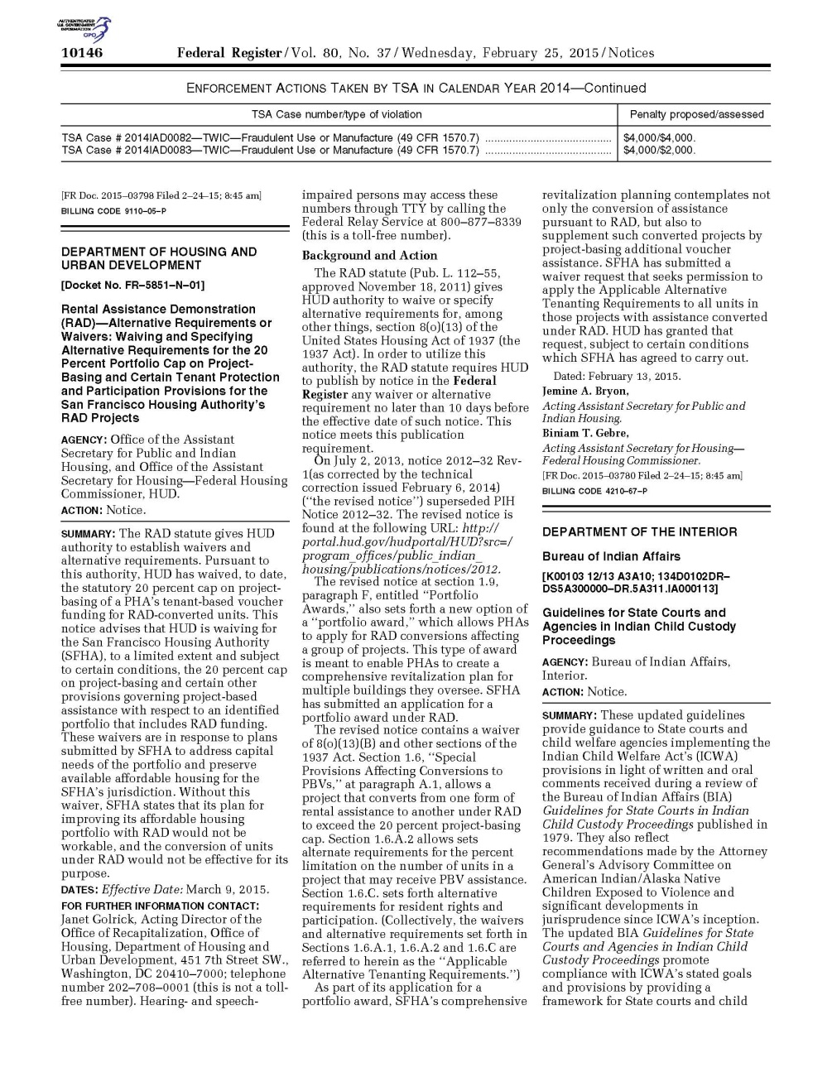
Revised Guidelines
5. Impact on Judicial Discretion
6. Best Interests of the Child Analysis

Slide 7
7. Lack of Foster and Adoptive Placements
8. How to Find a QEW

Slide 8
Required Timelines
Time to First Permanency Hearing
Time to Subsequent Permanency Hearing
Time to Permanent placement when Reunification is Unsuccessful
Time to TPR

Slide 9
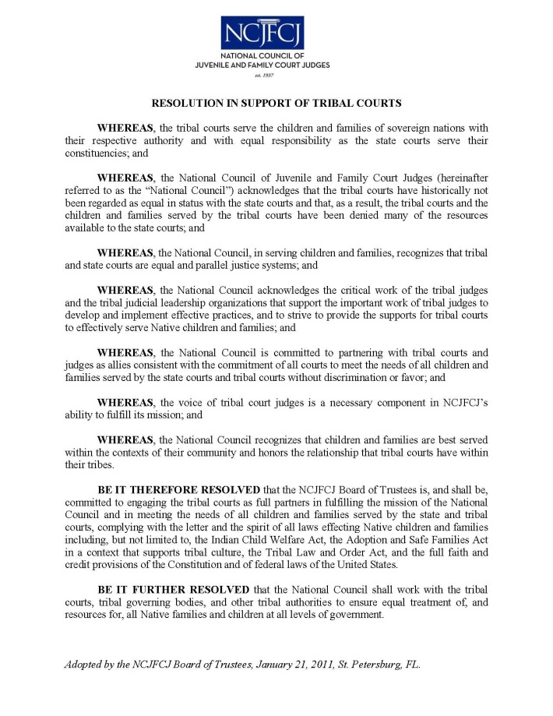
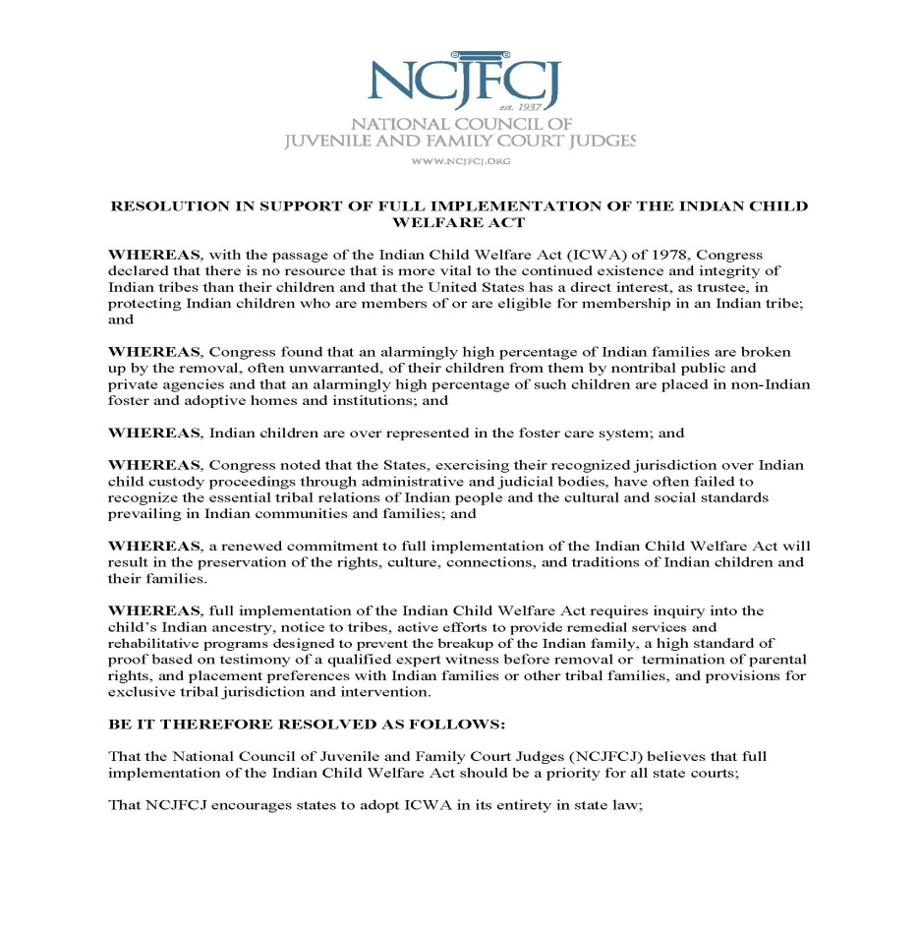
What Can Happen?
Resolution In Support of Tribal Courts
Resolution – Full Implementation of ICWA

Slide 10
MIIGWECH
Victoria Sweet
vsweet@njcfcj.org
775-784-6257

