Slide 1



VAWA Panel
Tribal In-House Counsel Conference
November 6, 2015

Slide 2
VAWA 2013 affirmed tribal inherent authority to exercise criminal jurisdiction over non-Indians who commit domestic violence, dating violence, or violations of protection orders in Indian country
Exercising special DV criminal jurisdiction is entirely voluntary and elective.
Special DV criminal jurisdiction does not change existing federal (or state) jurisdiction.

Slide 3
VAWA SDVCJ Requirements
Effective assistance of counsel that would be available in federal or state court;
Free appointed licensed attorneys for indigent defendants;
Law-trained tribal judges who are licensed to practice law;
Publicly available tribal criminal laws and rules of evidence and criminal procedure; and
Maintain a record of criminal proceeding;
Tribal court must provide the right to a trial by an impartial jury;
  Drawn from sources that reflect a fair cross-section of the community, including non-Indians.
  Tribal court must ensure defendants are timely notified of the right to habeas corpus and right to petition for stay of detention audio or video recording of trial proceedings

Slide 4
The Pascua Yaqui Tribe
The Pascua Yaqui Tribe reside on a two square mile reservation located seven miles from Tucson, AZ and 60 miles from the Border with Mexico. The tribe has approximately 20,000 enrolled members and 7 off-reservation Yaqui communities. 4-5,000 people reside on the Reservation. Approximately 800 non-Indians work for the tribal government and the casino, which is 32% of all employees. A reported 500 non-Indian community members reside on the reservation (U.S. Census).

Slide 5
Pascua Yaqui Overview
Since February 26, 2014 (the date of the first arrest of a non-Indian), the Tribe has had 23 reported cases involving non-Indian defendants. The 19 cases with non-Indian defendants involve 15 defendants (4 re-offended). Of those:
4 cases are currently active
6 convictions by plea agreement
4 were serious enough to warrant referrals for federal prosecution
10 were dismissed/declined for jurisdictional, investigative, or witness related problems (6 were dismissed due to Castleman)

Slide 6
Pascua Yaqui Cases
17 defendants (19 cases)
Median Age: 31 Ages 19-50
9 Hispanic offenders (1 female), (2 Mexican Legal Permanent Residents) 3 African-American males, 2 Caucasian males, 1 Asian male,
14 male, 1 female (1 same-sex case)
85 law enforcement contacts with Pascua Yaqui Police pre- and post-VAWA
10 violent injuries (Hair dragging, Strangulation, Bruising, Closed fist strikes to face)
4 defendants have re-offended post-VAWA (due to Castleman issues primarily)
Only 3 offenders did not have criminal records in the State of Arizona
7 of the offenders had been arrested for violent crimes, weapons, or threats (assault, threats, weapon misconduct, assaults, trespassing, and domestic violence) in the State of Arizona
2 offenders are Felons, both having been convicted for Burglary in the State of Arizona
10 of the offenders have been arrested in AZ for cases of drug use/possession/DUI or alcohol
2 offenders had active felony warrants, one out of Oklahoma for Armed Robbery

Slide 7
Pascua Yaqui Implementation Statistics
15 female victims, 2 male victims
Median age: 30 Ages 19-43 (all adults)
8 victims of dating relationships
3 female victims= married partners
2 female mothers of defendant’s children
3 cases involved Orders of Protection pre- and post-arrest
18 children present during incidents -Ages: Infant – 11 years old Median Age: 4 years old
3 cases resulted in open dependency
[If the 567 federally recognized American Indian Tribes had VAWA jurisdiction during the Pilot phase, and each averaged at least 19 cases, Tribes could have prosecuted or perhaps prevented approximately 10,000 cases of DV perpetrated by non-Indians offenders and protected at least that many victims (even more if you count children)]

Slide 8
Additional Data
At least 8 offenders were living on the Reservation in Tribal Housing; others were staying intermittently or for a short period of time
8 of the incidents involved alcoholic intoxicants
One incident involved a same-sex relationship
Most of the offenders and victims appear to be unemployed
None of the Tribal victims or defendants appear to be active cultural participants
One Defendant, while being arrested stated, “You can’t do anything to me anyway.”

Slide 9
Implementation Obstacles & Challenges
Intangibles
Notice
Law Enforcement
Assessment of Tribal Court System
Code Changes
Jury Selection
Incarceration of Non-Indian Defendants Expenses
Post Conviction Issues

Slide 10
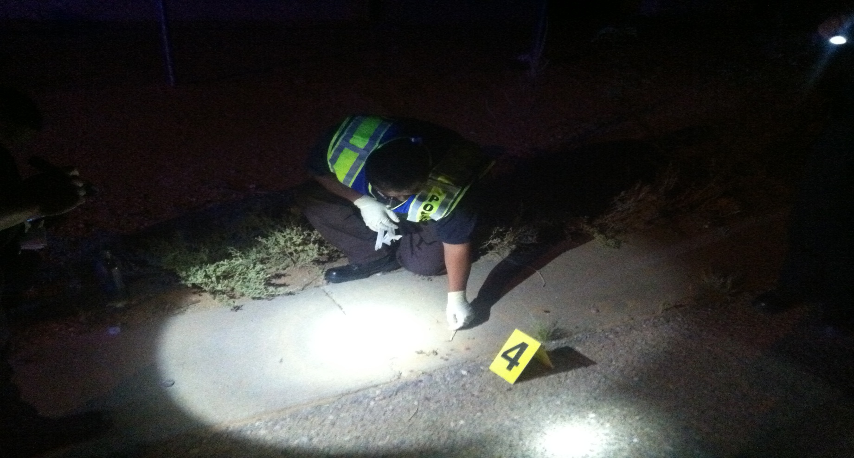
"Can you imagine responding to call where there is clear evidence of a crime committed by an individual and you cannot arrest them? I think the community felt cheated. It made police officers and victim advocates feel powerless.“
– Chief Michael Valenzuela, PYPD

Slide 11
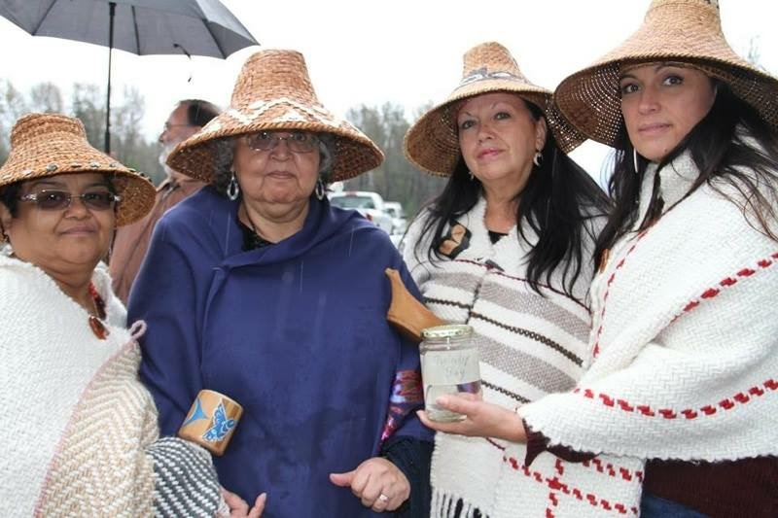
Tulalip Overview

Slide 12
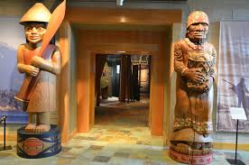
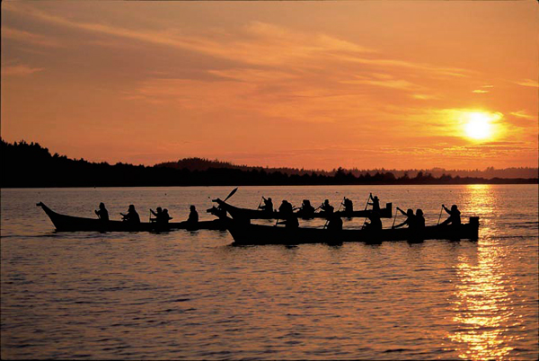
The Tulalip Tribes is…
A Sovereign Nation located in the NW corner of Washington state. A traditional fishing, hunting, and gathering tribe.

Slide 13
What Crimes Are Covered?
Tribes’ criminal jurisdiction over non-Indians is limited by VAWA 2013 to crimes of:
  Domestic violence
  Dating violence
  Violations of protection orders
  The crime must occur within Indian country, the victim must be a native person, and the defendant must have sufficient ties to the community:
    Living, working or having an intimate relationship with a tribal member or other native living within the tribe’s Indian Country.

Slide 14
Current Statistics at Tulalip
  Eleven cases with nine defendants
    Age range of defendants 21-35
    Defendants have had over 100 contacts with Tulalip Police Department since 2008
    3 Caucasian, 2 African American, 3 Hispanic and 1 un-enrolled Canadian Indian
    6 had children in common with the victim of the crime
  Results
    6 found guilty
    1 to be prosecuted with US Attorney’s Office and our tribal SAUSA
    2 pre-trial
    2 dismissed

Slide 15
Details of Sentencing
All required to complete DV Perpetrator’s treatment
CD treatment if alcohol or drugs involved
All jail and fine
Most No Contact Orders
All no firearm possession
All will be excluded

Slide 16
Challenges
Crimes that go unpunished—lack of jurisdiction over:
  Crimes against children
    Criminal endangerment
  DV-related (attendant) crimes that don’t involve use of force
    Criminal mischief
    Trespass
  Interfering with reporting DV
  Drug crimes
  U.S. v. Castleman
    Concern for the tribes who define DV for their community differently than federal definition.

Slide 17
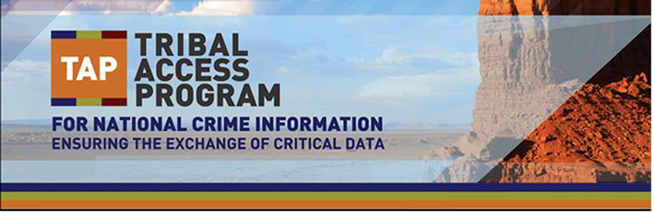

Slide 18
TAP Program
The U.S. Department of Justice (DOJ) has established the Tribal Access Program (TAP) for National Crime Information to provide tribes access to national crime information databases for both civil and criminal purposes as the Tribal CJIS Systems Agency (CSA ).
TAP will allow tribes to more effectively serve and protect their nation’s citizens by ensuring the exchange of critical data.

Slide 19
TAP – Access to Databases through Federal Portal
As a CSA for federally-recognized tribes, DOJ will support access to Criminal Justice Information Services (CJIS) and safety information owned by the States.

Slide 20
10 Pilot Tribes Approved
Cherokee Nation of Oklahoma,
Eastern Band of Cherokee Indians of North Carolina,
Keweenaw Bay Indian Community of Michigan,
Oneida Indian Nation of New York,
Pascua Yaqui Tribe of Arizona
Suquamish Indian Tribe of the Port Madison Reservation of Washington,
Shoshone-Bannock Tribes of the Fort Hall Reservation of Idaho,
Tulalip Tribes of Washington,
Confederated Tribes of the Umatilla of Oregon and
White Mountain Apache Tribe of the Fort Apache Reservation of Arizona.

Slide 21
NCAI & The Inter-Tribal Working Group
Monthly Calls
Updates
Technical Assistance
ITWG Meetings
Castleman Issue from U.S. v. Castleman 134 S. Ct. 1405, from footnote 4 of the majority and footnote 7 from the concurrence.

Slide 22
Purpose Code X
Bureau of Indian Affairs (BIA) Purpose Code X Program ensures children requiring emergency placements are placed in safe homes:
Interested tribes submit application/paperwork to BIA.
BIA dispatch centers will conduct name-based criminal history background checks at any time for emergency child placement for tribal social service agencies.
Follow-up fingerprint submission must be provided to the FBI within 15 calendar days from the date the emergency name-based checks are conducted, if children are still in placement.
Fingerprint submission may be completed utilizing TAP workstation.
  Web site: http://www.bia.gov/WhoWeAre/BIA/OJS/
  NOTE: This is the only authorized use of BIA-OJS Purpose Code X Program.

Slide 23
The Castleman Issue – 25 U.S.C. 1304(a)
(1) Dating violence - The term "dating violence " means violence committed by a person who is or has been in a social relationship of a romantic or intimate nature with the victim, as determined by the length of the relationship, the type of relationship, and the frequency of interaction between the persons involved in the relationship.
(2) Domestic violence - The term "domestic violence" means violence committed by a current or former spouse or intimate partner of the victim, by a person with whom the victim shares a child in common, by a person who is cohabitating with or has cohabitated with the victim as a spouse or intimate partner, or by a person similarly situated to a spouse of the victim under the domestic- or family- violence laws of an Indian tribe that has jurisdiction over the Indian country where the violence occurs.

Slide 24
Castleman Contd.
18 U.S.C. §16: The term “crime of violence” means—
(a) an offense that has as an element the use, attempted use, or threatened use of physical force against the person or property of another, or
(b) any other offense that is a felony and that, by its nature, involves a substantial risk that physical force against the person or property of another may be used in the course of committing the offense.

Slide 25
Did the defendant’s conduct involve the reckless or intentional use, threatened use, or attempted use of force capable of doing injury to the victim or the victim’s property?
If yes, that conduct must be alleged and proved, and the tribe can charge the defendant using any tribal statute it deems appropriate regardless of whether the statute has, as an element, the use, threatened use, or attempted use of physical force.

Slide 26
Michelle Demmert, Attorney for Tulalip mdemmert@tulaliptribes-nsn.gov
Alfred Urbina, Attorney General for Pascua Yaqui
Alfred.Urbina@pascuayaqui-nsn.gov
Tamera Begay, Legal Fellow for NCAI
tbegay@ncai.org

