Slide 1

Native American
Law and Policy
Tribes Lobbying Congress:
Who Wins and Why
Sam Daughety
samuel.daughety@dentons.com
202/408-6437

Slide 2
Why Do Tribes Lobby Congress?
To influence decisions that affect your tribe and your members
Congress' special role in Indian affairs:
  The federal trust responsibility
  The government-to-government relationship
  Congress' delegation of a wide range of authorities to administrative agencies
"If you don't have a seat at the table, you're probably on the menu"

Slide 3
Who Wins? Tribal Legislative Successes (111th-114th Cong.)
American Investment and Recovery Act (tribal-specific provisions)
Tribal Law and Order Act of 2010
HEARTH Act
Violence Against Women Reauthorization Act (tribal specific provisions)
Indian Health Care Improvement Act
Stafford Act (tribal emergency declaration provisions)
Claims Resolution Act of 2010 (Cobell Settlement)
Tribal General Welfare Exclusion Act

Slide 4
Why?
Coalition-Building
Broad, Bipartisan Congressional and Tribal Support
Localized / Home-State Issues
Congressional Relationships and Education
Time and Resources
Does Not Cost Federal Government Money

Slide 5
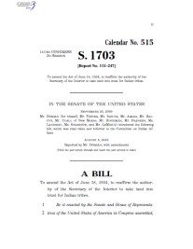
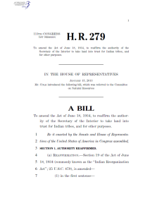
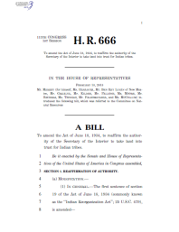
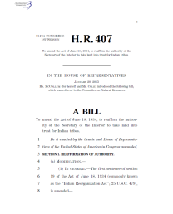
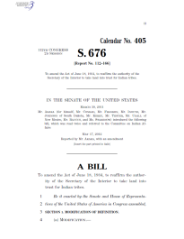
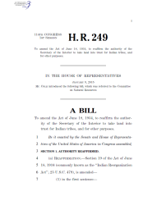
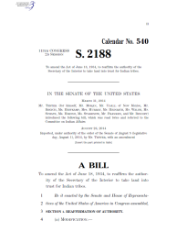
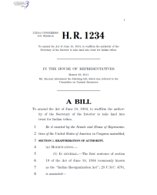
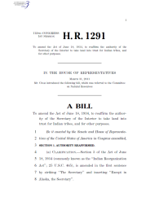
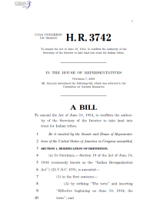
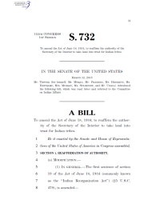
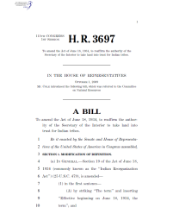
Who…Hasn't Won Yet?

Slide 6
Tribal Participation in Congressional Advocacy
Money
Lobbying
Money and Lobbying
Influencing federal policy with limited resources

Slide 7
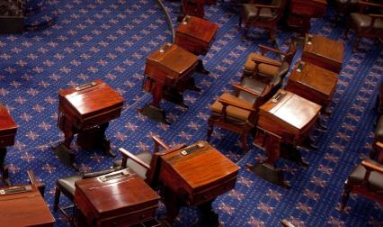
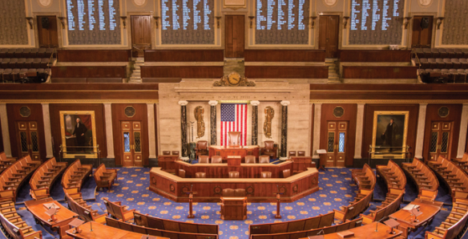
Congressional Elections
House/Senate Races
Polling and Forecasts

Slide 8
Who Wins and Why: Examples

Slide 9
Tribal General Welfare Exclusion Act
IRS sought to impose federal income taxes on tribal government programs and services
2012: IRS proposed safe harbor for specific programs
2013: TGWEA Introduced
  H.R. 3043 -- Reps. Nunez (R) and Kind (D) + 60 cosponsors
  S. 1507 -- Sens. Moran (R) and Heitkamp (D) + 24 cosponsors

Slide 10
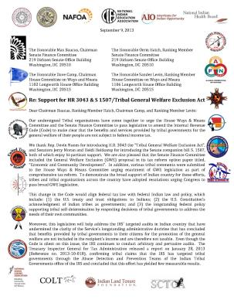
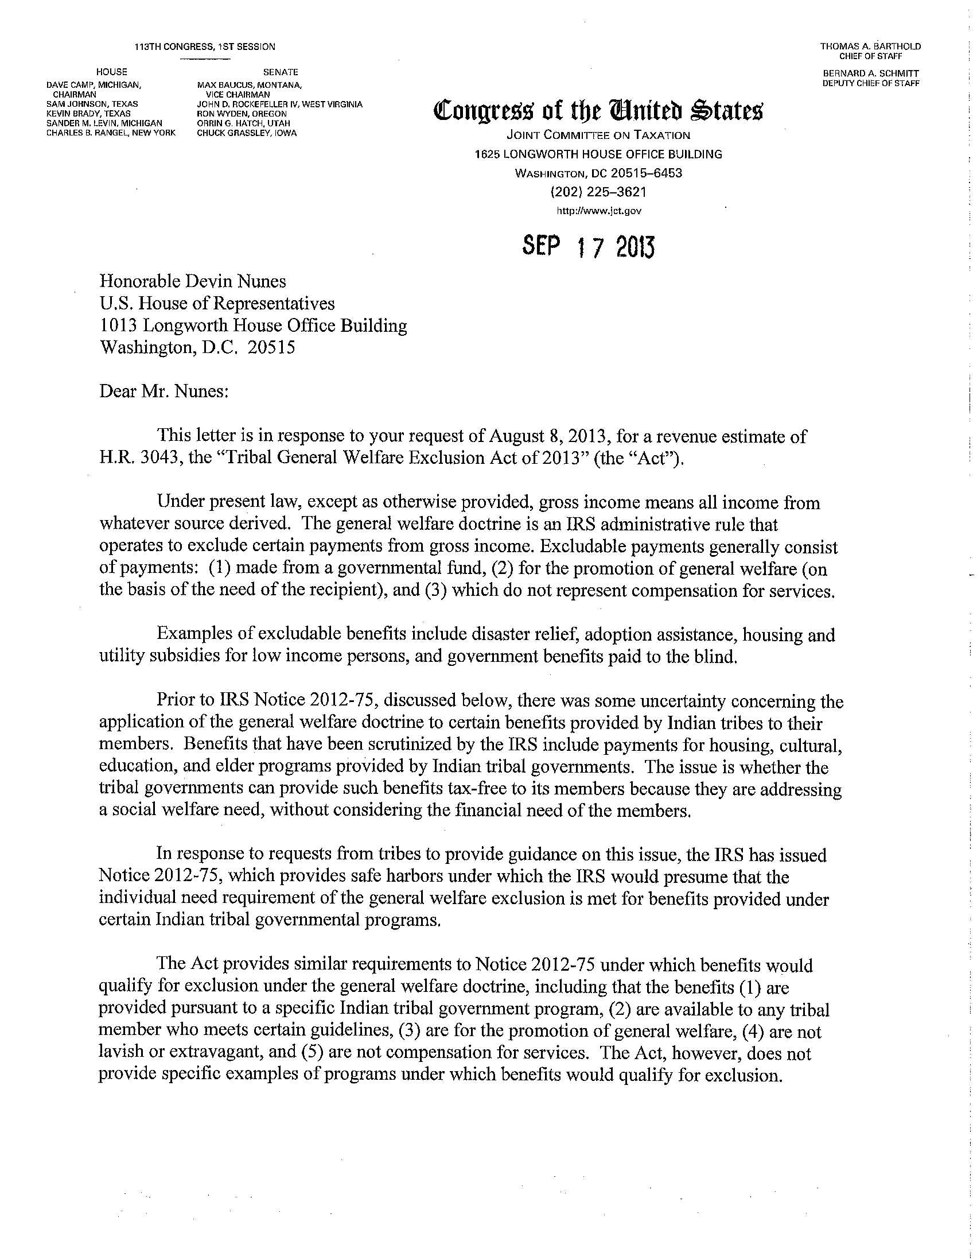

Tribal General Welfare Exclusion Act
Widespread tribal and non-tribal support
Sustained, long-term effort
Joint Committee on Taxation: bill "would have a negligible effect on federal fiscal revenues"

Slide 11
Tribal Law and Order Reauthorization Act
Reauthorizes provisions in the Tribal Law and Order Act of 2010
S. 2920 (Sens. Barrasso and McCain)
Specific additional improvements: access to data, information sharing, juvenile justice, substance abuse, public safety
Reported out of Senate Indian Affairs Committee in June

Slide 12
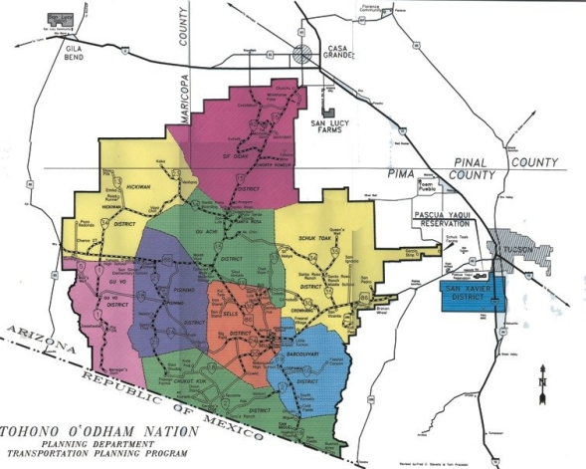
TLORA - Tribe-Specific Provisions
4,500 square miles (75 miles of international border)
29,400 miles of roads maintained by BIA
Customs and Border Patrol vehicles -- high traffic, road damage
Road repair agreements hung up between DOI and DHS

Slide 13
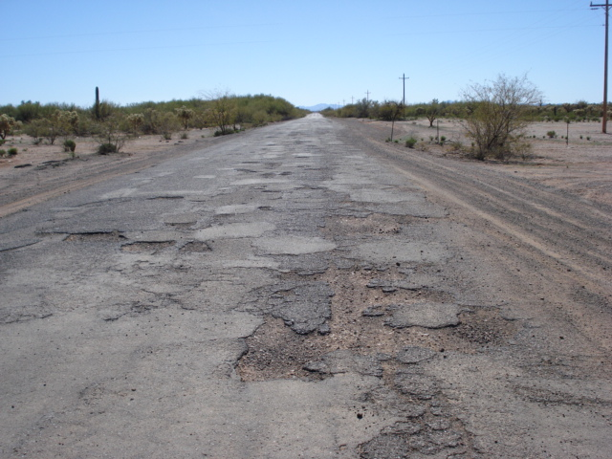

Slide 14
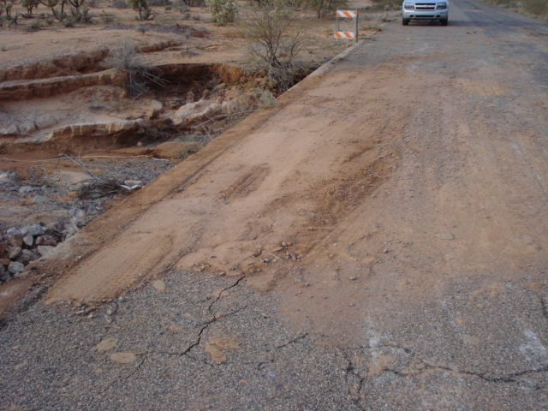

Slide 15
TLORA - Tribe-Specific Provisions
McCain amendment to TLORA during markup in Senate Indian Affairs Committee:
  "MAINTENANCE OF CERTAIN INDIAN RESERVATION ROADS.—
  The Commissioner of U.S. Customs and Border Protection may transfer funds to the Director of the Bureau of Indian Affairs to maintain or repair roads under the jurisdiction of the Director, on the condition that the Commissioner and the Director mutually agree that the primary user of the subject road is U.S. Customs and Border Protection."

Slide 16
The Elusive Quest for a Carcieri Fix

Slide 17
Carcieri v. Salazar
Section 19 of the Indian Reorganization Act: "The term 'Indian' as used in this Act shall include all persons of Indian descent who are members of any recognized Indian tribe now under Federal jurisdiction"
February, 2009: Supreme Court decides Carcieri v. Salazar
“[T]he term ‘now under Federal jurisdiction’…unambiguously refers to those tribes that were under the federal jurisdiction of the United States when the IRA was enacted in 1934.”

Slide 18
Carcieri Fixes introduced:
111th - 114th Congresses
111th Congress (2009-2010) S.1703 (Dorgan, D-ND). 12 Cosponsors. Favorably Reported by Senate Committee on Indian Affairs. H.R.3697 (Cole, R-OK). 12 Cosponsors. Hearings held. H.R.3742 (Kildee, D-MI). 44 Cosponsors. Hearings held. | 112th Congress (2011-2012) H.R.1234 (Kildee, D-MI). 30 Cosponsors. Hearing held. H.R.1291 (Cole, R-OK). 10 Cosponsors. Hearing held. S.676 (Akaka, D-HI). 9 Cosponsors. Hearings held. Favorably reported by the Senate Committee on Indian Affairs.
113th Congress (2013-2014) S.2188 (Tester, D-MT). 13 Cosponsors. Hearings held. Favorably reported by Senate Committee on Indian Affairs. H.R.666 (Markey, D-MA). 33 Cosponsors. H.R.279 (Cole, R-OK). 37 Cosponsors. | 114th Congress (2015-2016) H.R. 249 (Cole, R-OK). 39 Cosponsors. H.R. 407 (McCollum, D-MN). 10 Cosponsors. H.R.3137 (Cole, R-OK). 49 Cosponsors. S. 732 (Tester, D-MT). 7 Cosponsors. S. 1879 (Barraso, R-WY). 0 Cosponsors. Favorably reported by Senate Committee on Indian Affairs with amendment in the nature of a substitute. S. 1931 (Moran, R-KS). 2 Cosponsors.

Slide 19
Carcieri Fix - 111th and 112th Congresses
111th Congress: Fix language included in an appropriations bill by the House Interior Appropriations Subcommittee
  Rep. Cole: "Without this language, the standard set forth in Carcieri v. Salazar will be devastating to tribal sovereignty and economic development"
  December, 2010: bill passes the House of Representatives but not before Carcieri Fix stripped in the Senate
112th Congress: Senate version (reportedly) nearly passes, but pulled from consideration at last minute
No subsequent legislation advances this far

Slide 20

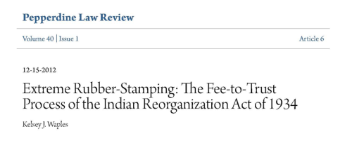
The Elusive Quest for a Carcieri Fix
Congressional support challenges
Non-tribal opposition, primarily based on gaming concerns
Full tribal buy-in?

Slide 21
Administrative Action and Judicial Challenges
December 2010: Administration decision to accept land in trust for Cowlitz Tribe:
  Distinguishes recognition from jurisdiction
  Creates two-part test for whether tribe under federal jurisdiction in 1934
  Solicitor later releases Carcieri "M Opinion"
2011-2016: litigation over Cowlitz decision
July 2016: Confederated Tribes of the Grand Ronde Community Of Oregon v. Jewell, ___ F.3d ___ (D.C. Cir. 2016)
October 2016: petition for cert. filed

Slide 22
Tribe-Specific Legislative Fix
Gun Lake Trust Land Reaffirmation Act (2014)
  Applies "Patchak Fix" for Gun Lake Tribe
  Reaffirms trust acquisition
  Prohibits litigation over trust acquisition
2014-2016: Litigation over Gun Lake acquisition resumes and then broadens to include Reaffirmation Act
July 2016: Patchak v. Jewell ___ F.3d ___ (D.C. Cir.)
October 2016: petition for cert. filed
More tribe-specific fixes in future?

Slide 23
Tribal Participation in the Federal Lobbying Process

Slide 24
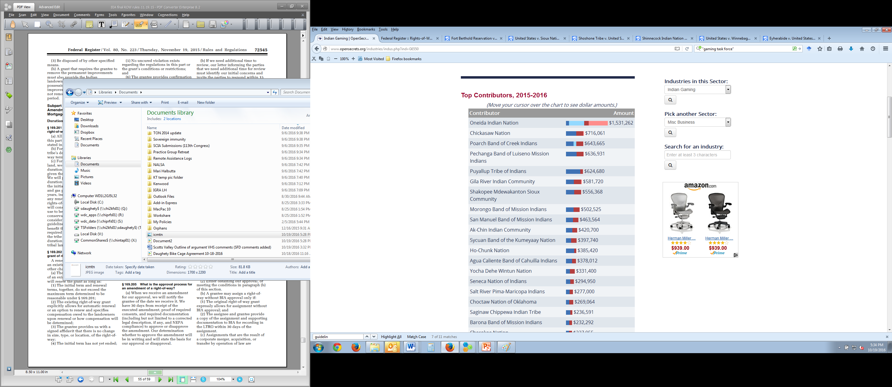
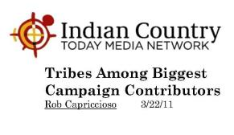
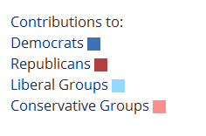
What most people think of first:
Campaign
Contributions
Top Contributors, 2015-2016:
Source: Open Secrets

Slide 25
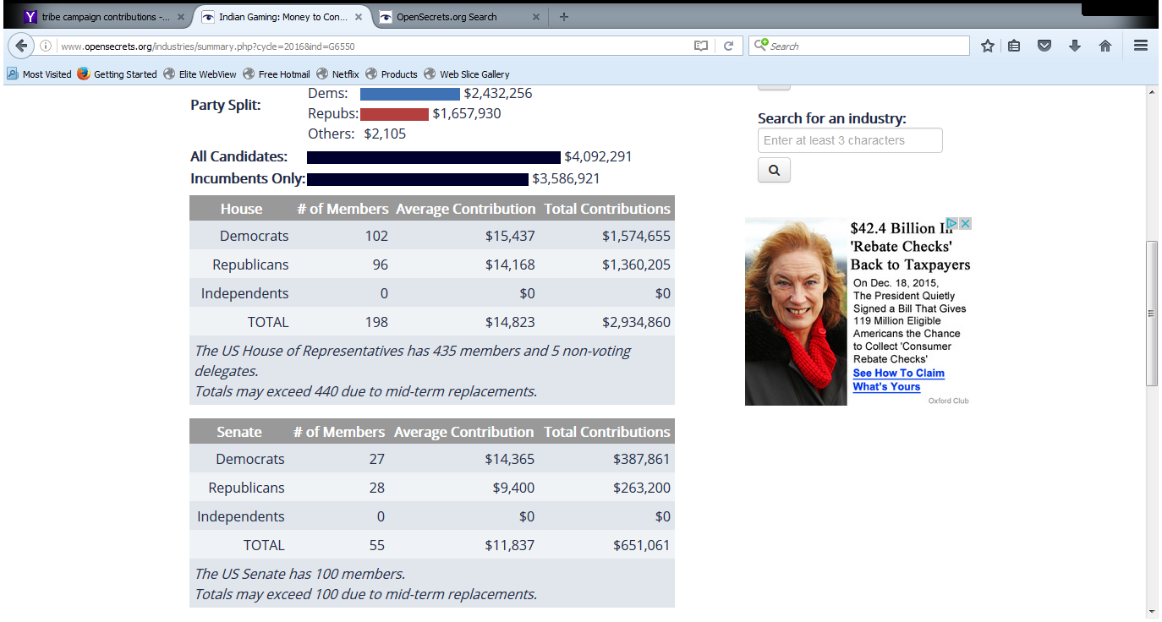
Tribal Campaign Contributions YTD 2016
Source: Open Secrets

Slide 26
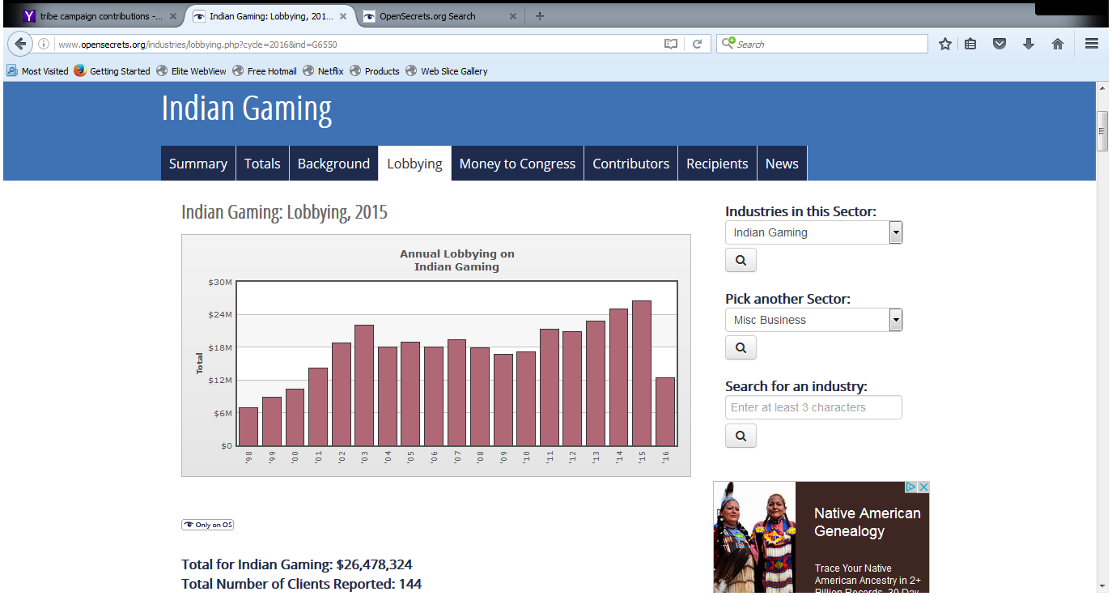
And Then of Course There is Lobbying…
Tribal Spending on Lobbyists On Indian Gaming issues:
Source: Open Secrets

Slide 27
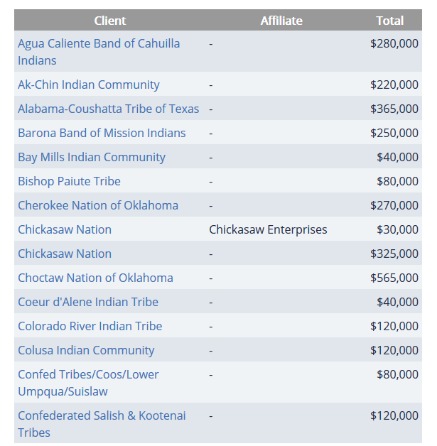
Roughly 1/4 of Tribes use Lobbyists
2015 reported individual tribal spend for lobbying on tribal gaming varied from as much as $2.9 million in 2015 to a little as $10,000.
Source: Open Secrets

Slide 28
What About the other Three-Quarters of Federally Recognized Tribes?
Are they getting as much attention from the decision-makers? Probably not.
Can tribes more effectively advocate for their issues anyway? Yes.
  Coalition building and participation
  Relationship building (both Congress and Administration)
  In-house intergovernmental positions

Slide 29






Coalition Building and Participation

Slide 30
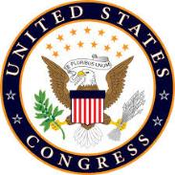

Relationship building in Washington
Participate in intertribal association annual summits
Get to know your Congressional Representatives (and their staff)
Get to know the Administration and its decision-makers (and the career staff and tribal liaisons)

Slide 31
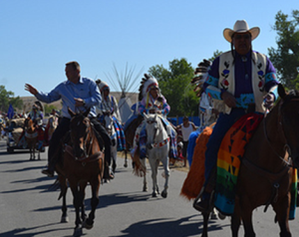
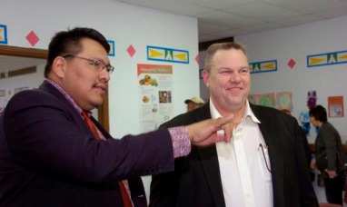
Relationship Building Close to Home
Visit members of your state congressional delegation and their staff in their district offices.
  Visit administrative officials in regional offices
  Invite members of your state congressional delegation to your reservation (and make the most of the opportunity)

Slide 32
Meeting with the Decision-Makers
  You may only get 15-30 minutes
  Explain the background of your issue
  Be clear about your "ask"
  Leave behind a clear written summary of your issue
    But be aware materials left at the agencies are likely subject to the Freedom of Information Act
    Materials left in congressional offices are likely to be shared with other offices (and potentially lobbyists for other tribes or other parties)

Slide 33
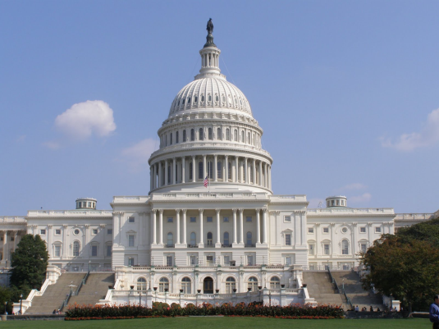
The Legislative Branch:
Congressional Elections
___________________________________________

Slide 34
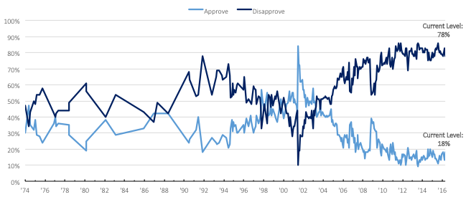
Congressional approval reaches three-decade low
Congressional approval rating
.
34

Slide 35
Republicans currently hold the five Senate seats most likely to flip in 2016
National Journal's Hotline’s 2016 senate rankings
■ Seat Held by Republican ■ Seat Held by Democrat
1. Illinois: Sen. Mark Kirk (R) is trailing in polls in a blue state, and is lacking in support from outside spending groups. Kirk has publicly disavowed Trump in a TV ad, seeking to distance himself from his party.
Incumbent: Mark Kirk (R)
Challenger: Tammy Duckworth (D)
2. Wisconsin: Former Senator Russ Feingold (D) is running an aggressive campaign against Ron Johnson (R); a recent poll had Feingold up 6 points.
Incumbent: Ron Johnson (R)
Challenger: Former Sen. Russ Feingold (D)
3. Pennsylvania: Polls show Toomey trailing McGInty as Clinton pulls ahead in Pennsylvania. Toomey is very well funded.
Incumbent: Pat Toomey (R)
Challenger: Katie McGinty (D)
4. New Hampshire : Ayotte is running a disciplined race but has been trailing in the polls, and Democrats have an early spending advantage.
Incumbent: Kelly Ayotte (R)
Challenger: Gov. Maggie Hassan (D)
5. Indiana: Bayh was once winning by double-digits, but now this is a margin-of-error race. Republicans have outspent Democrats 2-to-1.
Incumbent: Dan Coats (R) (retiring)
Challengers: Former Gov. Evan Bayh (D) and Rep. Todd Young (R)
WI
NH
NV
PA
IL
IN
MO
AZ
NC
FL
.
.

Slide 36


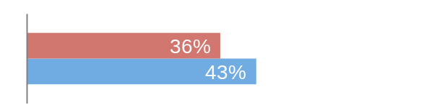


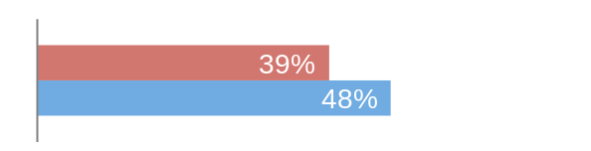
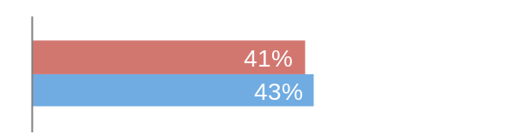


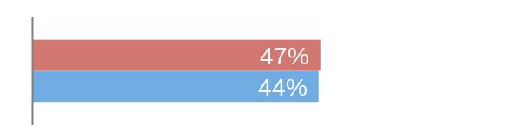


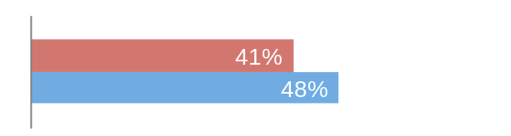


Which Senate seats are most likely to flip?
National Journal's Hotline’s 2016 Senate rankings
State
Incumbent
Challenger
Polling
1. Illinois
Mark Kirk
Tammy Duckworth
2. Wisconsin
Ron Johnson
Russ Feingold
3. Pennsylvania
Pat Toomey
Katie McGinty
4. New Hampshire
Kelly Ayotte
Maggie Hassan
5. Indiana
Open
Todd Young
Evan Bayh
*based off one recent poll
.
.

Slide 37
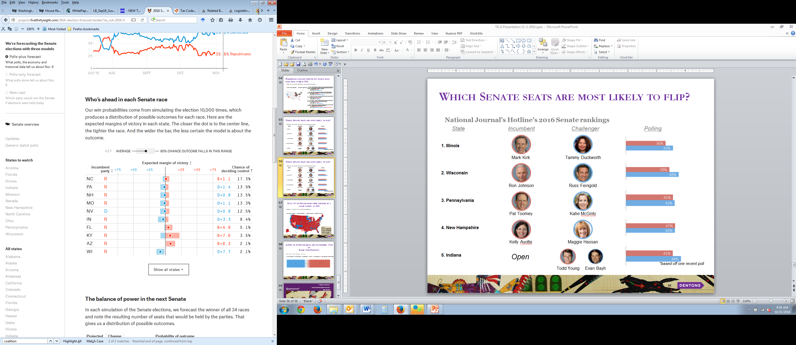
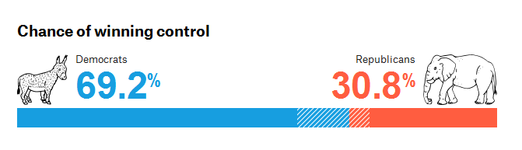
Which Senate seats are most likely to flip?
Source: FiveThirtyEight
.
.

Slide 38
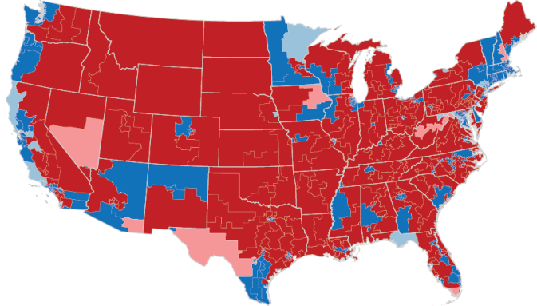
Only 5% of House races were decided by a close margin in 2014
Margins of victory in 2014 House elections
■ Margin of >5% Dem ■ Margin of 0-5% Dem ■ Margin of 0-5% Rep ■ Margin of >5% Rep
Analysis
Because so few districts produce competitive races, some observers predict that the GOP will retain their majority in the House until districts are redrawn following the 2020 census
AK

Slide 39
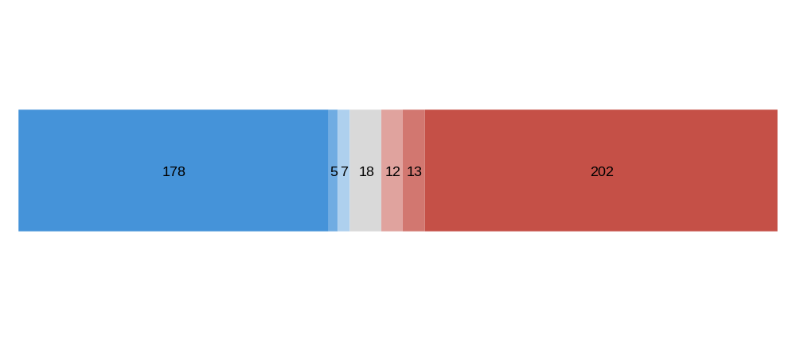
As Few As 20 House Seats are Considered Toss Up
Races This Election
2016 House Race Ratings, by Party
■ Solid Democrat ■ Likely Democrat ■ Lean Democrat ■ Toss Up ■ Lean Republican ■ Likely Republican ■ Solid Republican
39

Slide 40
Questions?
Sam Daughety
samuel.daughety@dentons.com
202/408-6427

