Slide 1
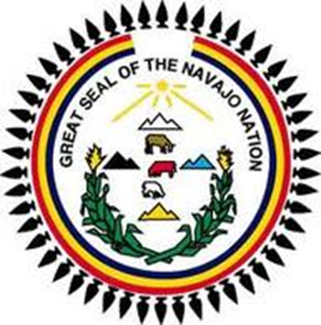
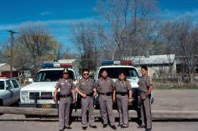
CROSS-COMMISSION AGREEMENTS
PAUL SPRUHAN
NAVAJO NATION DEPARTMENT OF JUSTICE

Slide 2
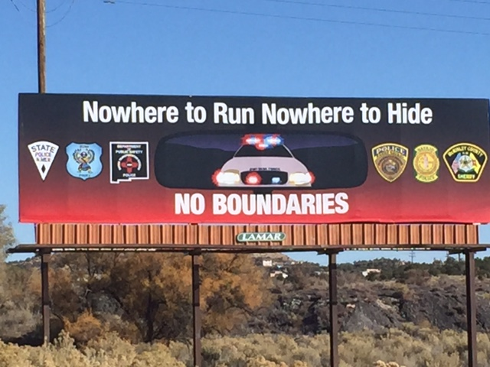

Slide 3
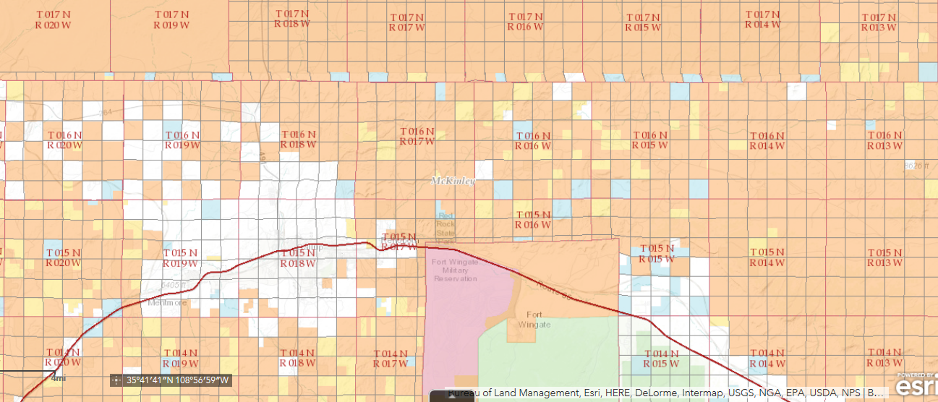

Slide 4
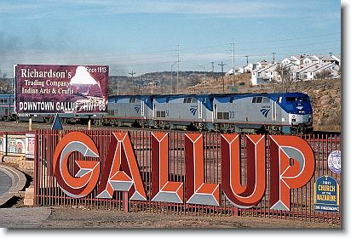

Slide 5
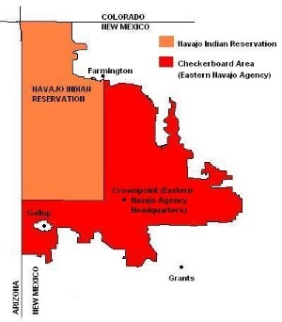

Slide 6
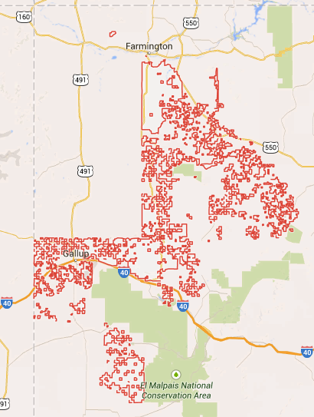

Slide 7
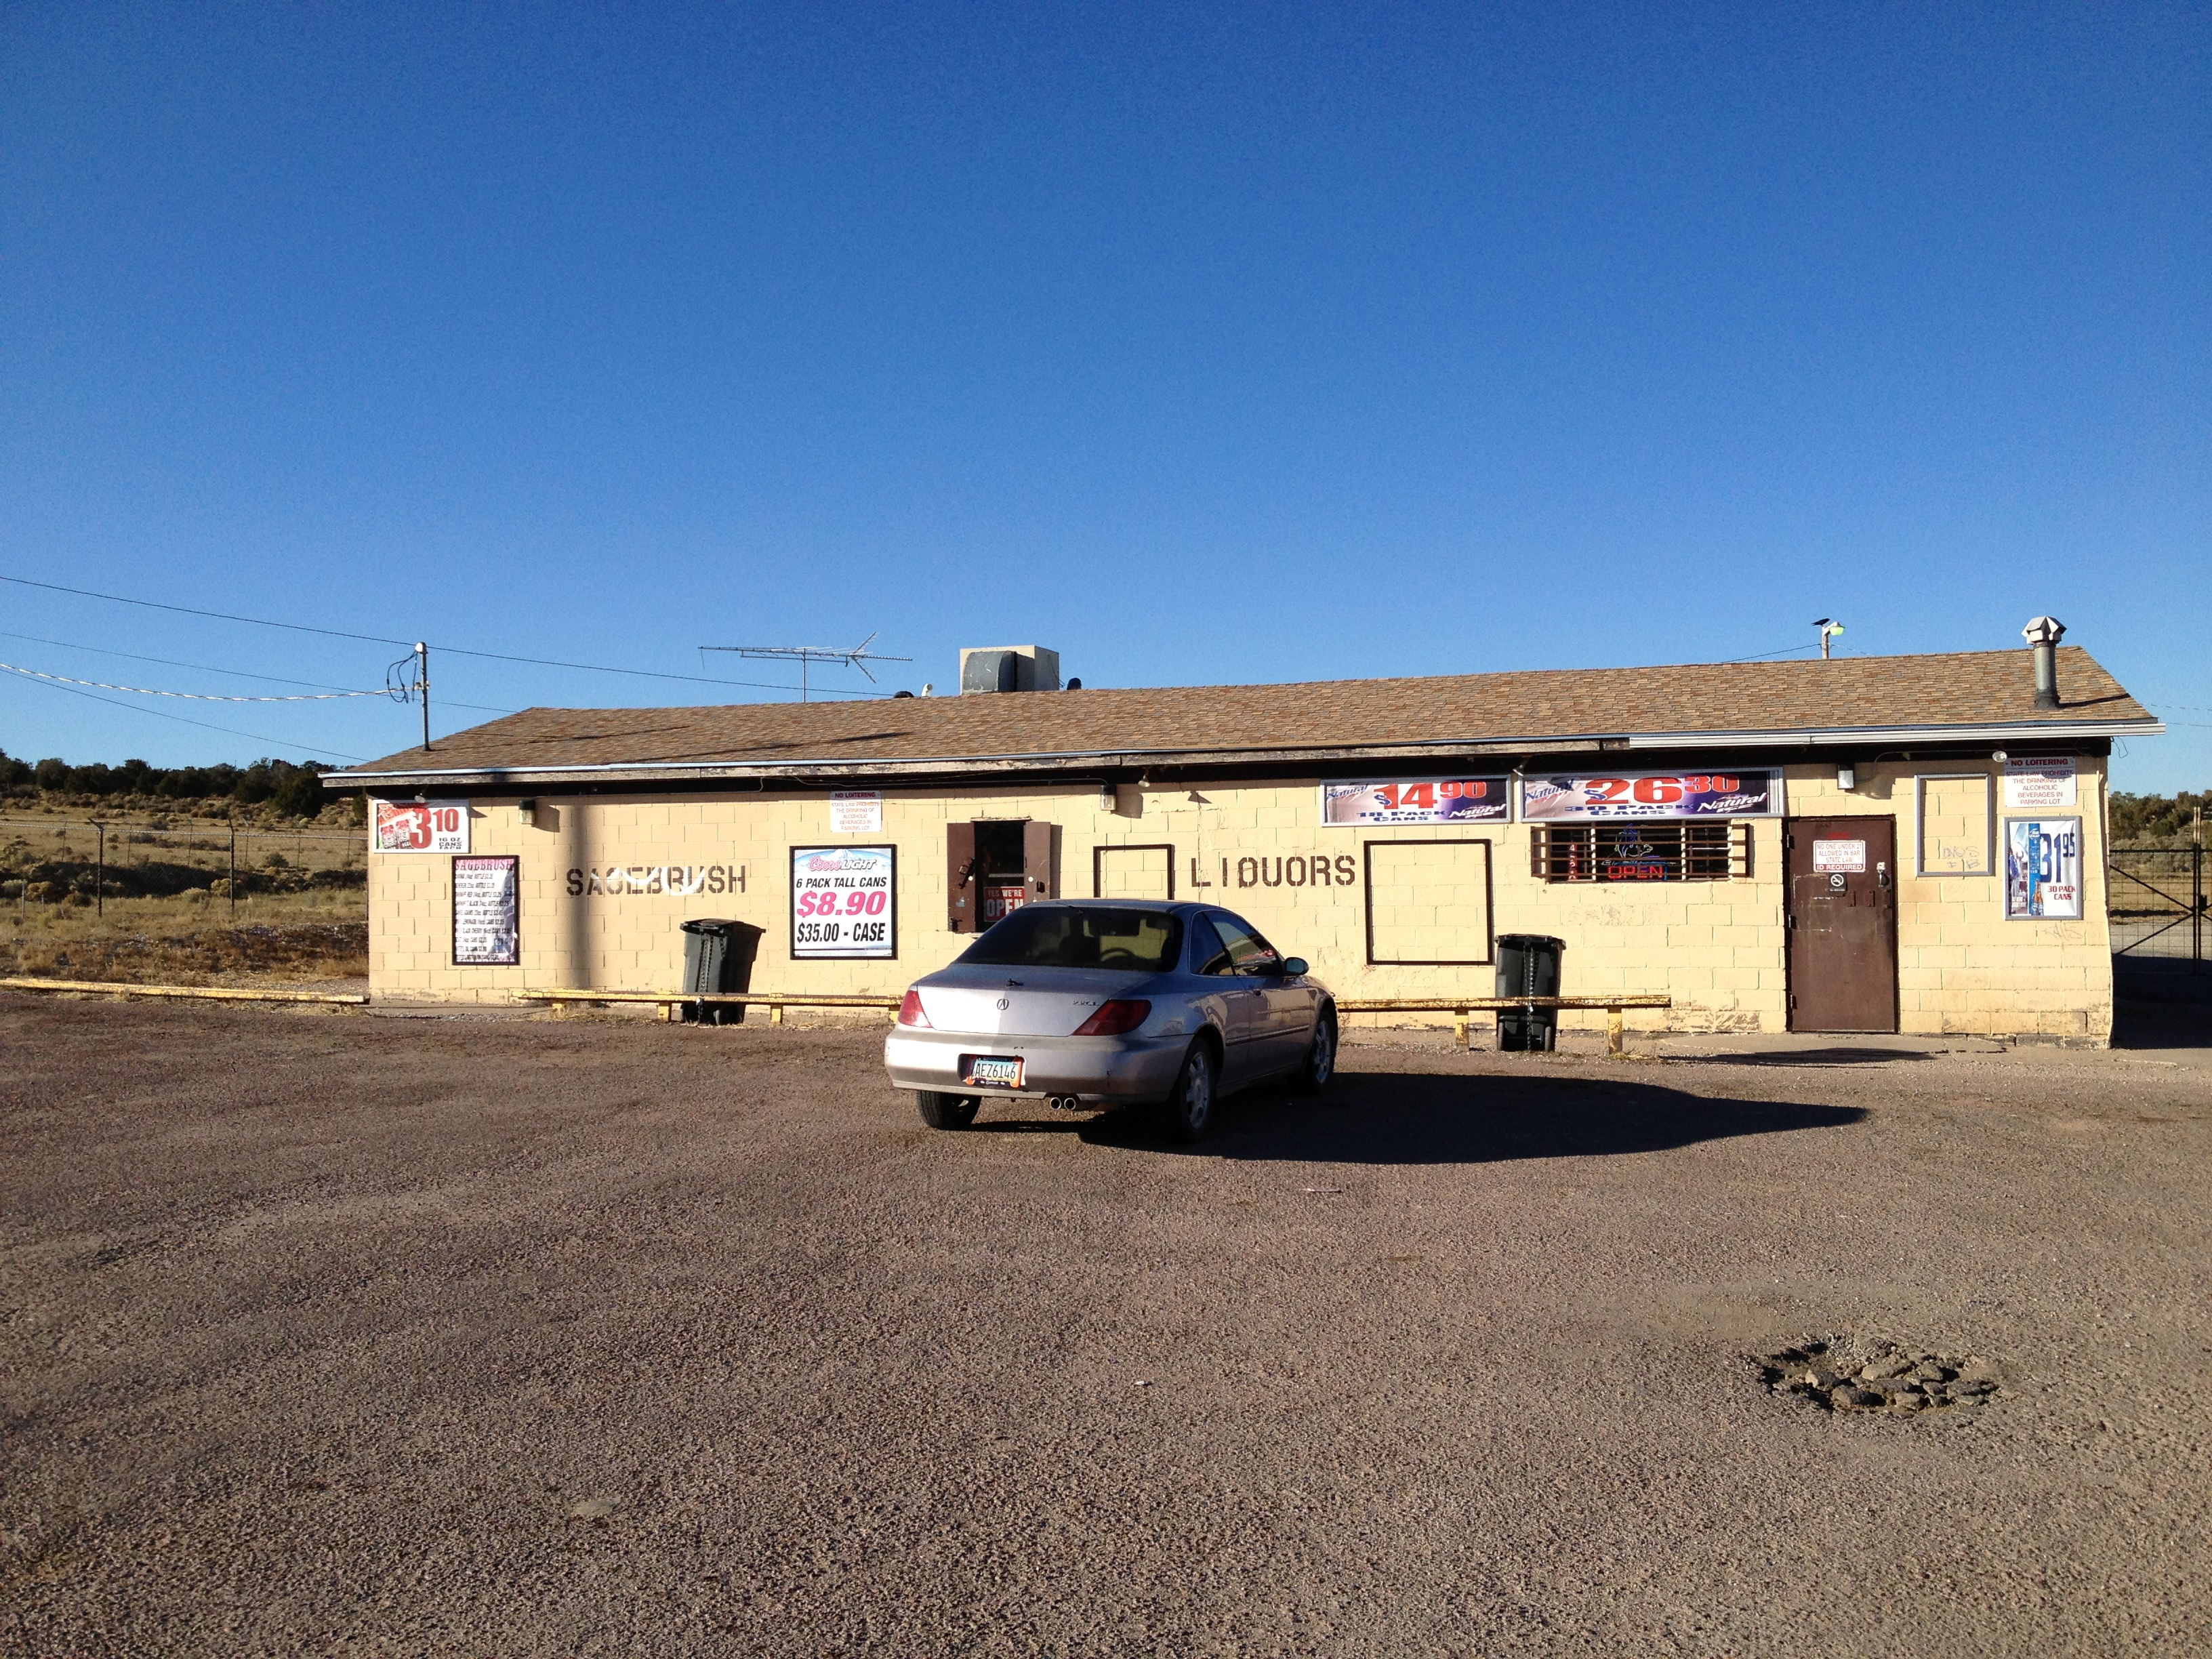

Slide 8
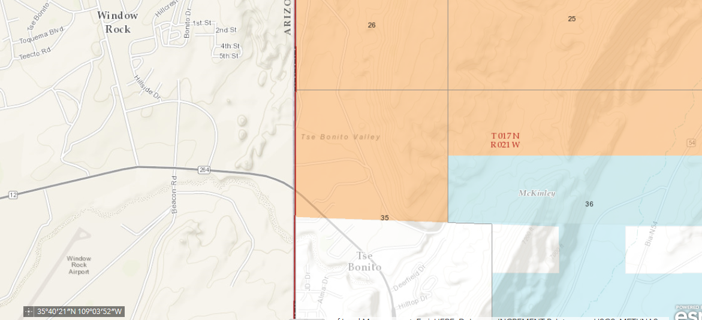

Slide 9
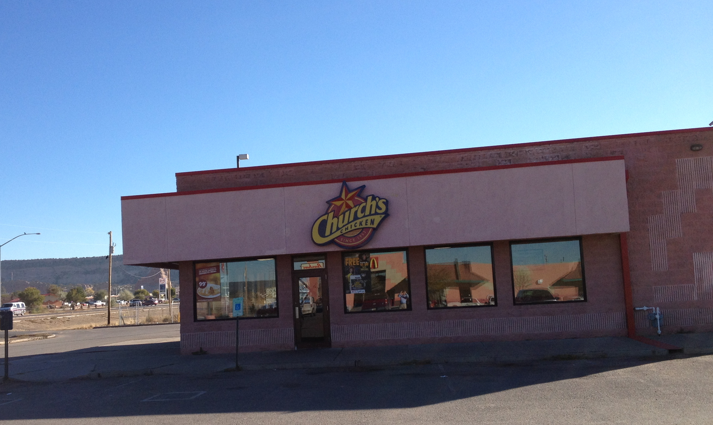

Slide 10
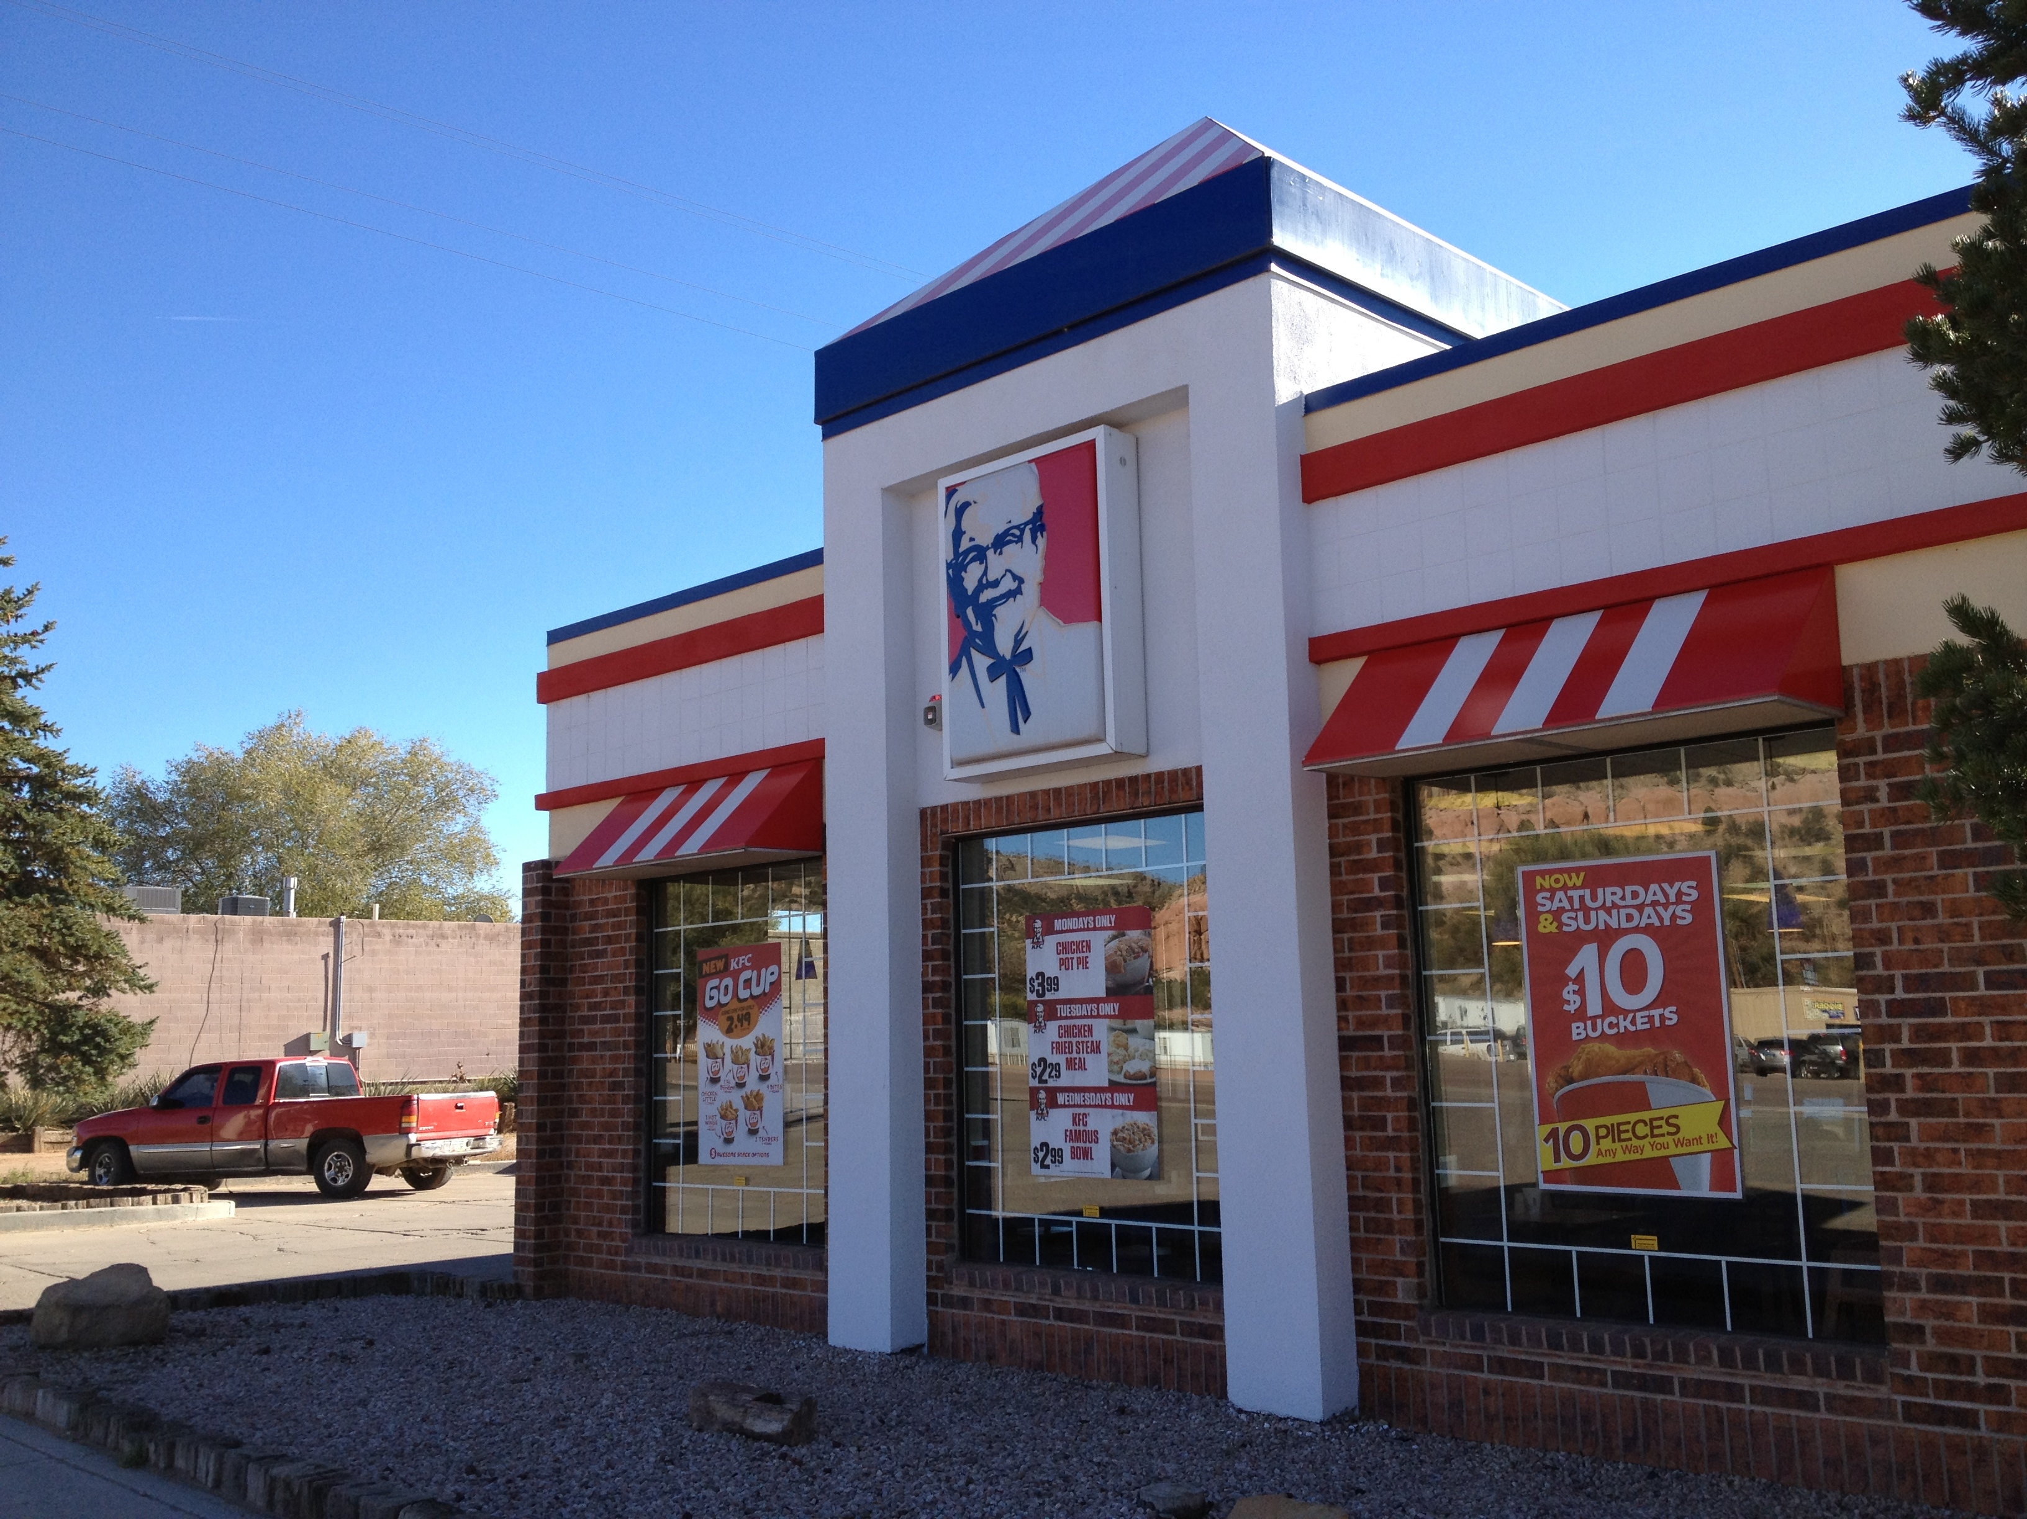

Slide 11
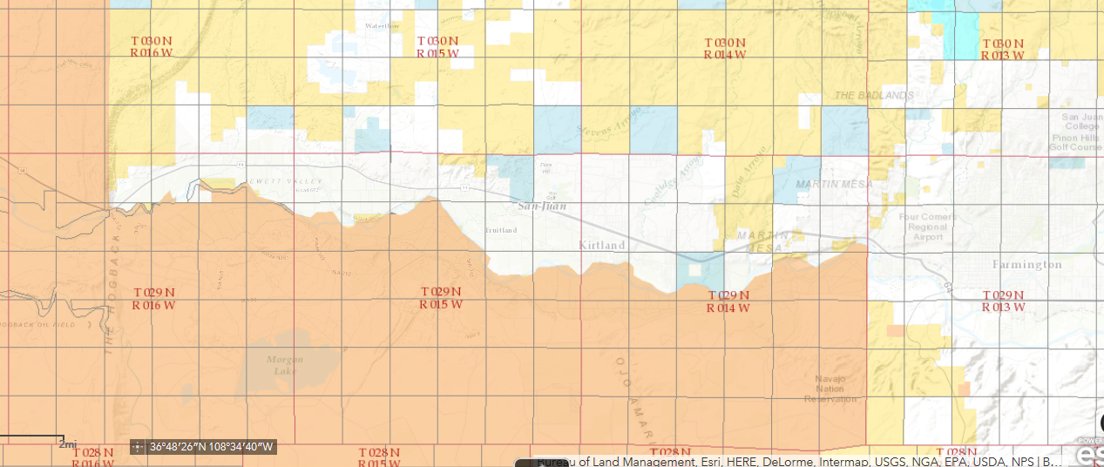

Slide 12
Impediments to Navajo and non-Navajo Law Enforcement
Territorial- no Navajo jurisdiction outside “Navajo Indian Country”/Limited jurisdiction for state and county within Indian Country
Jurisdictional- Nation has no jurisdiction over non-Indians/State has no jurisdiction over Indians/neither has jurisdiction over non-Indian crimes against Indians
Hot Pursuit/Extradition- State law enforcement cannot arrest and remove Indians after hot pursuit from state territory (aka “Rez Roll”)

Slide 13
Different State rules on Navajo Commissions
New Mexico-
State law allows State Police to commission Navajo law enforcement BUT limited by geography- no commission in Navajo border towns
Under state law, counties can commission tribal law enforcement, with no geographical limitations

Slide 14
ARIZONA
By state statute, tribal law enforcement may enforce Arizona law anywhere, as long as they are AZ-Post Certified.
Navajo police are required to be AZ-Post Certified, so all Navajo law enforcement on the “Arizona side” can enforce Arizona law without a commission agreement

Slide 15
Navajo Reasons for Cross-Commission
Additional resources/ potentially quicker response time.
Exercise of sovereignty/control access by outside law enforcement.
Political pressure by local communities to Council Delegates to provide more law enforcement.
Reciprocal authority over non-Indians (in New Mexico and Utah).

Slide 16
STATE/COUNTY Reasons
Jurisdiction to act within Nation and search and arrest Indians/potential hot pursuit arrest authority
Protection from liability for on-Reservation activities (incl. investigation of off-rez crimes)
Intergovernmental comity
Political support from Navajo voters for sheriff election

Slide 17
BEFORE 2011
Navajo Nation had agreements with:
New Mexico State Police (one way agreement)
Socorro County, New Mexico
McKinley County, New Mexico
Apache County, AZ
Navajo Nation issued commissions without written agreement to Arizona Highway Patrol and New Mexico State Police

Slide 18
STATE v. HARRISON
NM Sup. Ct. (2010)
San Juan County Deputy pursues Navajo into Navajo Reservation
Observes evidence of intoxication on state side
Does field sobriety test
Allows Harrison to leave, as knows no power to arrest
State uses evidence collected by county deputy in state prosecution for DWI

Slide 19
HOLDING
Nevada v. Hicks is not dispositive, as New Mexico recognizes wider protection of tribal sovereignty than US Supreme Court
Evidence of intoxication was admissible because Navajo Nation doesn’t have a law prohibiting searches by outside law enforcement

Slide 20
Navajo Nation Council Response
Passes “Cross-Commission Agreements Act of 2010.”
Explicitly passed to override State v. Harrison.
Prohibits search or arrest by county, state or municipal law enforcement unless authorized by a duly-approved cross-commission agreement.

Slide 21
POST-HARRISON EFFECT
Navajo and State Police amend 1981 commission agreement
Navajo Nation enters into agreements with:
Arizona DPS
City of Page, Arizona
Navajo County, Arizona
Coconino County, Arizona
San Juan County, Utah

Slide 22
NAVAJO NATION REQUIREMENTS
Must enter into commission agreement approved by Law and Order Committee and Budget and Finance Committee of Navajo Nation Council
Officers/deputies must attend 2 day course by Navajo DOJ and PD, and take and pass written examination
Must attend swearing in and receive commission card

Slide 23
LEGAL ISSUES FOR COMMISSION AGREEMENTS
Will the tribe allow a Hot Pursuit exception to extradition/scope of exception?
Who is responsible for liability/insurance, see Loya v. Gutierrez (N.M. Ct. App. 2013)?
Territorial scope of state/county authority (beyond county or state boundaries?)
Is commission two-way or one-way?
Whose law applies to traffic citations?

Slide 24
POLICY ISSUES
Who is responsible for prison transport?
Is this for regular patrols/just for emergency/mutual aid situations?
Potential abuse of authority by non-Indian officers/civil rights/profiling considerations

Slide 25
FEDERAL COMMISSION
Special Law Enforcement Commissions (SLECs)
Issued by Bureau of Indian Affairs
Can be issued to tribal law enforcement (through 638 contract or freestanding deputation agreement?)
Can be issued to state, county, municipal law enforcement with approval of tribe (Navajo Nation has not approved any)
Advantage- FTCA coverage when acting under federal commission.

Slide 26
FEDERAL EXTRADITION/DETAINER
Prior history of FBI/US Marshals Service “badging out” Navajo prisoners in Nation’s custody for tribal offense
Rehallio Carroll incident- young Navajo murdered a nun in Navajo, New Mexico
Carroll was in Navajo custody on Navajo offense
Federal officials served writ on Navajo Department of Corrections and removed him in violation of Navajo court order

Slide 27
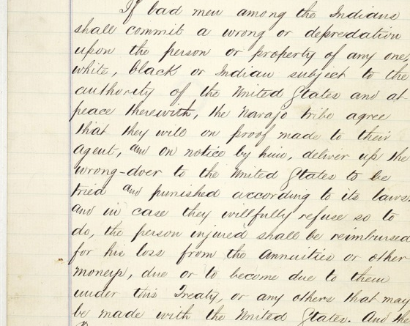
BAD MEN CLAUSE, TREATY OF 1868

Slide 28
BAD MEN CLAUSE TEXT
“If the bad men among the Indians shall commit a wrong or depredation upon the person or property of any one, white, black, or Indian, subject to the authority of the United States and at peace therewith, the Navajo tribe agree that they will, on proof made to their agent, and on notice by him, deliver up the wrongdoer to the United States, to be tried and punished according to its laws;”

Slide 29
Amendment to Navajo Extradition Statute
Through Navajo Nation Task Force and US Attorney’s Offices of 3 states
Creates “Detainer” policy that requires federal agents to request in writing transfer of custody of Navajo prisoners
Navajo prisoner has right to hearing before transfer
Federal complaint or grand jury indictment evidence of federal crime

