Slide 1
2016 Case law: Now what?
Tribal In-House Counsel Association
November 4, 2016
Jessica Intermill
Founding Member, Hogen Adams PLLC

Slide 2
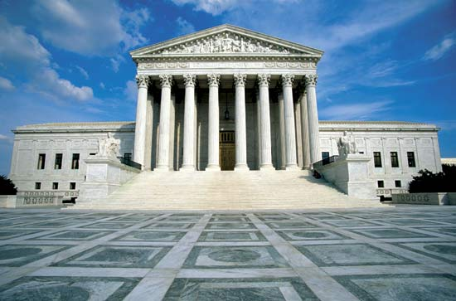
Big Supreme Court Year
Menominee Indian Tribe of Wisconsin v. United States
Nebraska v. Parker
Dollar General Corporation v. Mississippi Band of Choctaw Indians
United States v. Bryant

Slide 3
More to come in 2016-17
Lewis v. Clarke: “Whether the sovereign immunity of an Indian tribe bars individual-capacity damages actions against tribal employees for torts committed within the scope of their employment.”

Slide 4
More to come in 2016-17
Lee v. Tam: “Whether the disparagement provision in 15 U.S.C. 1052(a) is facially invalid under the Free Speech Clause of the First Amendment.”
And more???

Slide 5
Take-away 1: Immunity is still hot
Bay Mills warnings
Lewis v. Clarke (cert. accepted)
  Nov. 14: opening brief
  Dec. 14: employee’s brief
  Dec. 21: tribal amicus support

Slide 6
Take-away 1: Immunity is still hot
Suits against employees increasing
Immunity creep continues in other contexts
  Eminent domain
  Recoupment
But Rule 19 lives

Slide 7
Take-away 2: Tuscarora persists
Little River Band of Ottawa Indians v. National Labor Relations Board (denied)
Soaring Eagle Casino & Resort v. National Labor Relations Board (denied)

Slide 8
Take-away 2: Tuscarora persists
If you expect a general federal statute may apply:
  Consider arguing that the statute does not abrogate tribal immunity
  Legislate a parallel recovery scheme that allows a remedy but limits the tribe’s exposure

Slide 9
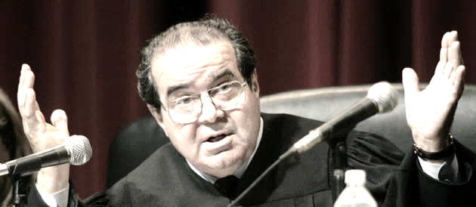
Take-away 3: Tribal jurisdiction?
Dollar General Corporation v. Mississippi Band of Choctaw Indians

Slide 10
Take-away 3: Tribal jurisdiction?
Dollar General had great facts and troubling oral argument questions
Justice Thomas is becoming more vocal about his disdain for Indian law and tribal sovereignty
The Court at least seems comfortable with tribal jurisdiction over members

Slide 11
2016 Case law: Now what?
Tribal In-House Counsel Association
November 4, 2016
Jessica Intermill
Founding Member, Hogen Adams PLLC
jintermill@hogenadams.com
651-842-9104

