Slide 1

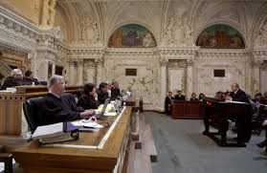
WHERE DO WE GO FROM HERE? CIVIL JURISDICTION AFTER Dollar General
PAUL SPRUHAN
NAVAJO NATION DEPARTMENT OF JUSTICE

Slide 2

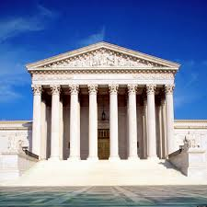
Dollar General case
Dollar General store located on Mississippi Choctaw trust land pursuant to lease
Lease includes consent to jurisdiction

Slide 3
More Facts
Dollar General got business license from tribe
Dollar General manager participated in youth internship program for Choctaw youth
Choctaw youth was placed at store
Youth was allegedly sexually assaulted by manager

Slide 4
PROCEDURAL HISTORY
Youth’s family sues Dollar General and manager in Mississippi Choctaw Tribal Court
Dollar General and manager move to dismiss, denied by tribal trial court
On interlocutory review, Choctaw Supreme Court affirms under Montana.
Dollar General and manager sue in federal district court.
Fed. District Court dismisses manager but not Dollar General- DG appeals, but not tribe.

Slide 5
5th Circuit Opinion
Court holds youth placement program is a “consensual relationship” under Montana’s first exception- apparently an “other arrangement.”
Also holds tort claims have a “nexus” to the relationship (protection of children; foreseeable)
Does not consider whether lease itself is a “consensual relationship” or whether tort claims have a nexus to lease, but mentions in a footnote that Dollar General is familiar with Choctaw law.

Slide 6
Further Rulings
Plains Commerce Bank does not further restrict Montana’s first exception to require a showing that consensual relationship “intrudes on the internal relations of the tribe or threaten self-rule”
Availability of punitive damages does not affect Choctaw jurisdiction when there is a consensual relationship

Slide 7
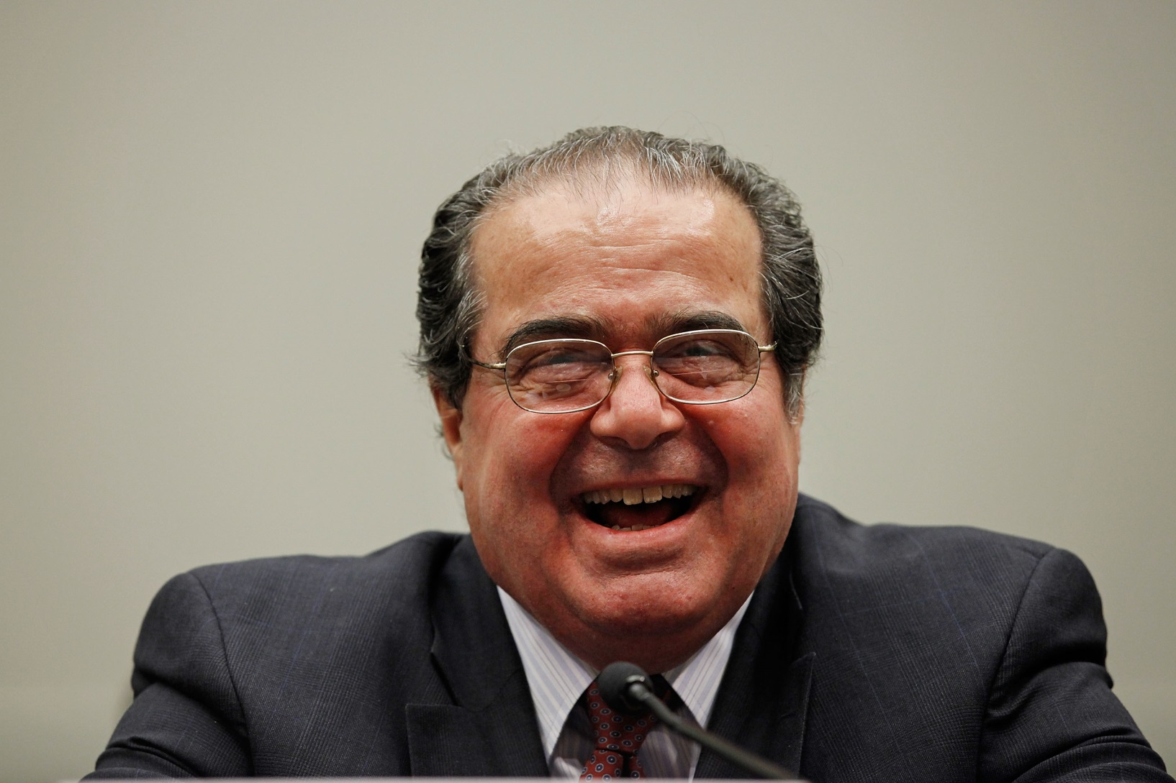
WHAT HAPPENED AT
THE SUPREME COURT?

Slide 8
EFFECT OF 4-4 TIE
No opinion.
5th Circuit opinion affirmed.
Mississippi Choctaw Court may proceed with case against Dollar General, but apparently not against the manager, as Tribe did not appeal dismissal by Federal District Court.

Slide 9
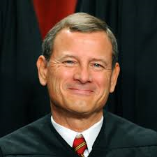
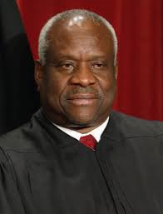
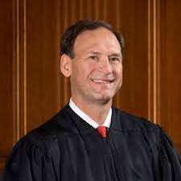
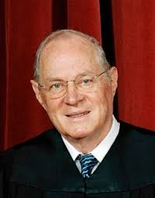
WHAT DO WE KNOW?
4 Justices believed that there is no tribal jurisdiction over tort against a non-Indian corporation when it operates on tribal trust land pursuant to a lease that has a consent provision and has a business license from tribe
.

Slide 10
WHAT DON’T WE KNOW?
Whether 5 justices will expand Nevada v. Hicks to apply Montana’s “general rule” to all assertions civil jurisdiction over non-Indians, even on trust land (assume at least 4 believe that).
Effect, if any, of Water Wheel v. LaRance (9th Cir.) in continuing to follow Merrion v. Jicarilla Apache right to exclude to evade Montana.
Whether a treaty, like the Crow Treaty of 1868, will exempt a tribe from Montana’s exceptions.

Slide 11
MORE QUESTIONS
Whether 5 justices will apply Plains Commerce Bank’s narrowing of the “consensual relationship” exception.
Whether a non-commercial agreement can ever be a “consensual relationship”.
Whether a state or local government can ever consent under Montana’s first exception.
Bare consent versus specific consent- is an agreement without a specific consent enough?

Slide 12
EVEN MORE QUESTIONS!
What 5 justices think a “nexus” to a consensual relationship is, particularly when the tribe asserts tort jurisdiction (Question of foreseeability).
Parker bomb? Is laches a viable defense to tribal civil jurisdiction, as suggested in Nebraska v. Parker (cf. City of Sherrill)?

Slide 13
Window Rock Unified
School Dist. v. Nez
Pending in 9th Circuit- stayed during Dollar General
Concerns Navajo Nation jurisdiction over employment at 2 Arizona-organized public schools
Schools operate on Navajo trust land pursuant to leases
One lease is silent on jurisdiction, the other has an ambiguous consent provision.

Slide 14
Legal Questions
What does the “plainly lacking” exception from exhaustion mean (“plausible” versus Dish Network v. Laducer frivolous standard?)
Does Treaty of 1868’s right to exclude exempt the Nation from needing to fulfill Montana’s exception? (See Montana , Section III)
Does Water Wheel or Nevada v. Hicks apply to state-organized school districts such that Montana’s “main rule” does or does not apply?

Slide 15
EVEN MORE QUESTIONS!
Are the schools “the state” and are they completely exempt from tribal jurisdiction?
If the school districts are fulfilling educational obligation under Enabling Act, can they consent under Montana?
Assuming leases are consensual relationships, is there a “nexus” to regulating employment?
WHEN WILL KNOW THE ANSWERS?
WHO KNOWS?

