Slide 1
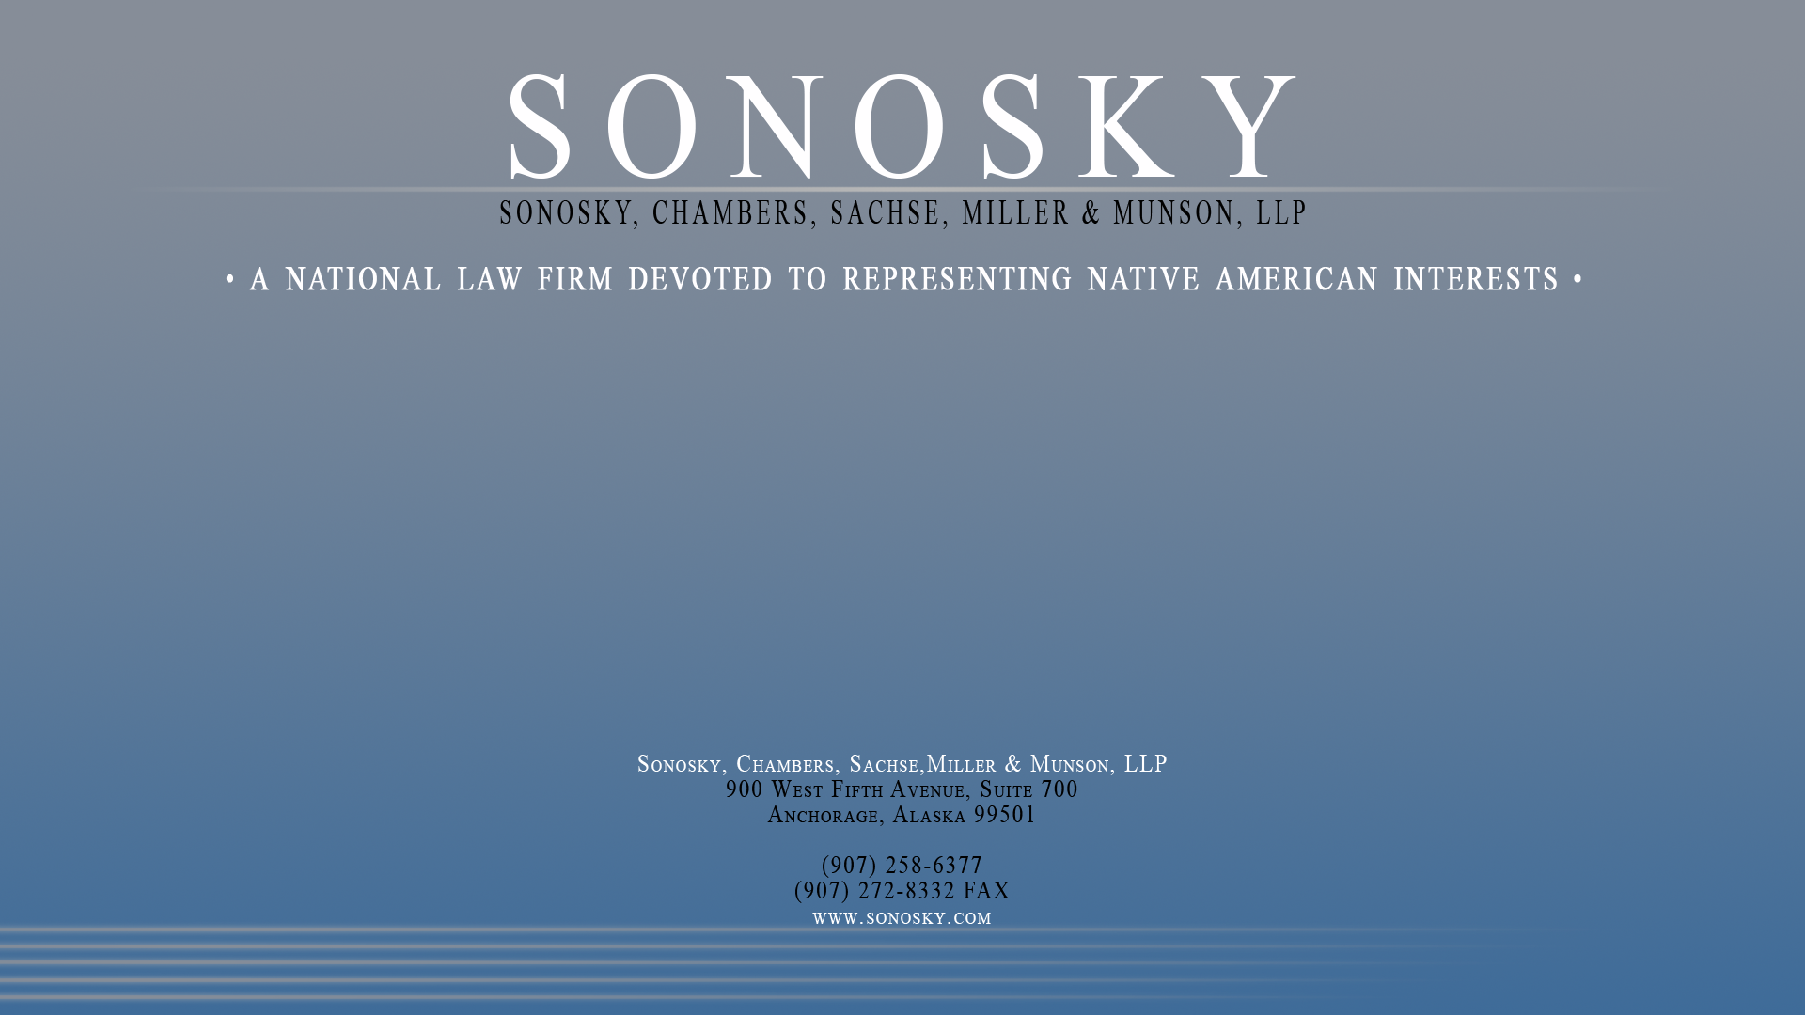
FEDERAL DISPLACEMENT OF TRIBAL JURISDICTION OVER NONINDIANS
THE CASE OF THE NATIONAL LABOR RELATIONS ACT
Lloyd B. Miller

Slide 2
Tribes and the NLRA
The Legal Issue
  Does the NLRA apply to tribal governments as employers of individuals working on trust lands
The Historic Issue
  The law had been settled for over 60 years, until 2004
The Practical Issue
  Impact of Board jurisdiction over tribal employment

Slide 3
The Competing World Views
Standard Test in Statutory Cases Statutory text Context and overall statutory scheme Legislative history Indian canon of construction NLRA canon of construction | Tuscarora-Coeur d’Alene Test A law of general applicability applies to a Tribe unless the law touches “exclusive rights of self-governance in purely intramural matters”; application of the law would “abrogate rights guaranteed by Indian treaties”; or proof “by legislative history or some other means that Congress intended [the law] not to apply to Indians on their reservations

Slide 4
Applying the Standard Test to the NLRA
Statutory text -- 29 U.S.C. §151(2); all gov’ts; “United States”
Context and overall statutory scheme -- terms suited to private sector; lack of sovereign immunity waiver (§185)
Legislative history – industrial strife; gov’t exemption; IRA/OIWA
Indian canon of construction -- the meaning of silence (Merrion, etc.)
NLRA canon of construction – “public questions particularly high in the scale of our national interest” (Law of Nations; First Amendment)
Context: IGRA
Context: authority over non-Indians on tribal lands: Mescalero Apache & Montana

Slide 5
Applying the Tuscarora-Coeur d’Alene Test to the NLRA
• Is the NLRA a law of general applicability? (San Juan v. Little River)
  Does the NLRA touch “exclusive rights of self-governance in purely intramural matters”
  Would applying the NLRA “abrogate rights guaranteed by Indian treaties” (Chickasaw v. Little River)
  Is there proof “by legislative history or some other means that Congress intended [the NLRA] not to apply to Indians on their reservations
• Judicial narrowing of jurisd. over non-Indians to the “periphery” of tribal sovereignty (Little River)
• Board claimed discretion not to apply the Act in particular settings based on the “commercial” versus “governmental” distinction (San Manuel & Little River vs. YKHC )

Slide 6
The Problem with the Tuscarora-Coeur d’Alene (CdA)Test
Tuscarora’s dictum (“a general statute in terms applying to all persons includes Indians and their property interests.” ) and context (FPA)
CdA’s reliance on Farris and criminal law cases
CdA’s reliance on tax cases
CdA’s reliance on case law re private employers
CdA’s reliance on “intramural” test (see Montana, Cabazon)
CdA’s reliance on commercial vs governmental (Garcia, Kiowa)
CdA’s view of legislative silence (v. Bay Mills, Iowa Mutual)
CdA’s special difficulty in gaming context (Bay Mills (J. Sotomayor), Pauma)

Slide 7
How the Circuits line up
•10th Circuit: San Juan (en banc); Dobbs
• 6th Circuit: Little River (CdA + “periphery” issue)
• D.C. Circuit: San Manuel (what is sovereign “enough”)
• 9th Circuit: Pauma

Slide 8
The Peculiar Case of the Sixth Circuit
Little River
  Majority: Merritt, Gibbons (Fed. Cir.),
  Dissent: McKeague
Soaring Eagle
  Majority: O’Malley, Donald
  Concurrence: White

Slide 9
Other Laws
OSHA exempts US and States
ADA exempts US
FMLA covers any “public agency”
ERISA tribal specific
ADEA exempts US
FLSA covers “public agency” with special exemptions for fire/law enf.

Slide 10
FEDERAL DISPLACEMENT OF TRIBAL JURISDICTION OVER NONINDIANS
THE CASE OF THE NATIONAL LABOR RELATIONS ACT
Lloyd B. Miller

