Slide 1
Beyond Title 25: Putting Federal Law to Work for Tribes
Tribal In-House Counsel Association
October 26, 2017
Jessica Intermill
Founding Member, Hogen Adams PLLC

Slide 2

Beyond Indian Law

Slide 3
Beyond Indian Law
In federal court …

Slide 4
Beyond Indian Law
Merrion v. Jicarilla Apache Tribe (1982)
Nonmembers who lawfully enter tribal lands remain subject to the tribe’s power to exclude them. This power necessarily includes the lesser power to place conditions on entry, on continued presence, or on reservation conduct. . . .

Slide 5
Beyond Indian Law
Merrion v. Jicarilla Apache Tribe (1982)
Nonmembers who lawfully enter tribal lands remain subject to the tribe’s power to exclude them. This power necessarily includes the lesser power to place conditions on entry, on continued presence, or on reservation conduct. . . .

Slide 6
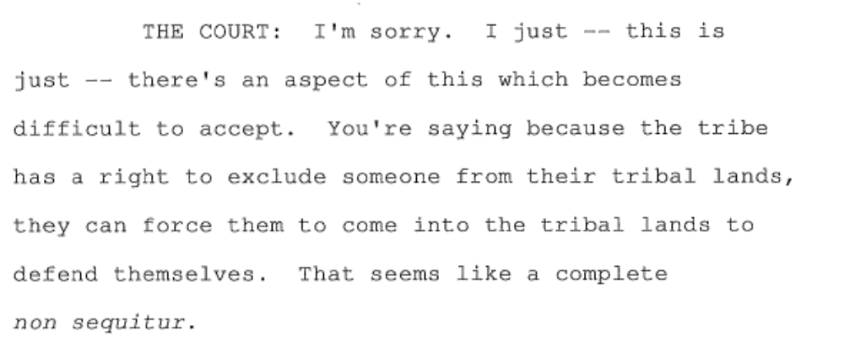
Beyond Indian Law

Slide 7
Beyond Indian Law
… and state court.

Slide 8
Beyond Indian Law
Michigan v. Bay Mills (2014)
Among the core aspects of sovereignty that tribes possess—subject, again, to congressional action—is the “common-law immunity from suit traditionally enjoyed by sovereign powers.” That immunity, we have explained, is “a necessary corollary to Indian sovereignty and self-governance.”

Slide 9
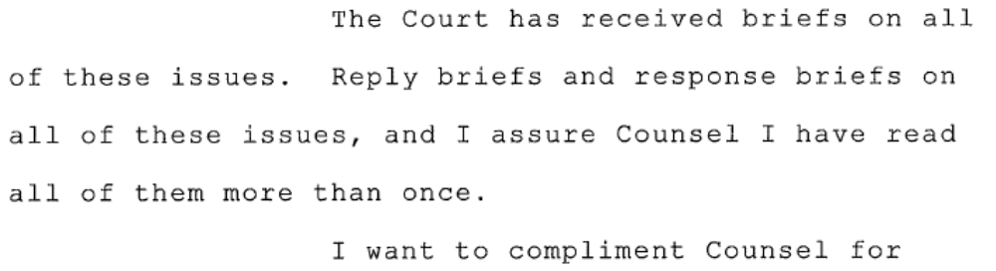
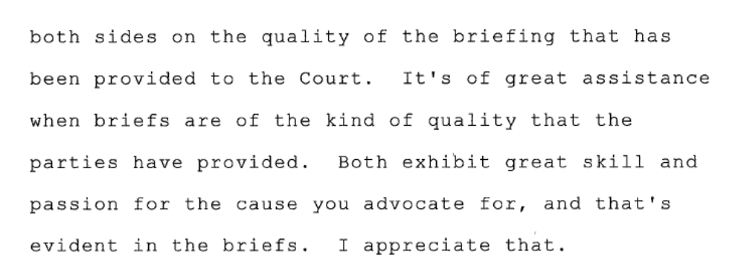
Beyond Indian Law
This Photo by Unknown Author is licensed under CC BY-NC-ND

Slide 10
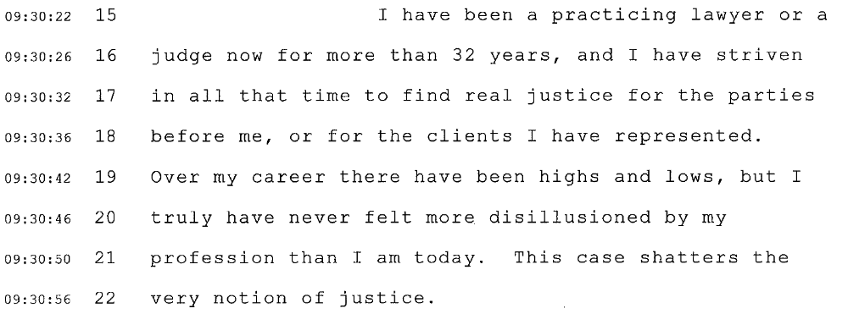
Beyond Indian Law
This Photo by Unknown Author is licensed under CC BY-NC-ND

Slide 11
Thinkish thoughts in 2016
Sometimes bad facts make bad law
Sometimes good judges make bad law because they don’t like Indian law
Sometimes tribal advocates should look outside of Indian law

Slide 12
Thinkish thoughts in 2016
The 2016 election brought a wave of uncertainty to Indian country. As the incoming administration stakes out its Indian policy, tribes need stable, reliable tools. This session will explore federal statutes that tribes can use outside of Indian law to protect tribal interests, including:
  Labor-law statutes as models for internal governance;
  The 1906 Antiquities Act as a tool to protect cultural properties;
  And more!

Slide 13
But the 2017 inauguration
Life outside Title 25

Slide 14
Beyond Indian Law
Life outside Title 25

Slide 15
Labor Law
Indian law: argue inapplicability of federal law, immunity where appropriate
Federal law: consider FMLA, OSHA, NLRA as a starting point for tribal law
Leverages federal law to create the “good facts” litigators (and judges) love
Generally, governance is better than gaps

Slide 16
Resource Preservation - Defense
Archeological Resources Protection Act
  “Archeological resources on public lands” are “an accessible and irreplaceable part of the Nation’s heritage”
  Prohibits some excavation on federal and Indian lands – no tribal veto on federal lands

Slide 17
Resource Preservation - Defense
National Historic Preservation Act
  Designation and protection of “historic sites,” including “traditional cultural properties”
  Requires “Sec. 106” review of federal actions that might affect any “district, site, building, structure, or object that is included in or eligible for inclusion in the National Register.”

Slide 18
Resource Preservation - Defense
National Historic Preservation Act (cont.)
  Sec. 106 mandates tribal consultation
  Procedural- does not forbid impact on historic properties

Slide 19
Resource Preservation - Defense
National Environmental Policy Act
  Requires analysis of federal actions that may significantly affect human health, environment
  Courts have expanded beyond air and water quality to protect “historic, cultural, and national aspects of our heritage.”
  Doesn’t mandate protection

Slide 20
Resource Preservation - Offense
Antiquities Act of 1906
  Response to archeological thefts
  President may designate national monuments in areas with “historic landmarks, historic and prehistoric structures, and other objects of historic or scientific interest.”
  Sec’y can make emergency designations

Slide 21
Antiquities Act of 1906
Limited to federal lands?
  U.S. can accept donated lands
  Some monuments have inholdings
  Possible argument for condemnation
Typically managed by NPS
  BLM, NFS also manage at times

Slide 22
Antiquities Act of 1906
151 monuments nationwide: often responding to threatened resources
Tool to limit or prohibit land uses:
  Prohibit hunting, fishing, grazing
  Stop mining leases, logging
  Bar motorized vehicles
  Require compliance with tribal law

Slide 23
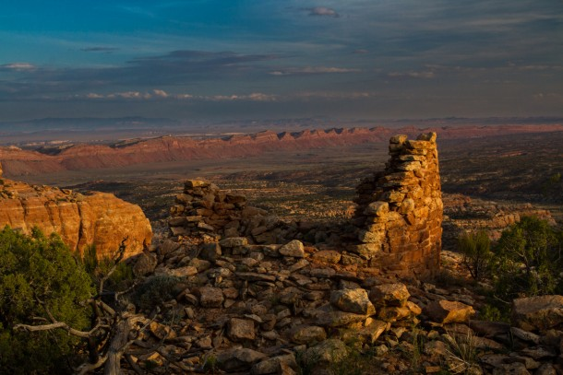
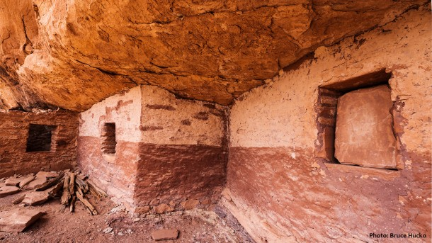

Antiquities Act of 1906
???

Slide 24
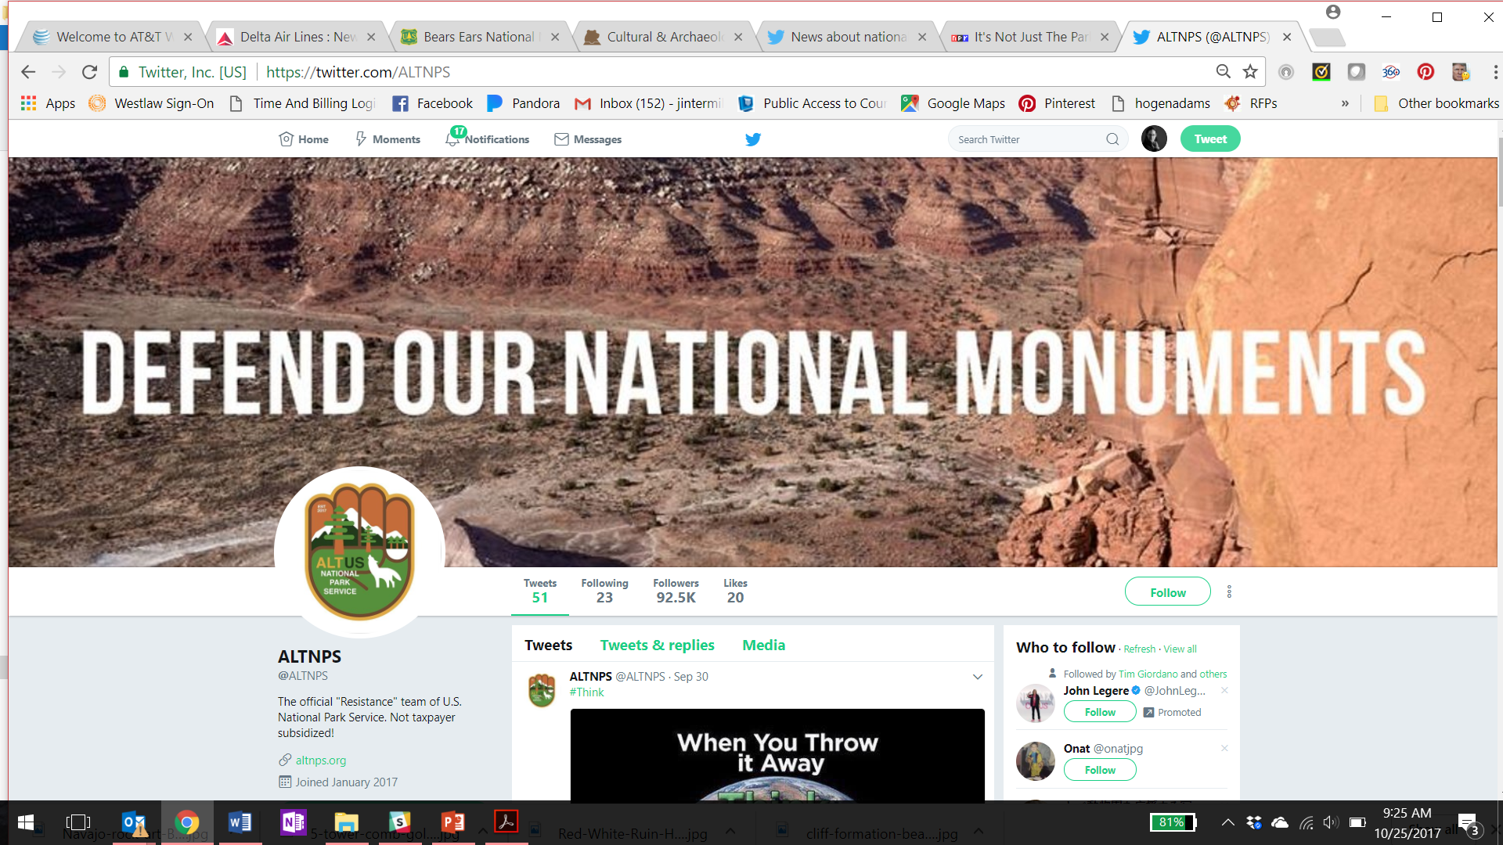

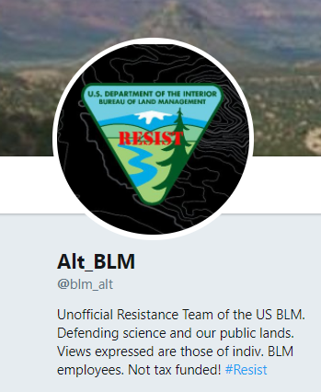
And more!
Think outside of the Title 25 box
Relationships & intergovernmental agreements

Slide 25
And more!
Consider alignment with federal objectives
  Energy development
  Education, other areas of spending substitution
Keep up the Indian law

Slide 26
Beyond Title 25: Putting Federal Law to Work for Tribes
Tribal In-House Counsel Association
October 26, 2017
Jessica Intermill
Founding Member, Hogen Adams PLLC
jintermill@hogenadams.com
651-842-9104

