Slide 1
Outlier Outsiders
The ICWA Lawsuits and What is Really Going On
Kate Fort (MSU Law) and Victoria Sweet (NCJFCJ)

Slide 2
Credit for Birch Stand Photo: Taken by BMIC Chairman Bryan Newland

Slide 3
Lawsuits and Partnerships
Nine suits (federal or cert petitions) dismissed since 2015
Four on-going
Who brings them?
What states?
And what are tribes actually doing in those states?

Slide 4
A.D. v. Washburn aka the Goldwater litigation aka the A.D. v. Tehsuda
Who is Goldwater?
What is their previous involvement in child welfare?
What are the claims in the suit?
Where is the case today?
Other involvement in Arizona

Slide 5
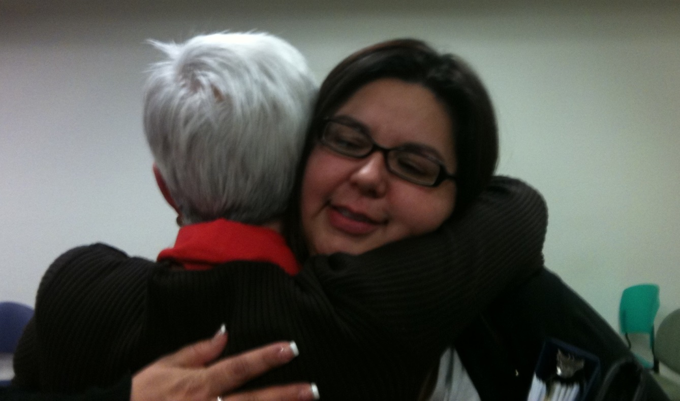
Tribal-Arizona Collaborations
In 2012 Established the ICWA Subcommittee of the Arizona State, Tribal and Federal Forum
Arizona ICWA Guide
AZICWA.org - is a website established by AOC for the ICWA Subcommittee and work/notices related to ICWA.
ICWA State and Tribal Conferences – 2010, 2012, 2013, 2015, 2017.
Tribal and State Judicial Roundtable - Held 11/13/13 & 11/14/13.
Arizona Rules of Juvenile Court
Increased ICWA training - ICWA training for Dependency 101
for new juvenile court judges increased from 30 minutes to 2.5
hours (mandatory for all Arizona juvenile court judges)
Trainings - Tribal Judges are invited to the Annual Dependency
102 training and the Annual Judicial Conference.
ICWA Leadership and Excellence Awards – Established in 2017

Slide 6
R.K.B. v. E.T. (SCOTUS Cert Petition)
Utah Supreme Court Case on Paternity
Amicus briefs in support of granting cert
  AAAA (written by Mary Beck from Mizzou and Mark Fiddler)
  Goldwater
  National Council for Adoption (remember them?)
  Utah Adoption Council

Slide 7
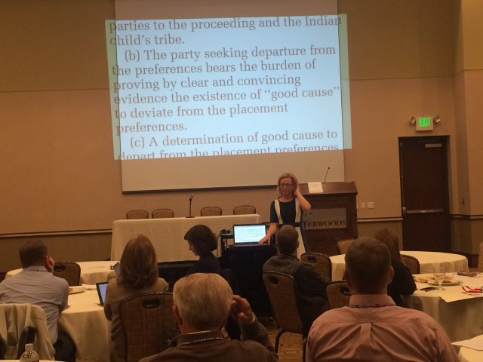
Tribal-Utah Collaboration
The DHS Tribal and Indian Issues Committee
Monthly Tribal Leaders Meetings
Annual ICWA conference
Utah judicial guide to ICWA implementation
The ICW Program Administrator has been instrumental in establishing MOU’s with five tribes.
ICWA Compliance Committee
The ICW Program Administrator has built relationships with each of the federally recognized tribes in Utah.
  This person, along with other agency representatives,
  meets quarterly with tribal leaders during their
  monthly coordinating meeting.

Slide 8
Americans for Tribal Court Equality v. Piper
Another Minnesota federal case
Attacking tribal courts and tribal jurisdiction with racist complaint (see also, Renteria v. Shingle Spring)
Long running attacks, with a promise to continue

Slide 9
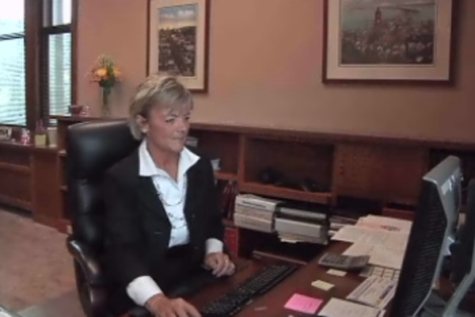
Tribal-Minnesota Collaborations
Data Collection Projects
HHS ICWA Implementation Project
Pilot Project, New Data Requirements
Tribal State Agreement
Customary Adoption
ICWA Docket/Court

Slide 10
Texas v. Zinke
States challenging ICWA on many fronts, including spending and equal footing, along with the previously discussed claims
Government’s motion to dismiss—Texas filed comments in support of ICWA during the regulation comment period

Slide 11
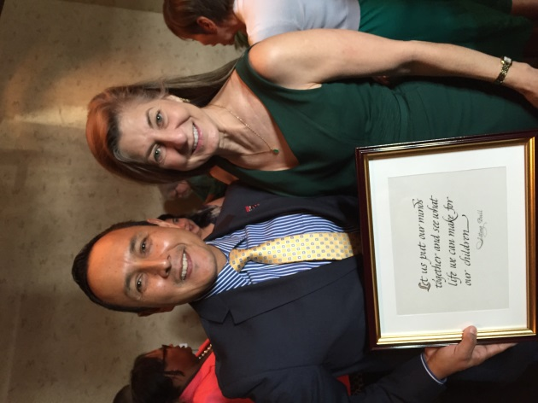
Tribal-Texas Collaborations
The Tribal/Texas Collaborative
The Texas Supreme Court Children's Commission
MOU Alabama Coushatta Tribe of Texas and Ysleta Del Sur Pueblo/Tigua Tribe
Formal liaison process with specified CPS staff exists in the regions where the three Tribes are located
All new caseworkers are required to attend the CPS Professional
Development training that includes a computer-based training on ICWA
DFPS, the three Tribes, and federal representatives continue to meet
twice a year to discuss areas of interest related to the Indian Child Welfare Act,
the Child and Family State Plan, and Title IV-E Intergovernmental agreements

Slide 12
Outlier Outsiders
These lawsuits are brought by those who don’t do the collaborative work on the ground.
The facts in the complaints are slanted, if not outright incorrect
There is a larger game at play in these cases (Prof. Berger’s presentation)
They don’t relate to the work in tribal and state courts, other than to make that work more difficult
The goals are multiple, but include diverting resources, creating uncertainty, and discrediting ICWA

