Slide 1
Nuts and Bolts —
Appellate Judging
Matthew L.M. Fletcher

Slide 2
5 Parts of an Opinion

Slide 3
1. Order

Slide 4
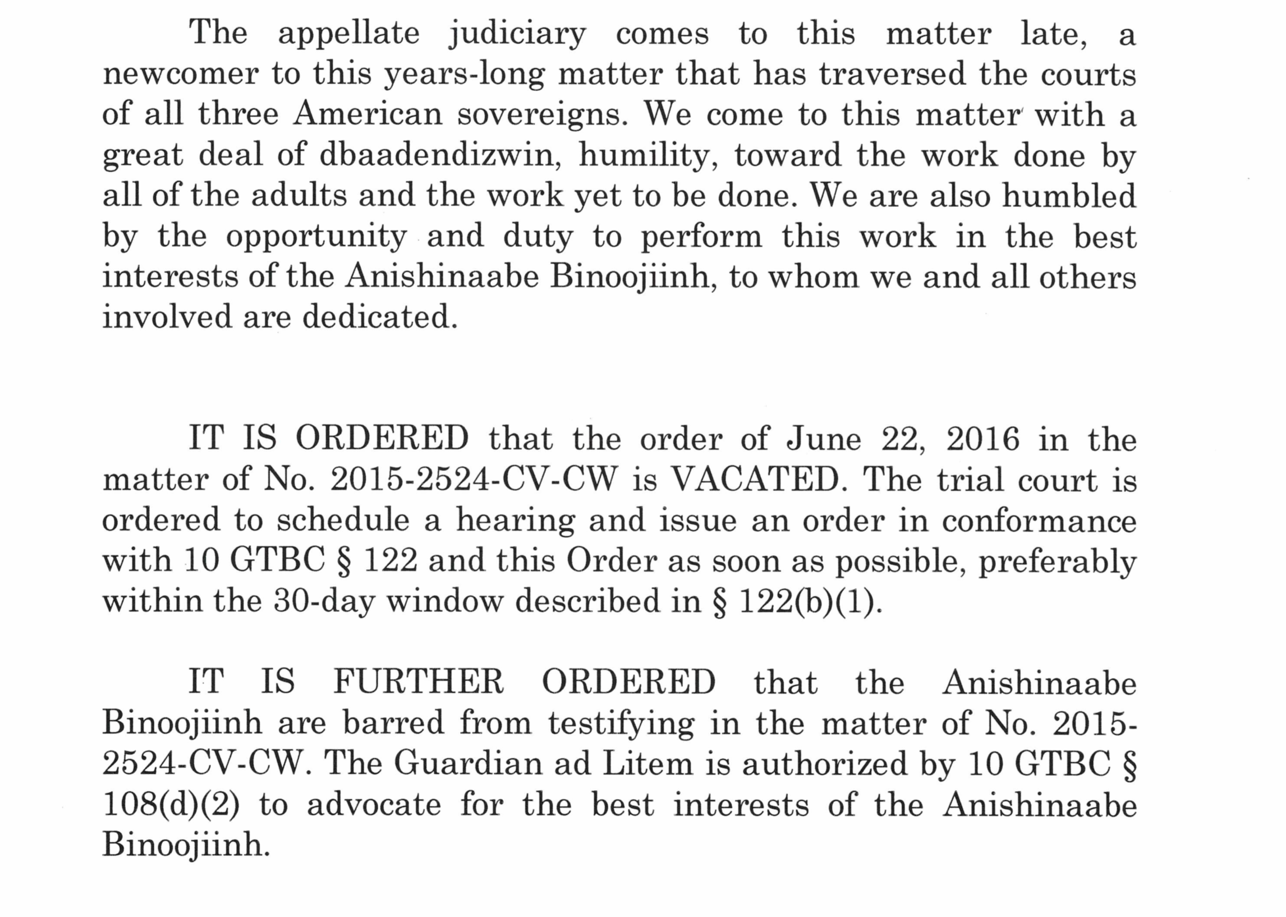

Slide 5
2. Questions Presented

Slide 6
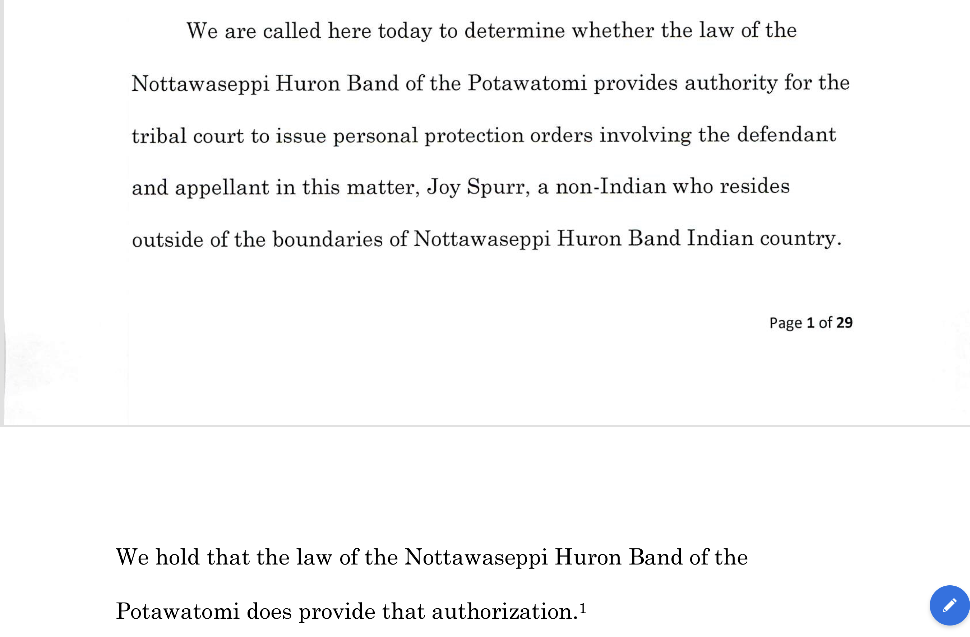

Slide 7
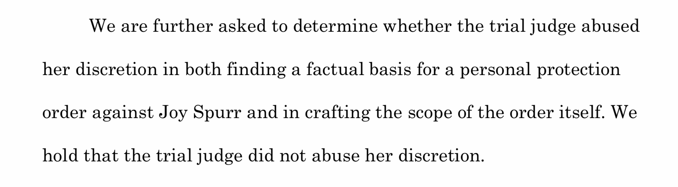

Slide 8
3. Procedural History

Slide 9
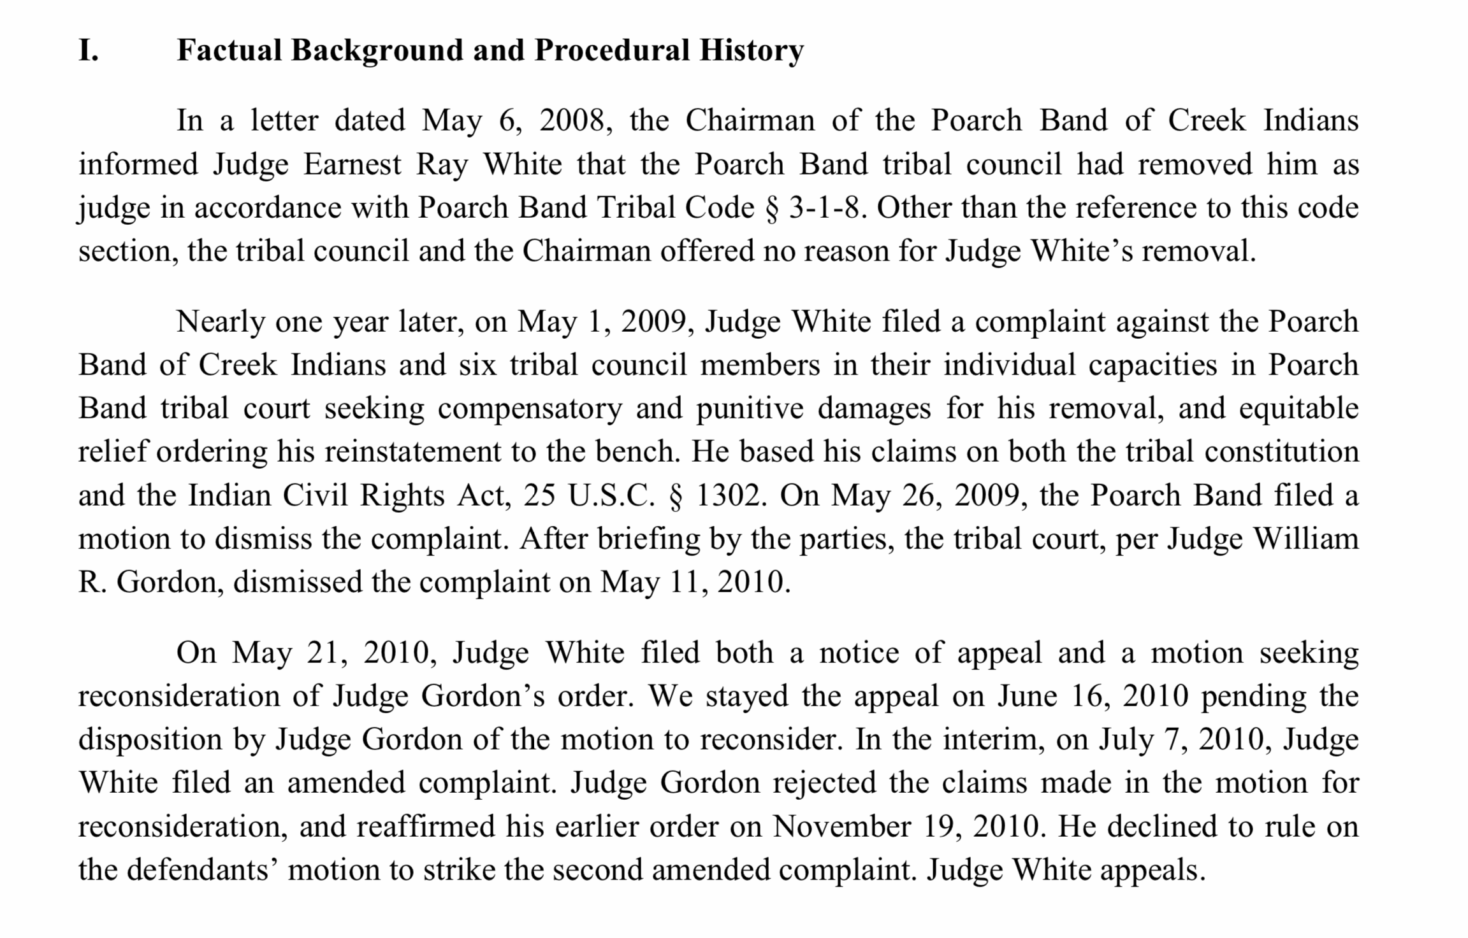

Slide 10
4. Facts

Slide 11
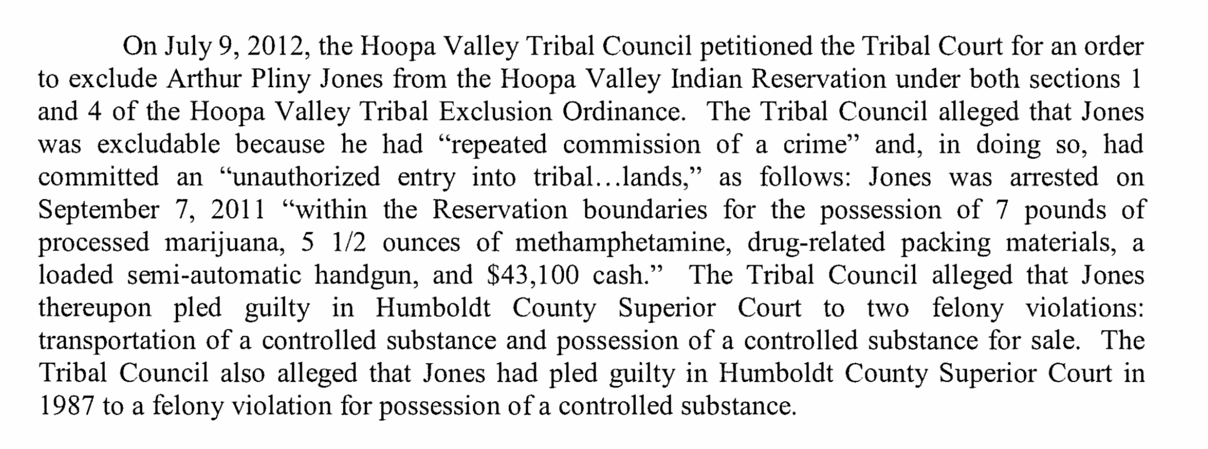

Slide 12
5. Legal Analysis

Slide 13
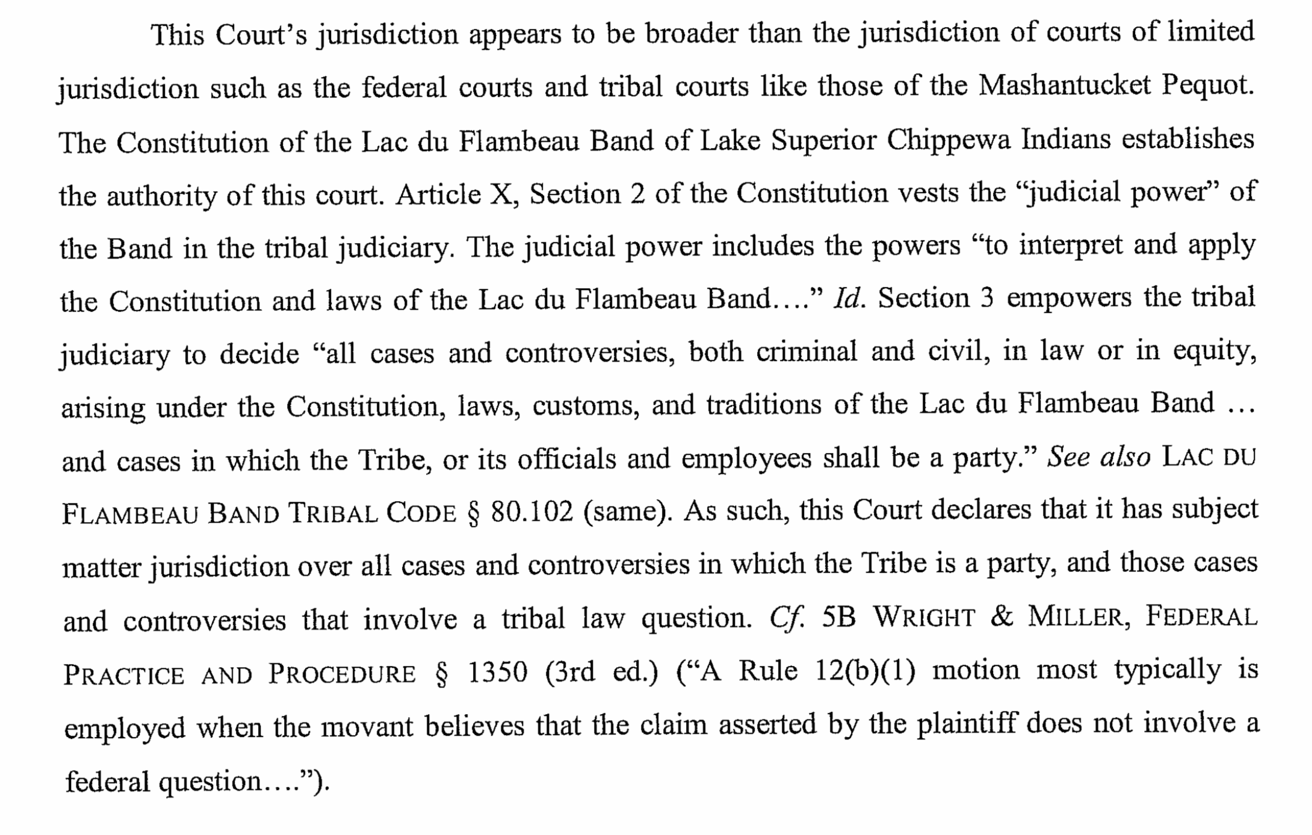

Slide 14
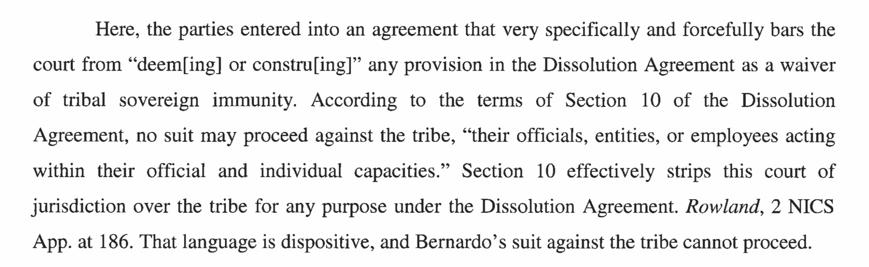

Slide 15
Notes on Introducing Tribal Customary Law

Slide 16
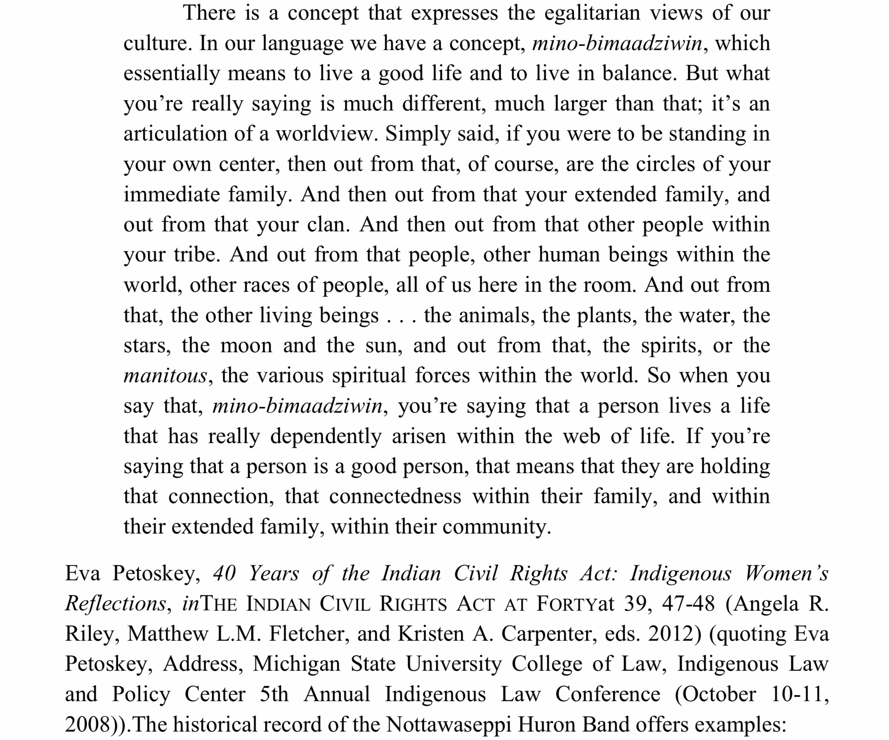

Slide 17
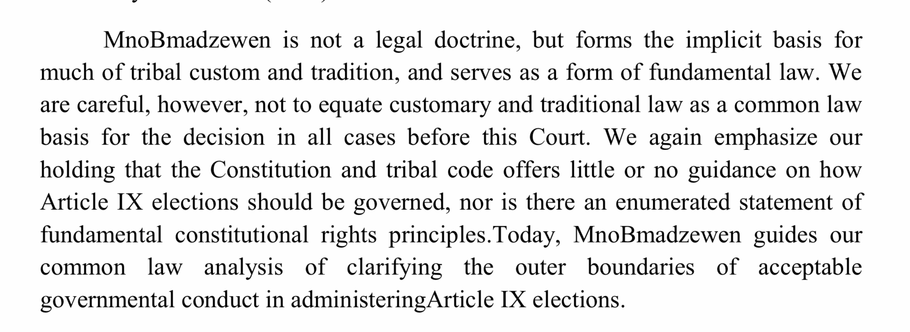

Slide 18
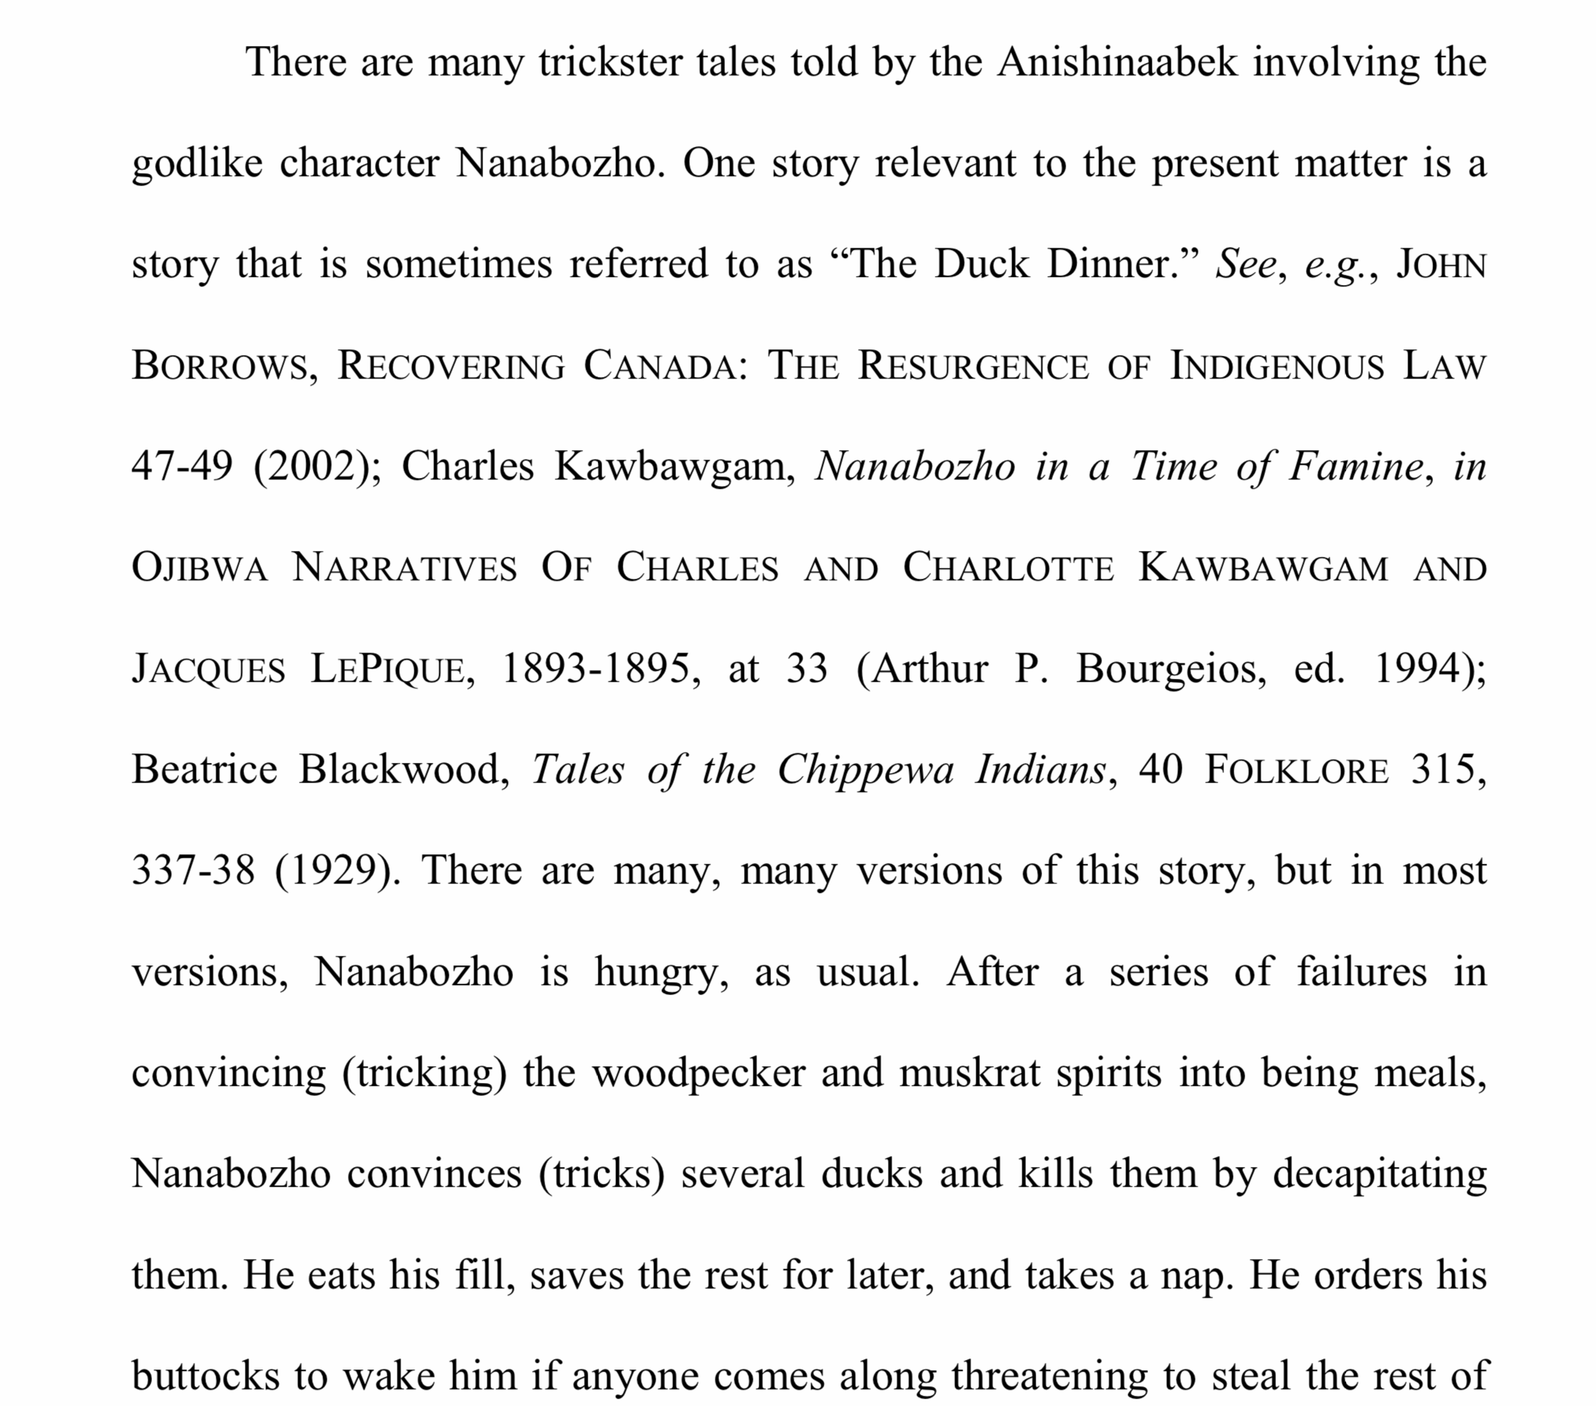
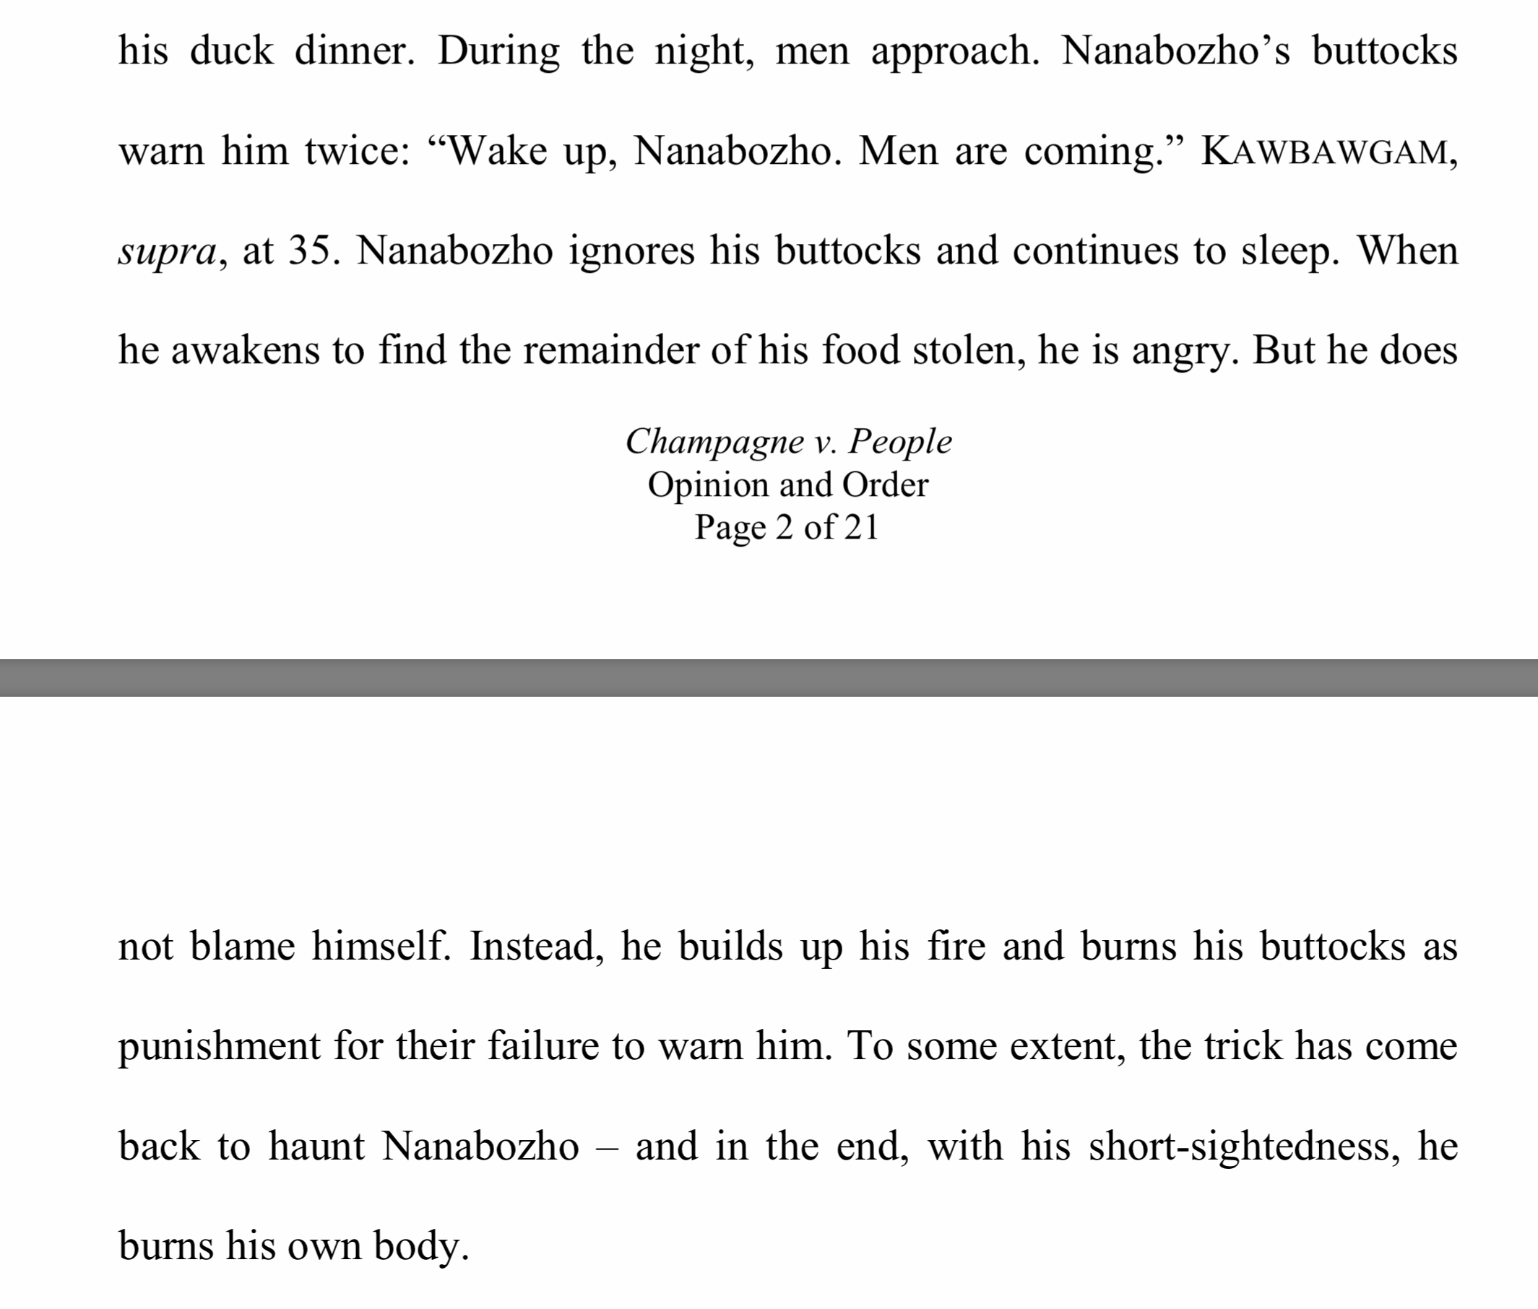

Slide 19

https://turtletalk.wordpress.com/matthew-lm-fletcher/tribal-court-opinions/

