Slide 1
Judicial Ethics
Matthew L.M. Fletcher

Slide 2
NAICJA
Judicial Code of Ethics

Slide 3
The Tribal Court Judge is the number one representative of the court. The court’s integrity and fairness defines a communities’ faith and health in utilizing a tribal court.

Slide 4
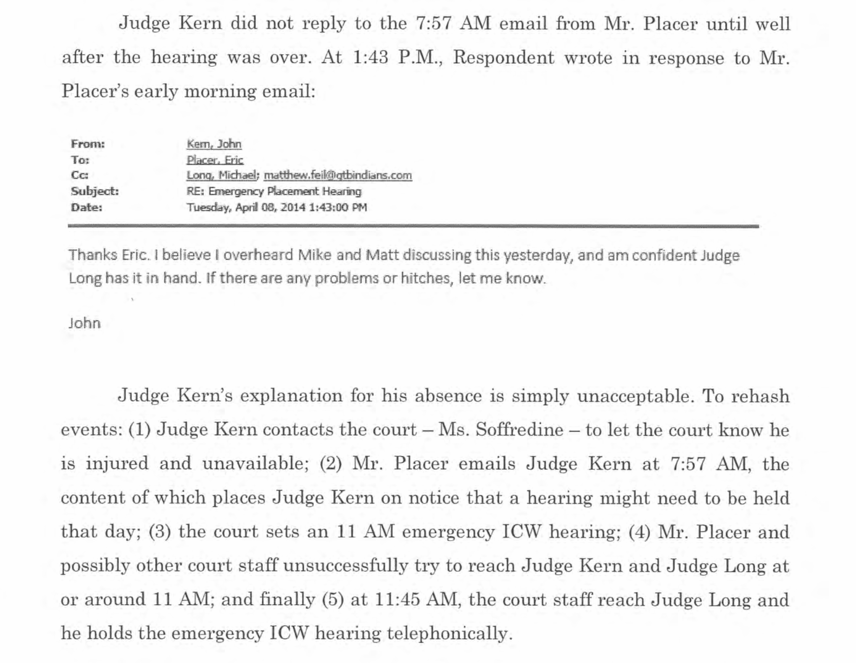

Slide 5
A judge should encourage a separation between the judicial branch and other branches of tribal government.
[separation of powers]

Slide 6
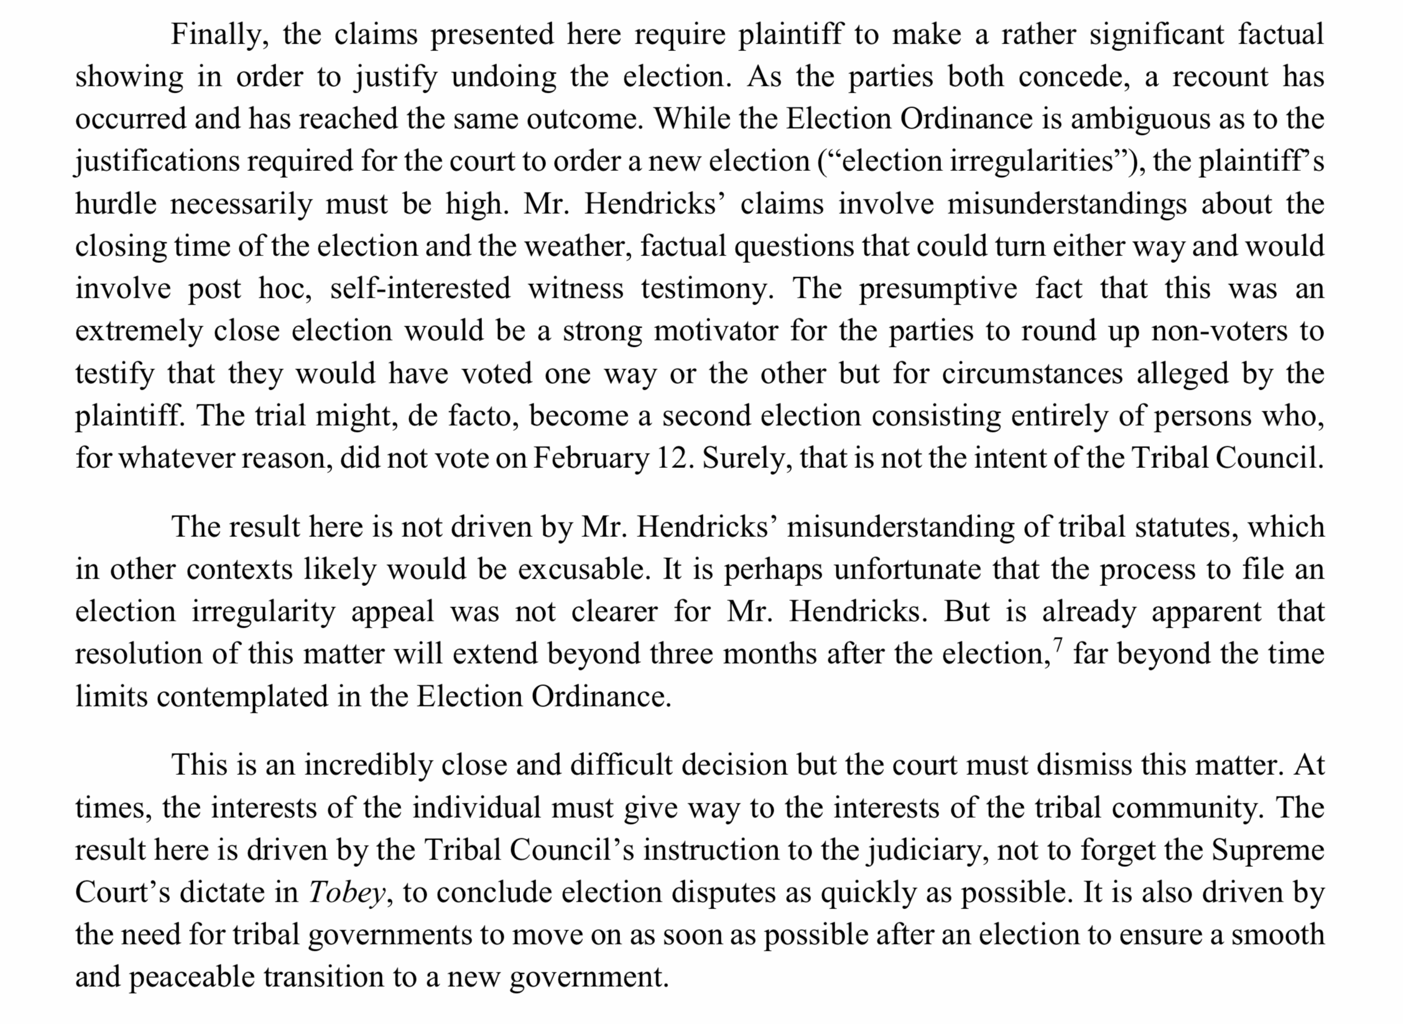

Slide 7
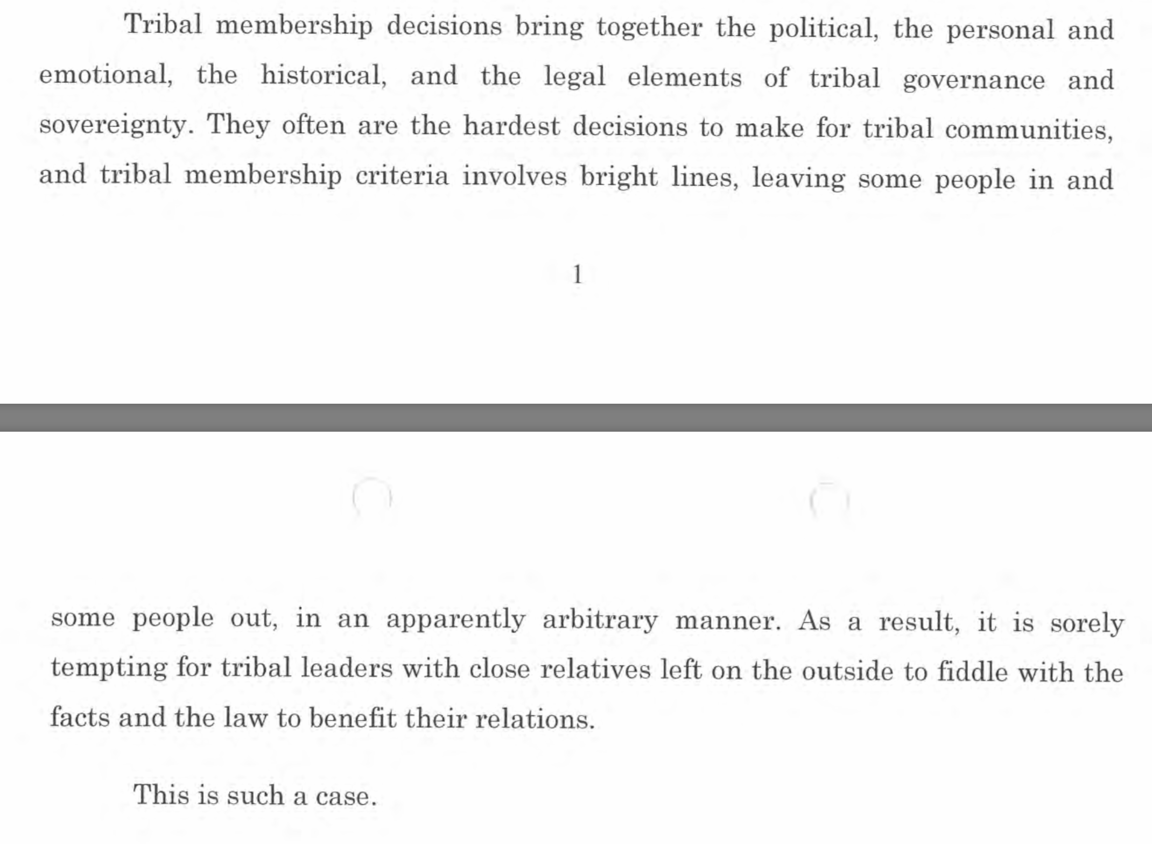
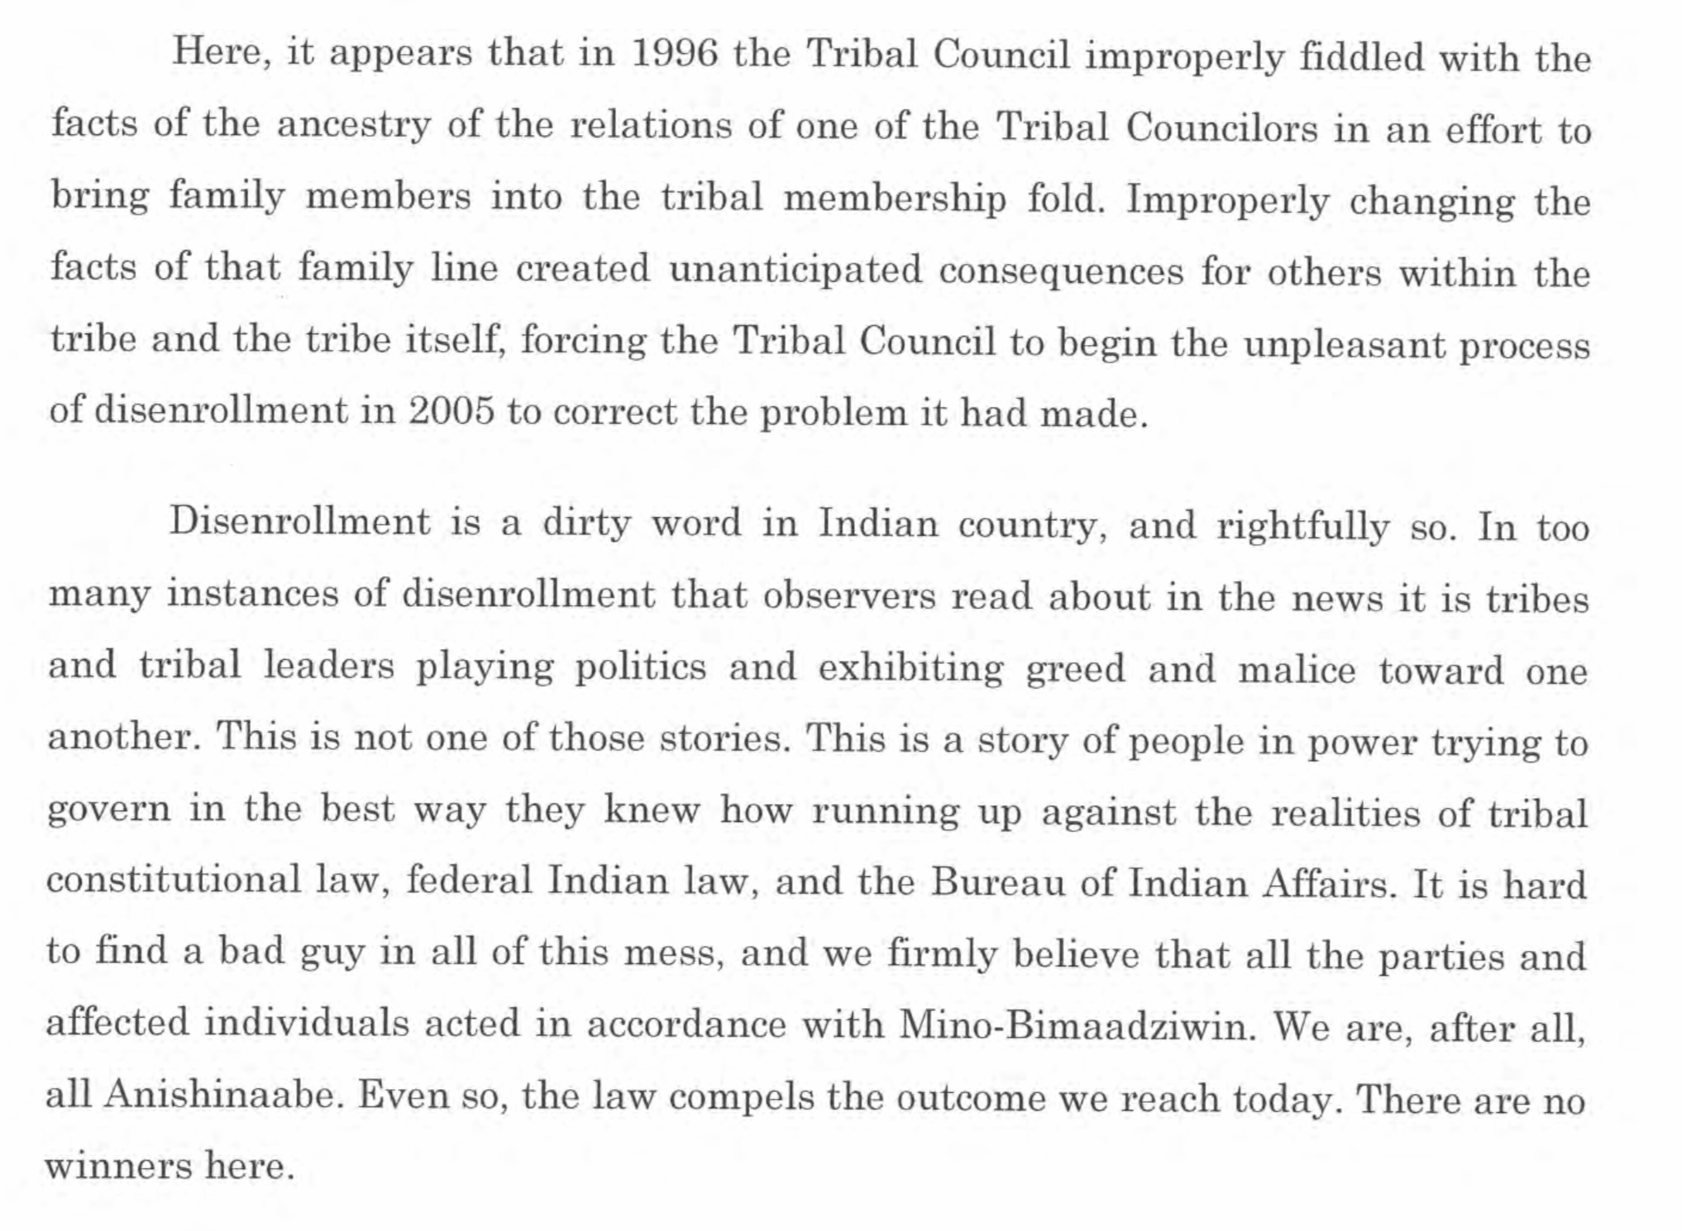

Slide 8
A judge should not participate in cases involving immediate family members, in cases involving someone with whom the judge has a strong personal relationship, or in cases where the judge has a significant, direct, financial, political, or other personal interest.
[conflicts of interest]

Slide 9
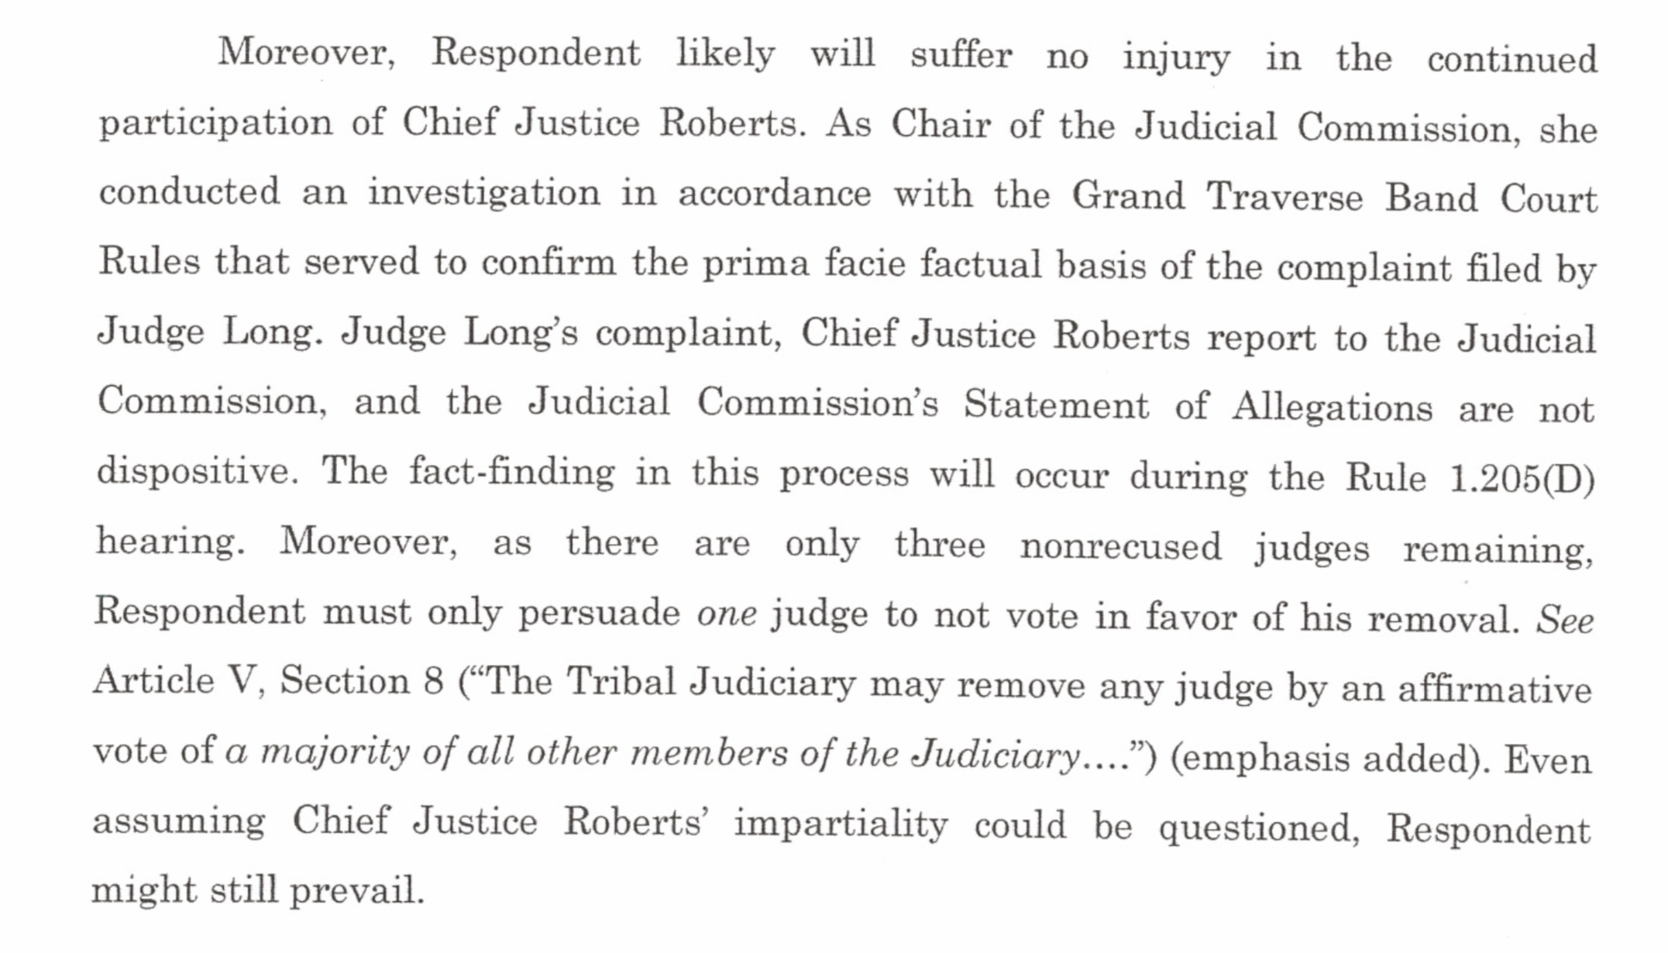

Slide 10
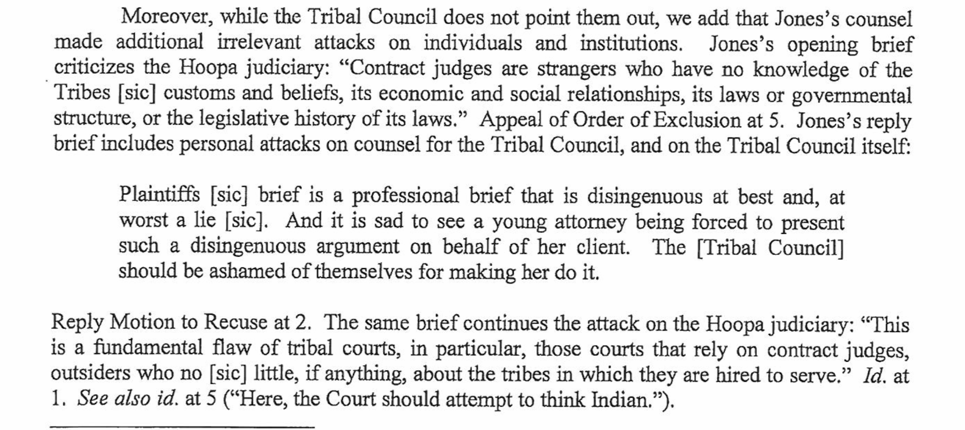

Slide 11
A judge has a responsibility to uphold confidentiality and should never discuss a case with outside parties or use confidential information acquired in the course of their official duties to further their personal interests.
[duty of confidentiality]

Slide 12
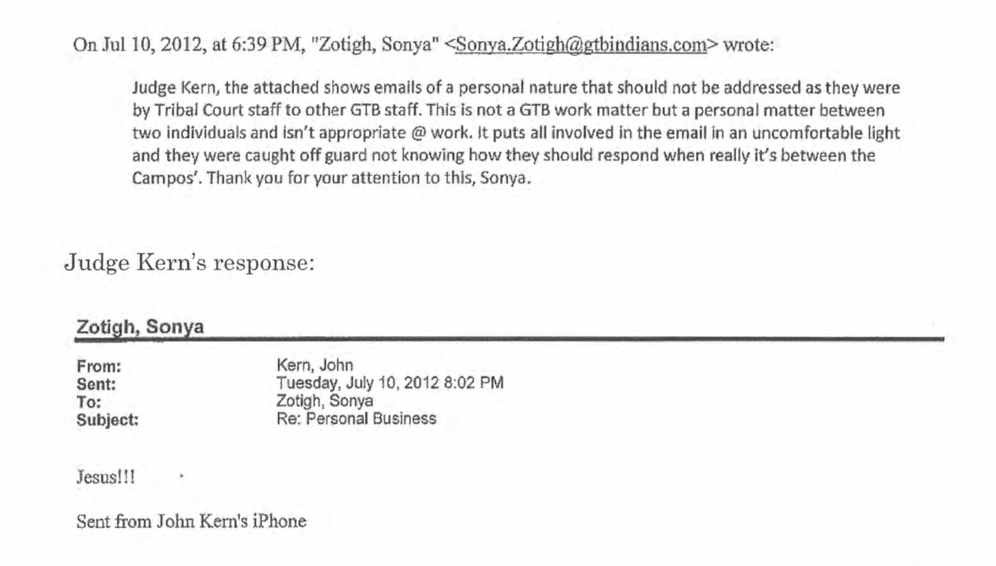

Slide 13
A judge should be aware that their conduct has a direct bearing on public attitude toward their court and as such, should conduct themselves appropriately.

Slide 14
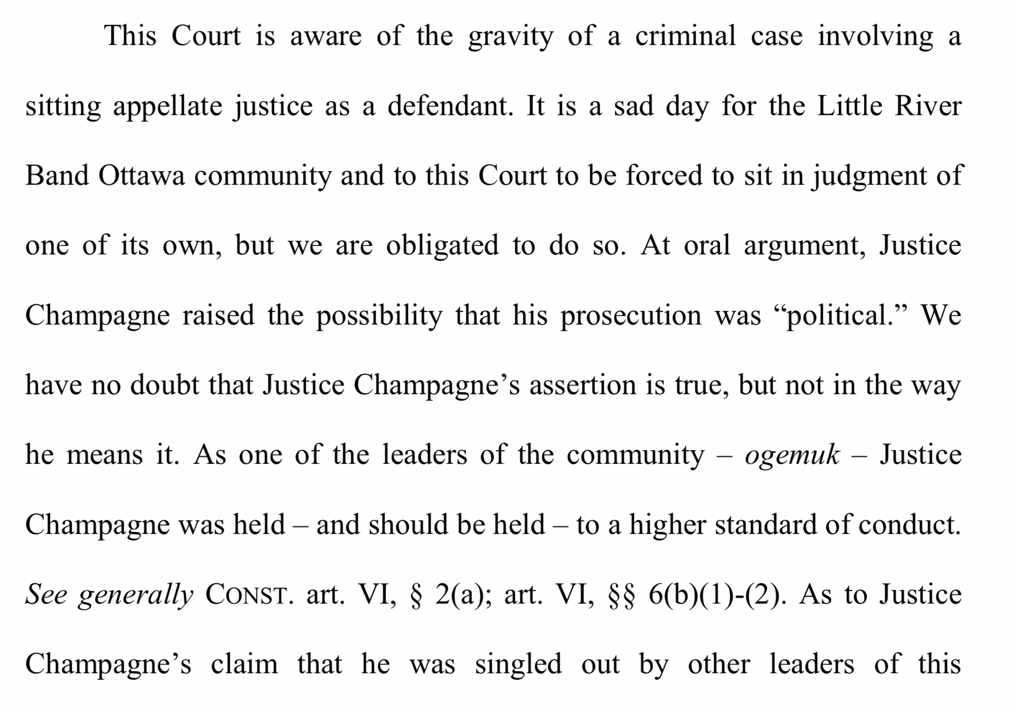
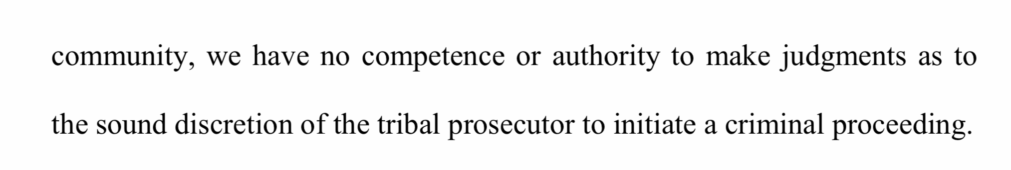

Slide 15
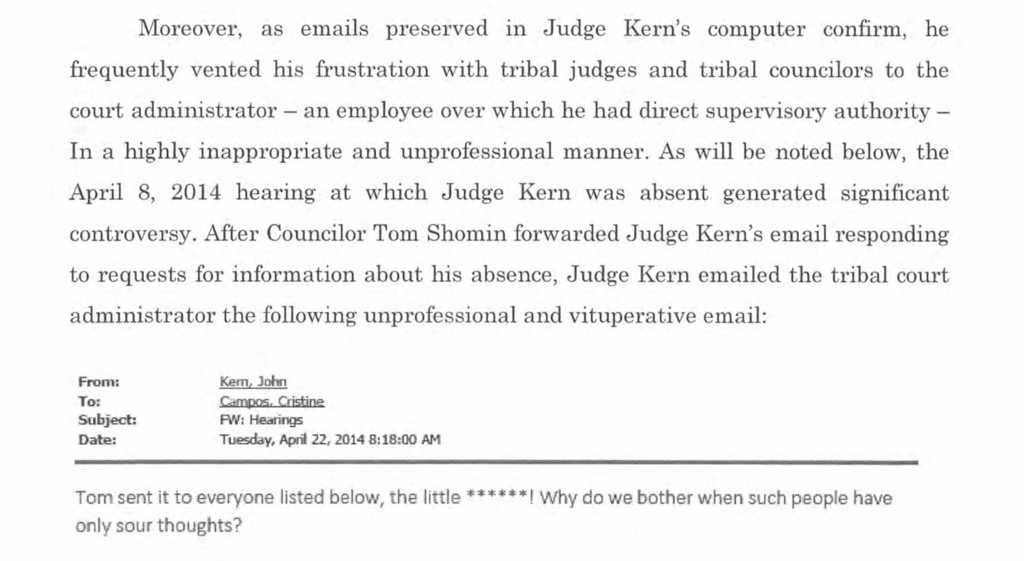

Slide 16

https://turtletalk.wordpress.com/matthew-lm-fletcher/tribal-court-opinions/

