Slide 1


ICWA Case Update
Kathryn “Kate” E. Fort

Slide 2
ICWA Appellate Project
Tracks appellate cases nationwide
Provides limited representation for tribes in ICWA appeals
Provides technical assistance and research for tribes
Provides training for jurists and other legal professionals on ICWA
All Case Documents (and other information) Available at: https://turtletalk.blog/icwa/

Slide 3
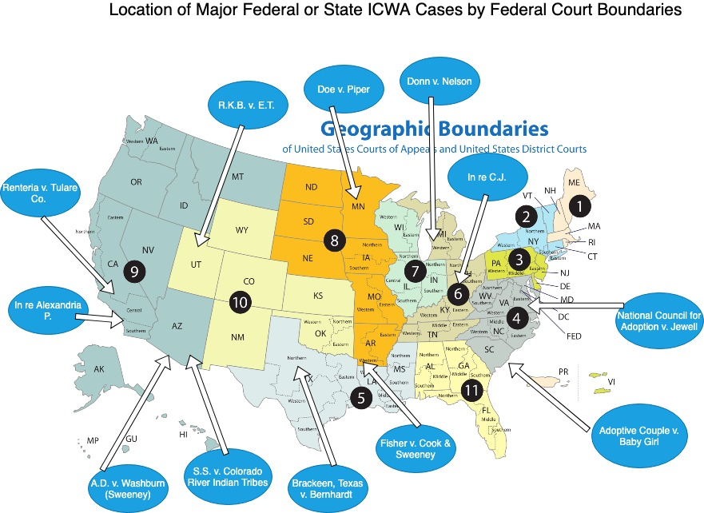

Slide 4
Brackeen/Texas v. Bernhardt
Northern District of Texas, 17-cv-00868
  Complaint filed on Oct. 25, 2017
  Plaintiff(s):
    Brackeens; Texas
  Defendants/Intervenors:
    Depts of Interior, BIA
  Two Amended Complaints (12/15/17; 3/22/18)
    Brackeens, Cliffords, and Librettis; Texas, Louisiana, and Indiana
    Depts of Interior, HHS, Bernhardt, Sweeney; Cherokee Nation, Quinault Indian Nation, Oneida Nation, Morongo Band of Mission Indians

Slide 5
Brackeen/Texas v. Bernhardt
Northern District of Texas, 17-cv-00868
  Issues in the Second Amended Complaint:
    Administrative Procedure Act/Final Rule
      Equal Protection, Tenth Amendment, Article I
    Violation of Article I/Commerce Clause
    Violation of the Tenth Amendment
    Violation of the Fifth Amendment/Equal Protection
    Violation of APA/Substantive Due Process (Indv)
    Violation of the Fifth Amendment/Due Process (Indv)
    Violation of Article I/Non-Delegation (States)

Slide 6
Brackeen/Texas v. Bernhardt
Northern District of Texas, 17-cv-00868
  Federal and Tribal Motion to Dismiss
  Plaintiffs Opposition to Motion to Dismiss AND Motion for Summary Judgment
  Navajo Nation Rule 19 Motion
  Briefings on Motions to Dismiss and Summary Judgment
  Amici:
    Ohio, Goldwater
    Law Profs, Gila River Indian Community, 7 states, 123 tribes and 14 Tribal Organizations

Slide 7
Brackeen/Texas v. Bernhardt
Northern District of Texas, 17-cv-00868
  Order Released on Oct. 10, 2018
  Court Granted the Plaintiffs Motions for Summary Judgment in Part and Denied in Part
    Granted:
      Equal Protection
      Non-Delegation
      Anti-Commandeering
      APA
      Unconstitutional under the Indian Commerce Clause (in one paragraph)
    Denied
      Substantive Due Process

Slide 8
Brackeen/Texas v. Bernhardt
Northern District of Texas, 17-cv-00868
  Stay Denied on Oct. 29, 2018
  Fifth Circuit Court of Appeals, No. 18-11479
Fifth Circuit Court of Appeals, No. 18-11479
  Stay Granted on Dec. 3, 2018

Slide 9
Brackeen/Texas v. Bernhardt
Fifth Circuit Court of Appeals, No. 18-11479
  Oral Arguments, March 13, 2019
  Briefing completed on February 19, 2019
  Plaintiffs:
    Brackeens, Cliffords, and Librettis; Texas, Louisiana, and Illinois
  Defendants/Intervenors:
    Depts of Interior, HHS, Bernhardt, Sweeney; Cherokee Nation, Quinault Indian Nation, Oneida Nation, Morongo Band of Mission Indians; Navajo Nation
  Amici:
    Christian Alliance, Project on Fair Representation, Goldwater/Cato/AAAA, Ohio
    Congress, Casey Family Programs and 30 orgs, 21 AGs, Indian Law Profs, Constitutional Law Profs, 325 Tribal Governments and 57 Tribal orgs, +3 additional

Slide 10
Brackeen/Texas v. Bernhardt
Fifth Circuit Court of Appeals, No. 18-11479
  Issues on Appeal:
    Standing
    Equal Protection
    Commandeering
    Non-Delegation
    Administrative Procedures Act

Slide 11
Important 2018 State Cases
In re L.D., 391 Mont. 33 (2018)
J.W.E. v. State, 419 P.3d 374 (Okla. Civ. App. 2018)
In re A.P., 818 S.E.2d 396 (N.C. 2018)
In re Beers, 325 Mich.App. 653 (2018)
In re E.R., 2018 COA 58, (Colo. App. 2018)
Matter of Welfare of S.R.K., 911 N.W. 821 (Minn. 2018)
Diego K. v. State Dept. of Health & Soc. Srvs. 411 P.3d 622 (Alaska, 2018)
In re B.Y., 432 P.3d 129 (Mont. 2018)

Slide 12
2018-2019 Michigan Cases
In re Beers, 325 Mich.App 653
In re Williams, 501 Mich. 289
6 unreported 2018 cases
5 unreported 2019 cases
No reported 2019 cases

Slide 13
Kate Fort
fort@law.msu.edu

