Slide 1

The Legacy of DAPL: Background and Lessons for Protecting Treaty Rights, Tribal Trust Resources, and Grandmother Earth Through Government-to-Government Consultation
Nicole E. Ducheneaux
Partner
Notes:
Dakota Access Pipeline Litigation: Background and Lessons for Tribes Protecting Treaty Rights, Trust Resources, and Grandmother Earth

Slide 2
I. The atrocities at Standing Rock – a case study in consultation
II. Origins and fundamentals of tribal consultation
III. DAPL litigation – remand and litigation moving forward
IV. DAPL lessons learned – the post-Standing Rock relationship with agencies, consultation, and litigation

Slide 3
Part I:
The Atrocities at Standing Rock:
A Case Study in Consultation

Slide 4
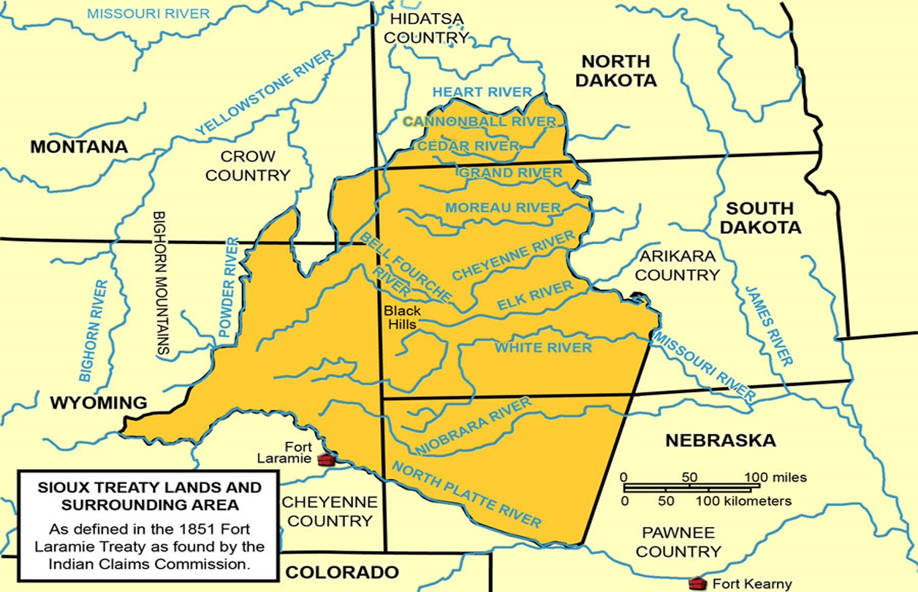
Lakota Territory Pursuant to
1851 Fort Laramie Treaty

Slide 5
Significance of Treaty Territory
Homeland – “absolute and undisturbed use and occupation”
Culture and livelihood – hunting, fishing, subsistence
Spirituality – Sacred Black Hills; sacred water

Slide 6
Status of Indian Lands
Ultimately and illegally diminished to present-day reservations
United States owns in trust, including resources like water, for the benefit of Tribes and owes a fiduciary responsibility (Johnson v. M’Intosh, 21 U.S. 543 (1823)
Treaty rights not explicitly abrogated, including off-reservation rights, remain in force (see, e.g. Minnesota v. Mille Lacs Band of Chippewa Indians, 526 U.S. 172 (1999))

Slide 7
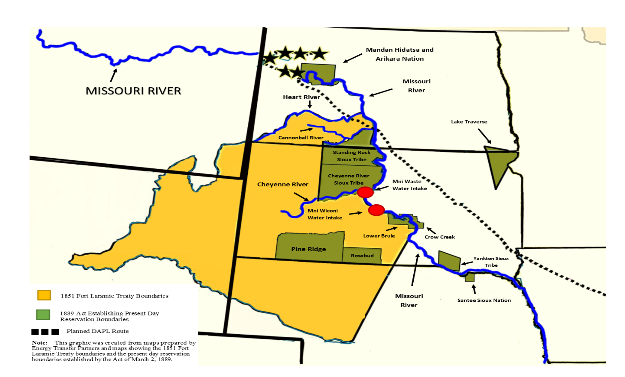
1851 Territory with Present-Day
Reservations and DAPL

Slide 8
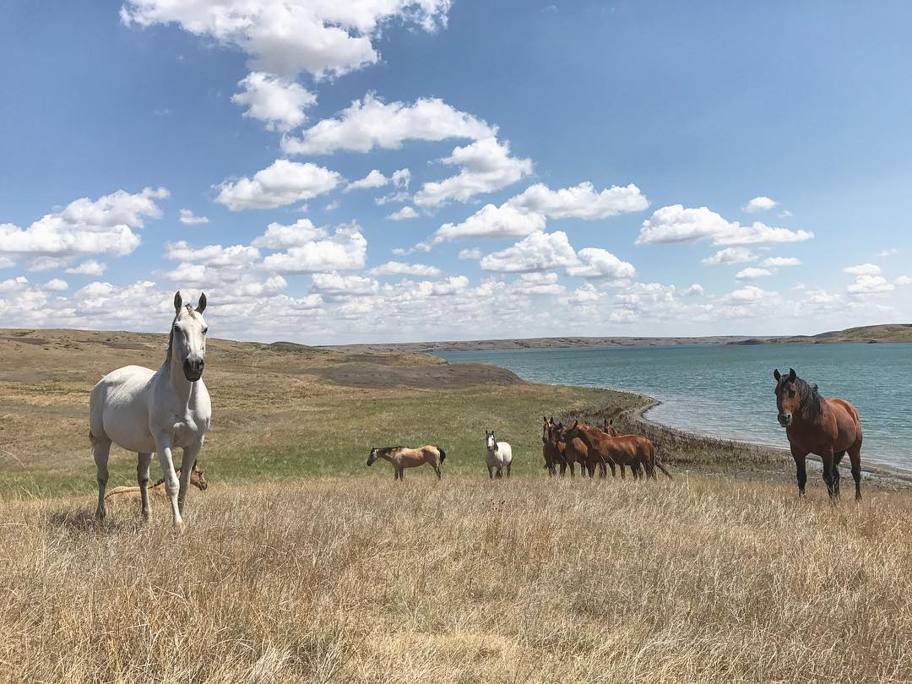
The Missouri River – Lake Oahe
Mni Sose

Slide 9
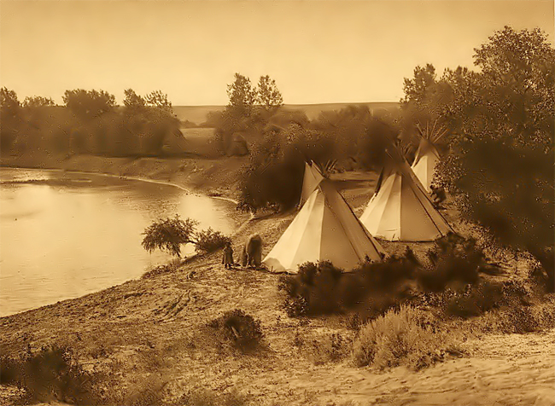
Importance of Mni Sose
The lifeline or blood line of the Lakota from time immemorial
Sacred sites, cultural sites, archeological sites, graves
Sole source of clean, fresh drinking water
Subsistence and culture – hunting, fishing, gathering plants and medicines
Religion and sacraments – water is our first medicine

Slide 10
DAPL Facts
1,200-mile pipeline designed to move over 500,000 gallons of crude oil from Bakken oilfields in North Dakota to Illinois daily
Permit under Section 408 of the Rivers and Harbors Act (33 U.S.C. § 408) required for occupation or alteration of Corps’ project
Easement required under the Mineral Leasing Act, 30 U.S.C. § 185, to cross Corps’ land
Verification that activities satisfied terms of Nationwide Permit 12 for other miscellaneous WOTUS crossings
NHPA Section 106 Process: scoping, identification of historic properties, assessment and resolution of adverse effects based on consultation

Slide 11
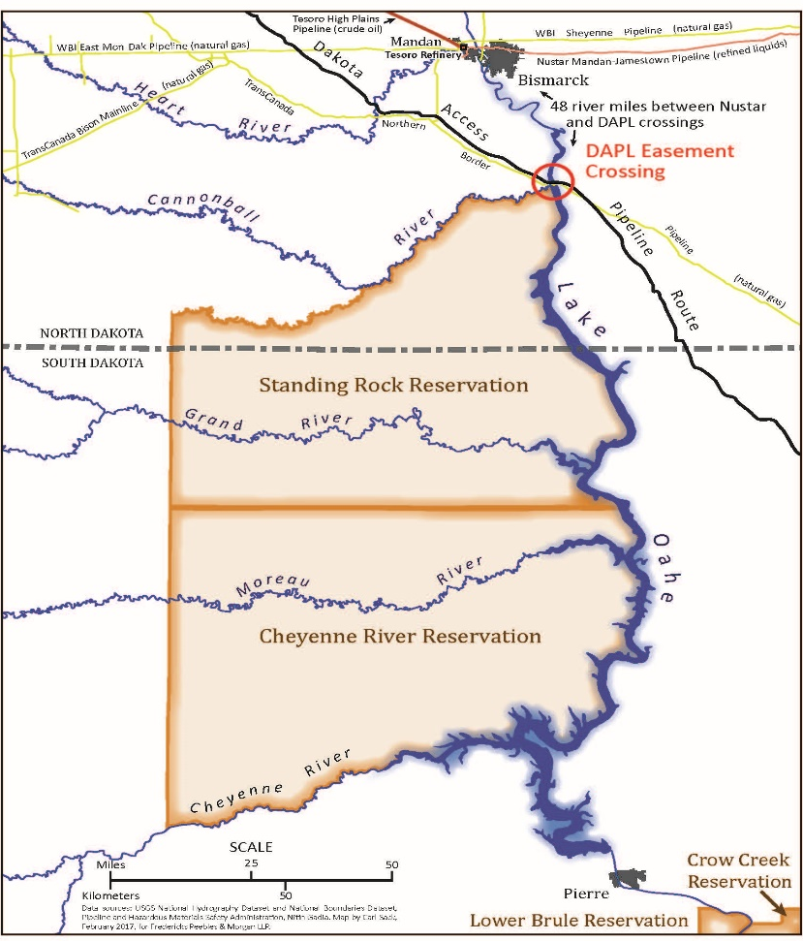
DAPL Crossing

Slide 12
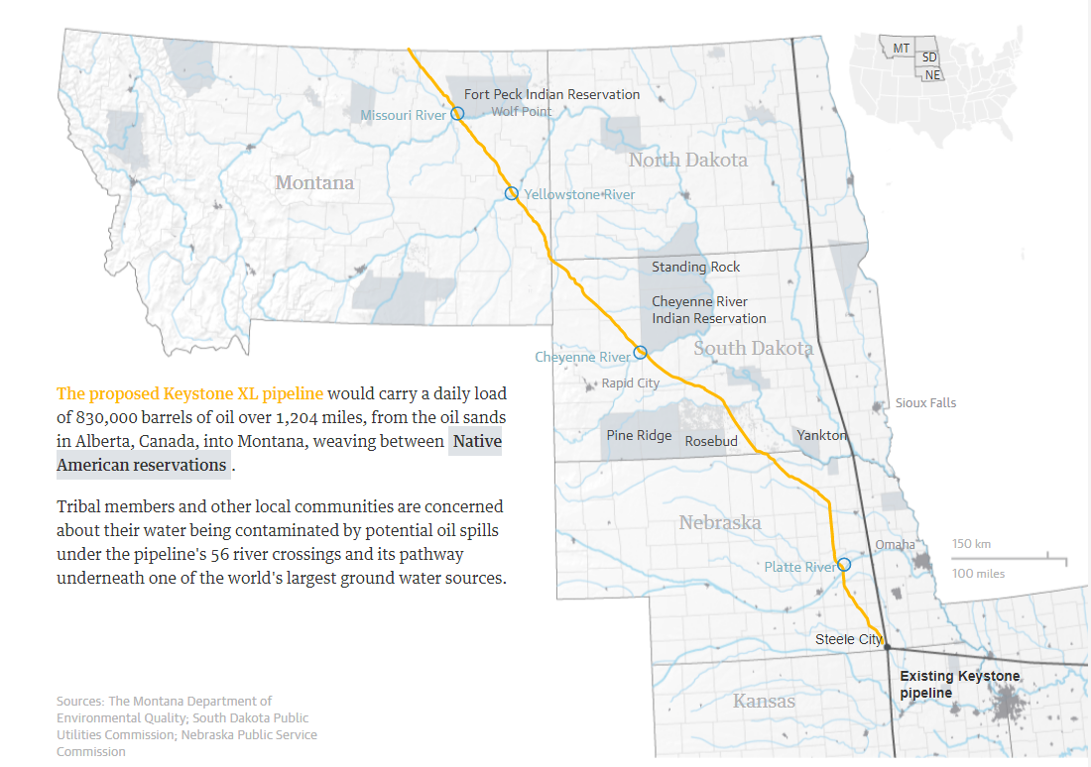
Comparison with KXL
(How Disgusting, Right???)

Slide 13
DAPL Crossing –
Significance to Lakota
Confluence of Missouri and Cannonball Rivers
Historic campsite of the people from time immemorial
Sacred site where whirling eddy had worn small boulders into perfectly round spheres (hence Cannonball river)
Location of numerous graves and stone cairns in the vicinity

Slide 14
Deficiency of
Section 106 Process
Generic form letter to Tribes
Initial cultural surveys accomplished without tribal involvement
Failure of government to respond to tribal requests for consultation
Focus primarily on SRST, despite legal interest of all signatories to 1851 and 1868 Treaties with the Sioux
Public comment sessions versus meaningful government-to-government consultation
Results of private archeological surveys done by non-tribal consultants, no tribal input regarding protocols or the area of potential effects
Failure to credit tribal experts, both traditional and academic and failure to assess sites identified by tribal experts
Failure to consider sites outside of bore pits
Disgraceful conclusion that “no historic properties affected”

Slide 15
The Terrible Paradox of the Records
Insufficient consultation resulted in a lack of record to demonstrate the existence of important cultural and historical sites; BUT
When we added specific detail to the record at the last minute, it was used against us to disastrous effect

Slide 16
A Labor Day
Weekend Tragedy
SRST Motion for Preliminary Injunction re: NHPA fully briefed and argued on August 24, 2016
August 28, 2016, landowner contacts SRST to advise that he had identified various stone cairn sites on his land along pipeline corridor
SRST THPO and consultant visit site and identified numerous significant cultural sites, including stone cairn/effigies and burial sites
Friday, September 2, 2016, SRST files supplemental declaration setting forth descriptions, locations, and graphs demonstrating nature and location of newly discovered sacred sites along pipeline corridor.
Saturday, September 3, 2016, DAPL plows directly through the newly discovered sites

Slide 17
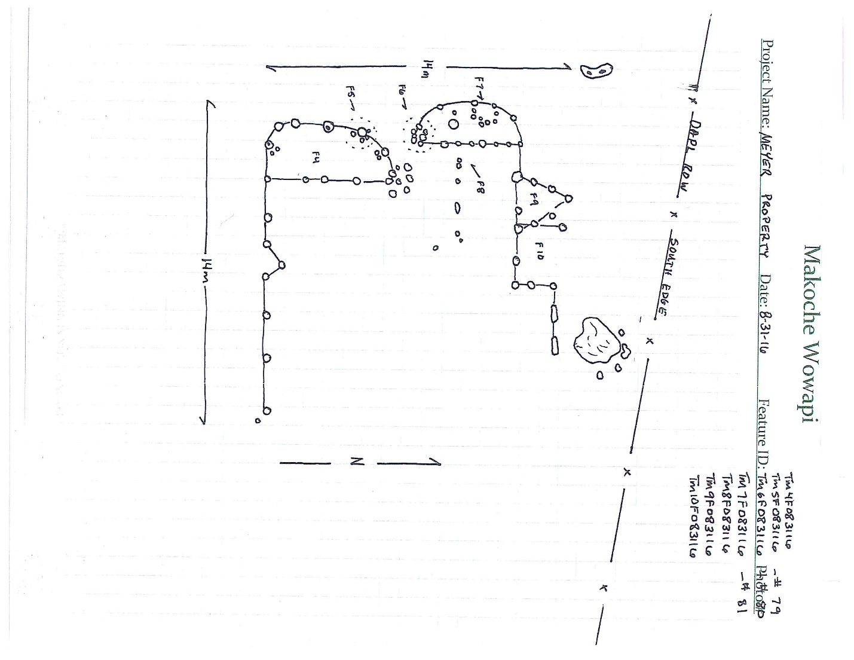

Slide 18
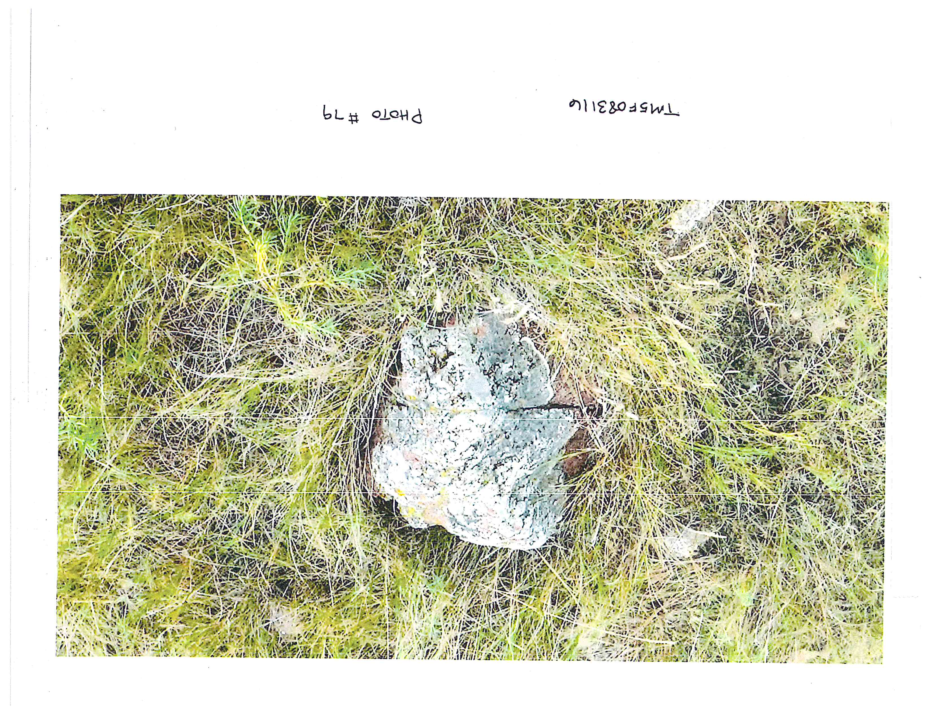

Slide 19
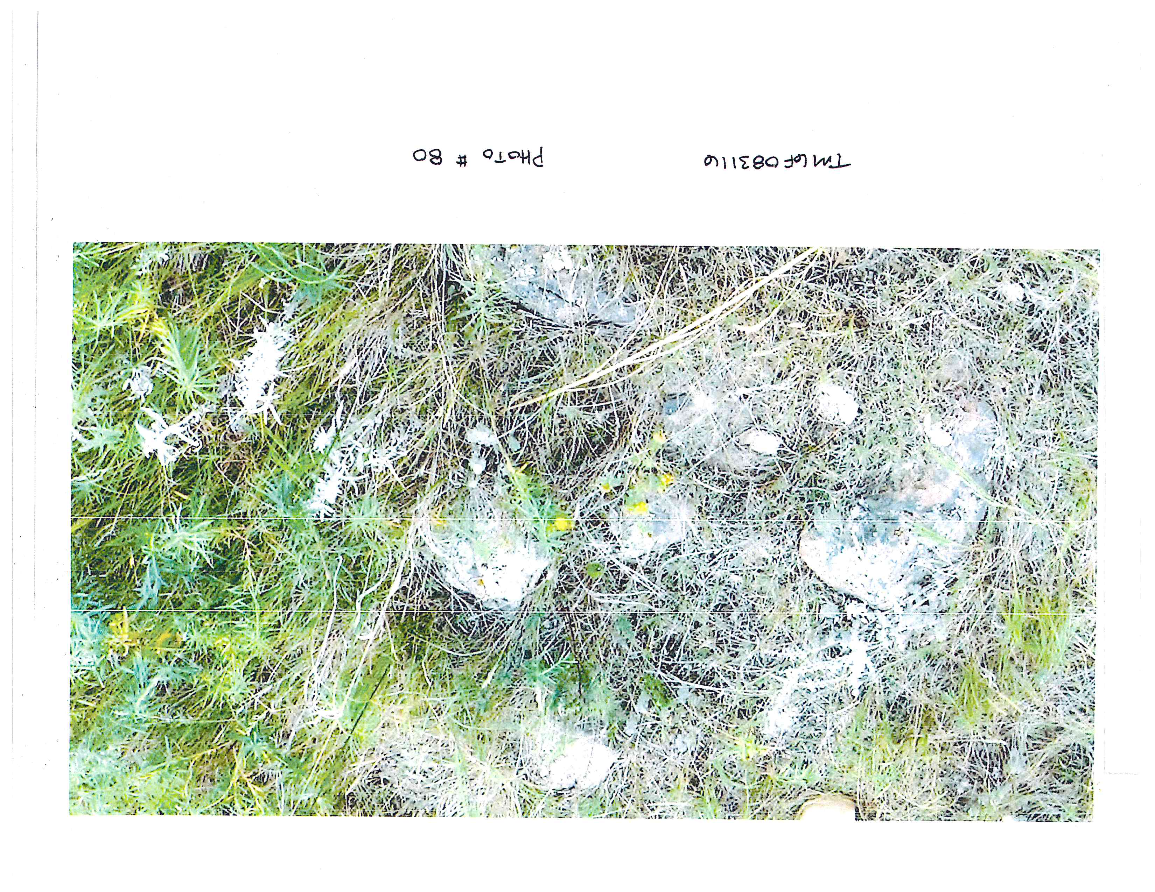

Slide 20
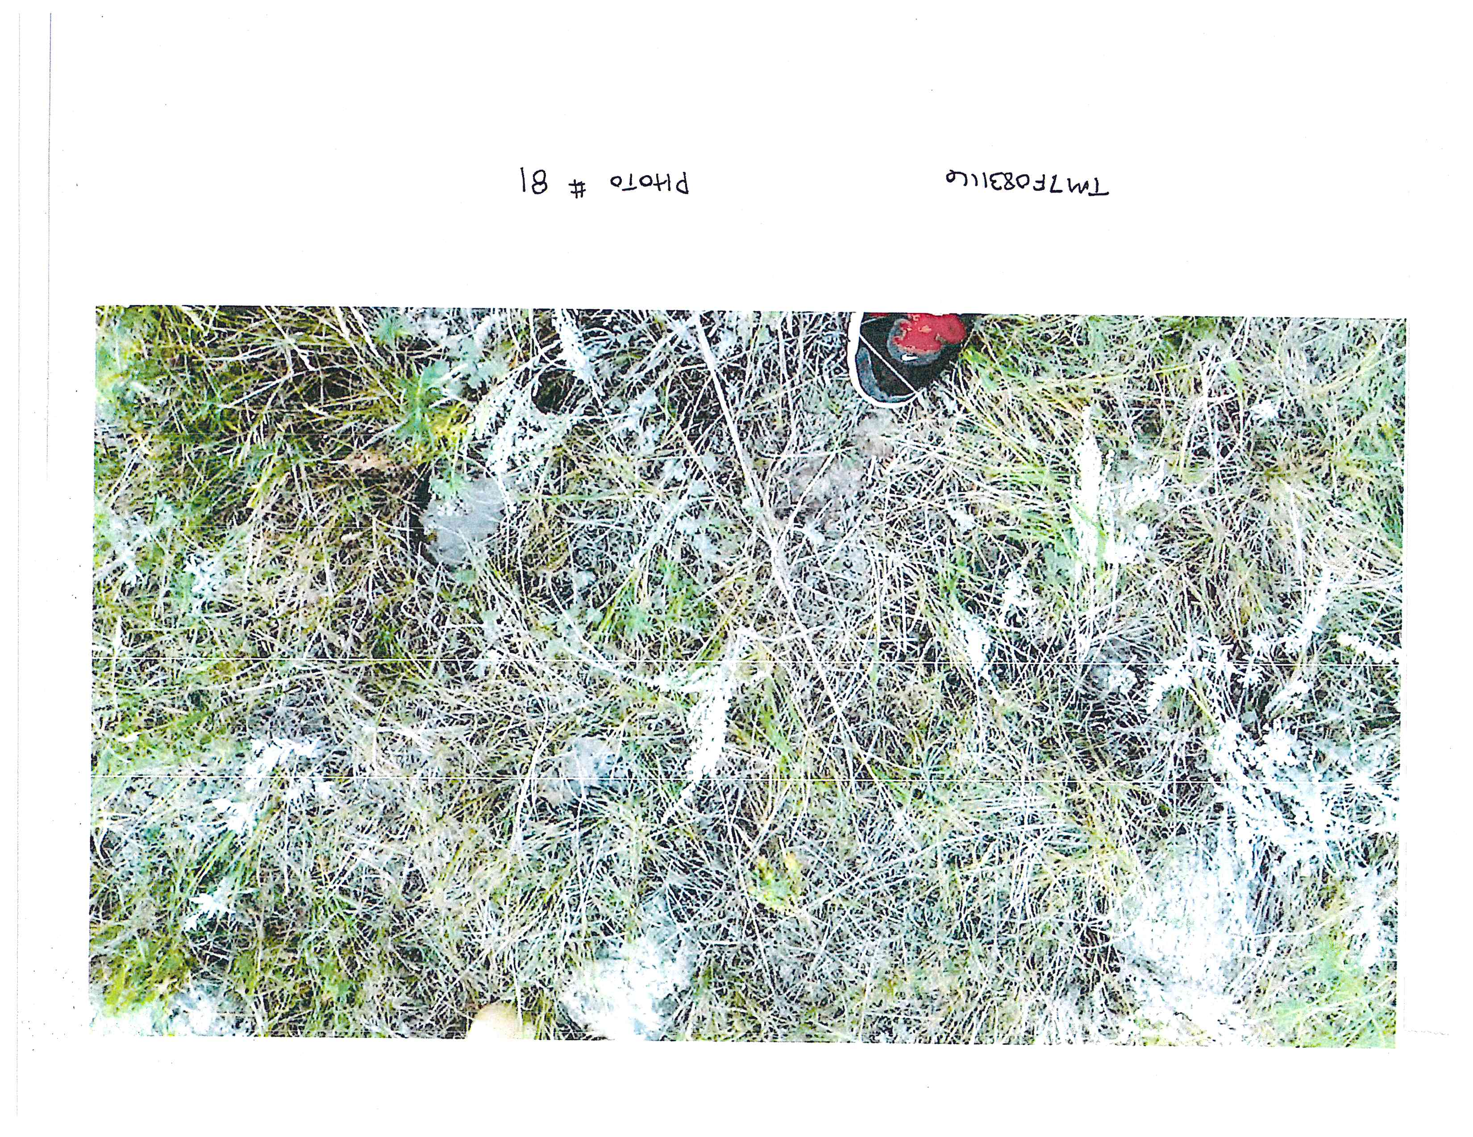

Slide 21
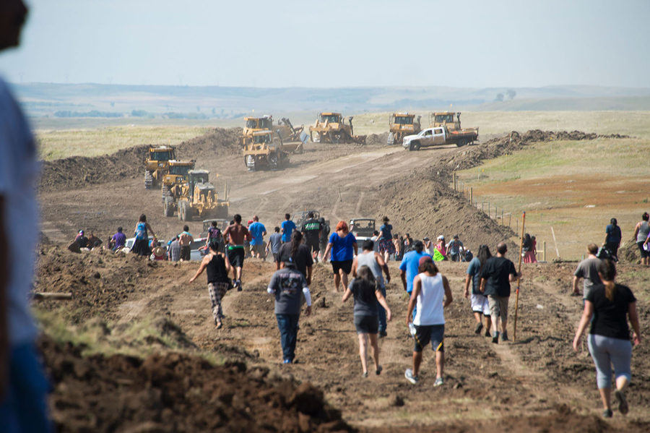
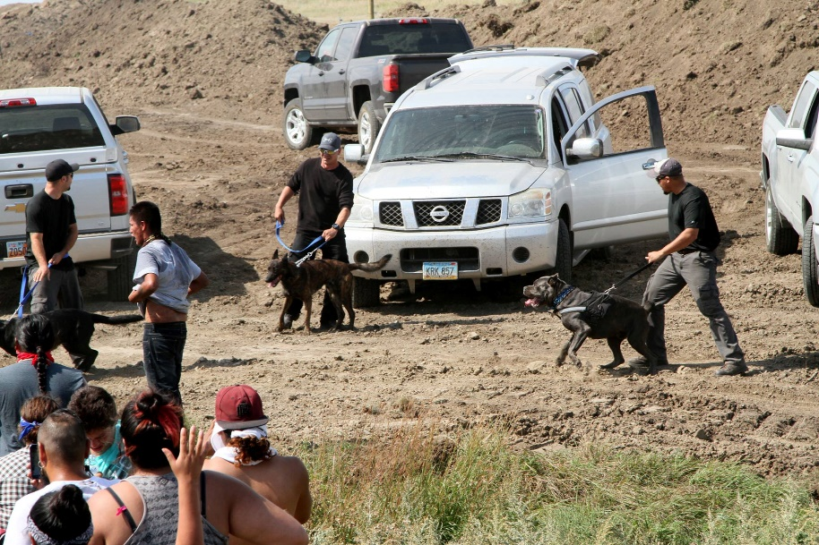
Clashes on September 3, 2016 –
Part I

Slide 22
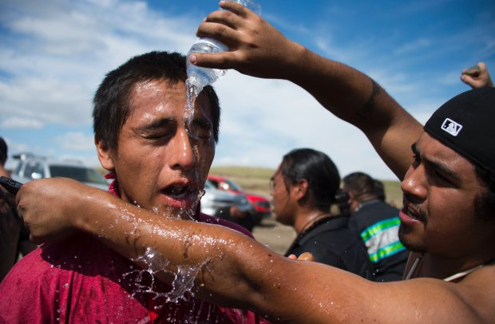
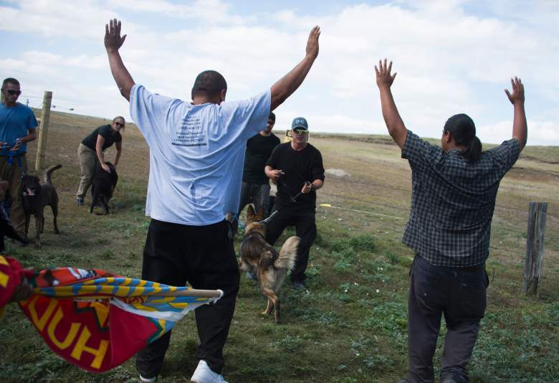
Clashes on September 3, 2016 – Part II

Slide 23
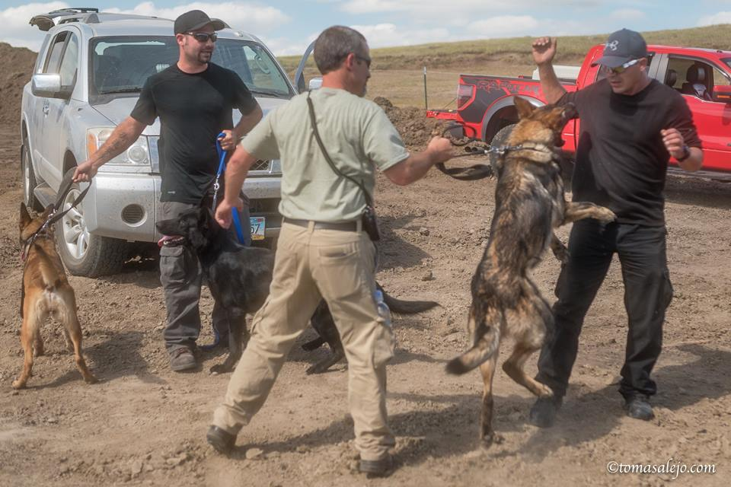
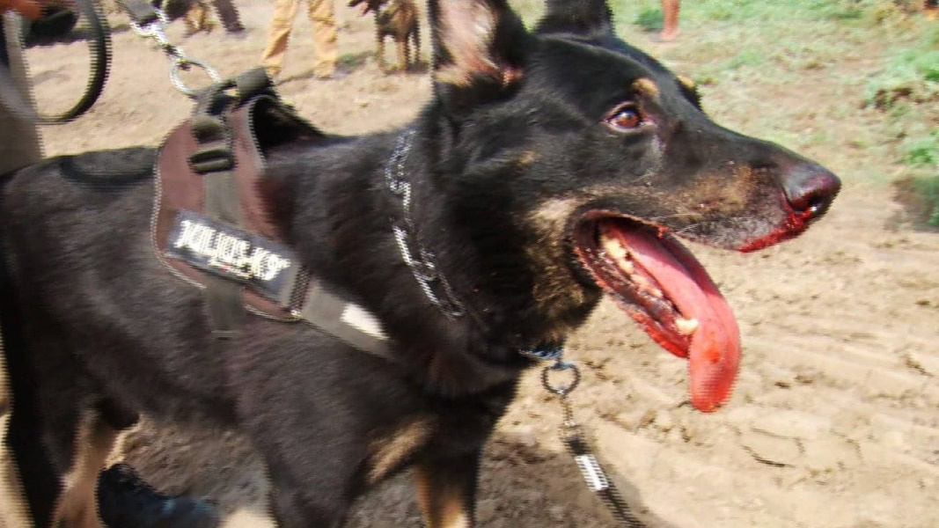
Clashes on September 3, 2016 – Part III

Slide 24
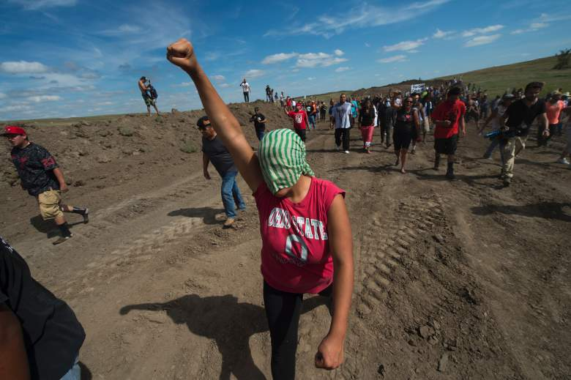
Clashes on September 3, 2016 –
Part IV

Slide 25
Results of the Flawed Consultation Process
Untold historically and culturally significant sacred sites and objects destroyed with no real penalty to oil company
Motion for Preliminary Injunction denied on September 9, 2016 on the grounds that consultation was sufficient

Slide 26
Other Important Post-Consultation Issues of Note
Obama time-out provided tribes with extra time to paper administrative record… And we won! (Sort of..)
Early 2017 RFRA issues. Hard fight and we lost, because of lack of record on religious beliefs…

Slide 27
Part II:
The Origins and Fundamentals of Tribal Consultation

Slide 28
Consultation with Tribes
Necessary because of Treaty rights, trust responsibility, and cultural, political, and public health consequences

Slide 29
International
Consultation Principles
United Nations Declaration on the Rights of Indigenous People (UNDRIP), September 13, 2007
Article 10: “Indigenous peoples shall not be forcibly removed from their lands or territories. No relocation shall take place without the free, prior and informed consent of the indigenous peoples concerned . . . .”

Slide 30
United States General
Tribal Consultation Requirements
United States required to consult with tribes as to impacts on tribal treaty rights and trust resources as a function of those treaty rights and the United States trust responsibility – this is sufficient to require such consultation
In light of the gravity of rights involved, this should require free, prior, and informed consent

Slide 31
United States’ View of Its Tribal Consultation Obligation
Despite general duty, the U.S. usually sees its obligation as limited to…
Tribal consultation also required as to impacts on tribal treaty rights as an inherent corollary and trust resources, Executive Order 13175, and related agency regs – but largely toothless and unenforceable
Tribal consultation statutorily required by Section 106 of the National Historic Preservation Act as to historic properties that have religious and cultural significance to Indians
Free, prior and informed consent, not required; just consultation

Slide 32
Tribal Consultation on DAPL
Corps, with DAPL archeologists, engaged in tribal consultation per the NHPA in a manner that Tribes felt was grossly deficient
Corps made no explicit or affirmative efforts to engage in tribal consultation as to treaty rights or trust resources; considered no tribal input on impact of spill on water or treaty rights

Slide 33
Discrete Lessons of DAPL Consultation
We lost on NHPA – explicit statutory provisions did nothing to protect us from inadequate consultation efforts on sacred sites and deliberate destruction of our sacred sites.
We won on the Treaties – let us not forget that not only are Treaties the Supreme Law of the Land, but our ancestors fought and died for those rights. The requirement to consult under our Treaties is POWERFUL AND SACRED.

Slide 34
A Caveat…
Don’t get me wrong about NHPA, it’s super, super important and a powerful arrow in our quiver.
All I mean, is don’t forget the profound power of our Treaties…

Slide 35
Part III:
Consultation Best Practices:
Holding the Government to Its Obligations and Creating a Rich Record for Your Fight

Slide 36
Lessons Learned From DAPL –
Cultural Competency of Your Attorney
“Where the buffalo roam…..”
Your tribal traditions and culture are the focus of this fight and they cannot be entrusted to an attorney who neither understands nor cares about them – they are your voice.

Slide 37
Lessons Learned From DAPL:
Tribal Engagement in Consultation
Insist upon proper consultation and be clear about the Tribe’s terms (in formal consultation policy);
React every time, and do it early time, often, and uniformly to the extent possible
Utilize experts – tribal, scientific, cultural, non-tribal;
Flex treaty rights, Winters rights, sovereign rights.

Slide 38
Lessons Learned From DAPL:
Creating a Tribal Consultation Policy
Flex your tribe’s sovereignty – create positive law, including a formal consultation policy that reflects your treaty rights and the government’s trust responsibility
One size does not fit all – consider your specific treaties, your specific culture, and your tribe’s traditions and political landscape
We don’t have to rely on the United States to dictate to us what consultation means. Some tribal laws stand on an equal footing with federal law and will be enforceable in federal court, e.g., tribal constitutions…

Slide 39
Sample Consultation Policy Components – Part I
Provide the Tribe with and explain all pertinent information concerning the impact on the Tribe’s rights before consultation in a timely manner.
Coordinate with the Tribe before consultation begins, especially with development of an agreement on consultation timelines.
Consult only with Tribal representatives who have been authorized to engage in government-to-government consultation by the Tribal government.
Make every effort to conduct Tribal consultation at the seat of Tribal government or elsewhere within the Tribe’s territory.

Slide 40
Sample Consultation Policy Components – Part II
Ensure that federal participants in Tribal consultation have actual decision-making authority.
Provide written confirmation that the agency has considered tribal comments and concerns and the agency’s response, whether positive or negative.
Obtain resolution of approval from the Tribe that the agency has satisfactorily consulted with the Tribe and the Tribe agrees with the agency’s response to Tribal concerns in each instance.

Slide 41
Lessons Learned From DAPL:
Reacting Early and Often
Work with THPO to create a system to track ALL Dear Tribal leader letters, impact, and responses – never miss one
Work with THPO and other cultural and historical experts to create a boiler plate initial comment letter and consultation request to ensure that the proper legal and factual bases are transmitted to various agencies without requiring the tribe to reinvent the wheel every time and amass huge legal bills

Slide 42
Why It All Matters
Tribal (human?) existence depends on clean environment – health, welfare, economy;
Threats to the environment are real – human error; when, not if;
Real world consequences – effects on major organs, birth defects, genotoxicity.

Slide 43
Conclusion
Mni wiconi! Water is life!
Wopila tanka. Thank you very much.

