Slide 1

The Secret Life of Litigators
Jessica Intermill, Hogen Adams PLLC
October 11, 2019
Tribal In-House Counsel Association
Indigenous Law & Policy Center
What is my litigator talking about?
Notes:
My name
Hogen Adams boutique
Heard from partner Andrew yesterday
Thank NALSA leadership for inviting me; honor to share my experiences with you
My practice
governance, litigation
Litigation re treaty rights
Res boundary
Right to exclude
Usufructuary rights
Treaties
Makes for a catchier presentation title
But not all tribes are treaty tribes, treaties are independent of preconstitutional sovereignty
By “treaties” I mean sovereign rights, whether treaty protected or not

Slide 2

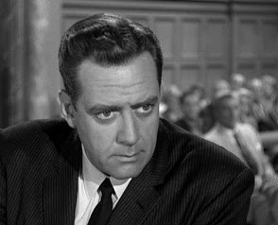
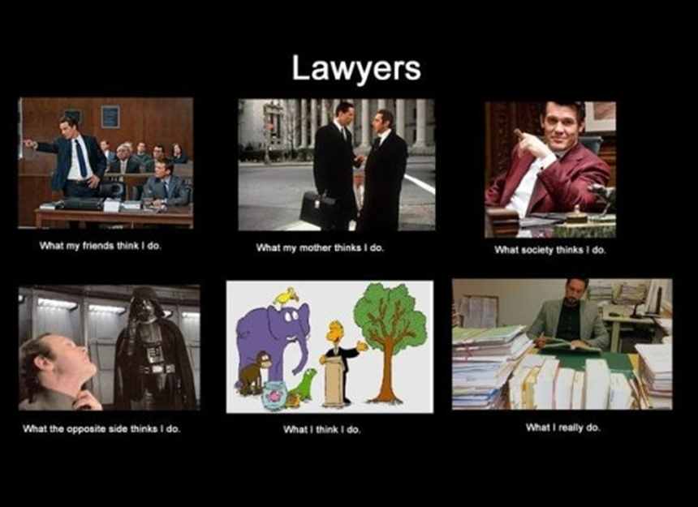
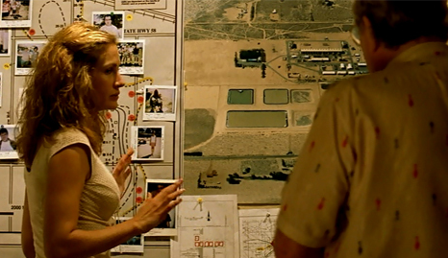
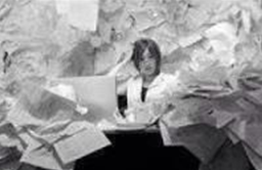
The Secret Life of Litigators
LITIGATORS
What my friends think I do
What my mom thinks I do
What society thinks I do
What opposing counsel
thinks I do
What I think I do
What I actually do

Slide 3

The Secret Life of Litigators

Slide 4

The Secret Life of Litigators

Slide 5
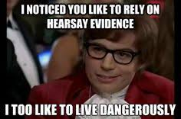
The Secret Life of Litigators

Slide 6
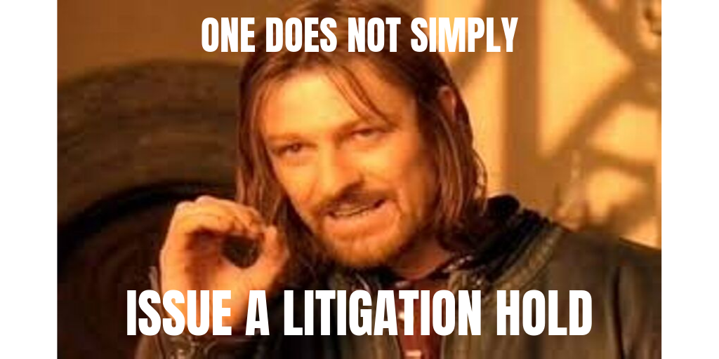
The Secret Life of Litigators

Slide 7

The Secret Life of Litigators

Slide 8
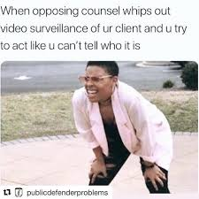
The Secret Life of Litigators

Slide 9
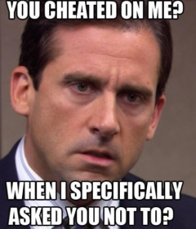
The Secret Life of Litigators

Slide 10

The Secret Life of Litigators

Slide 11
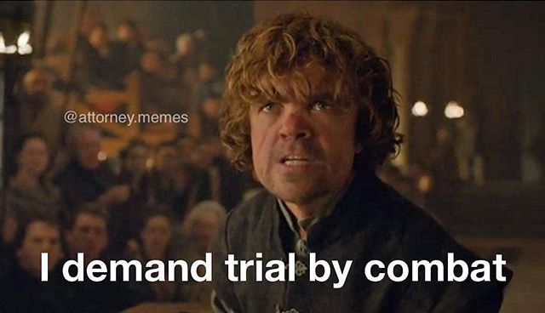
The Secret Life of Litigators
Client: Let’s take this to mediation
Opposing counsel:

Slide 12
The Secret Life of Litigators
Tribal In-House Counsel Association
Indigenous Law & Policy Center
Jessica Intermill, Hogen Adams PLLC
jintermill@hogenadams.com
Notes:
My name
Hogen Adams boutique
Heard from partner Andrew yesterday
Thank NALSA leadership for inviting me; honor to share my experiences with you
My practice
governance, litigation
Litigation re treaty rights
Res boundary
Right to exclude
Usufructuary rights
Treaties
Makes for a catchier presentation title
But not all tribes are treaty tribes, treaties are independent of preconstitutional sovereignty
By “treaties” I mean sovereign rights, whether treaty protected or not

