Slide 1
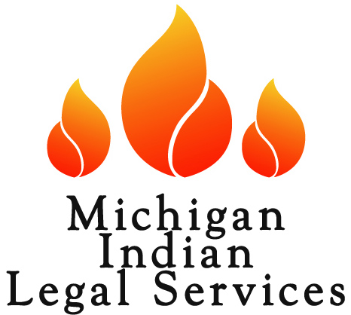
Native American Indian Legal Services-Tribal Collaboration
Indigenous Law and Policy Center
Michigan State University College of Law
East Lansing, MI
October 9, 2019
Cami Fraser, Executive Director
Michigan Indian Legal Services

Slide 2
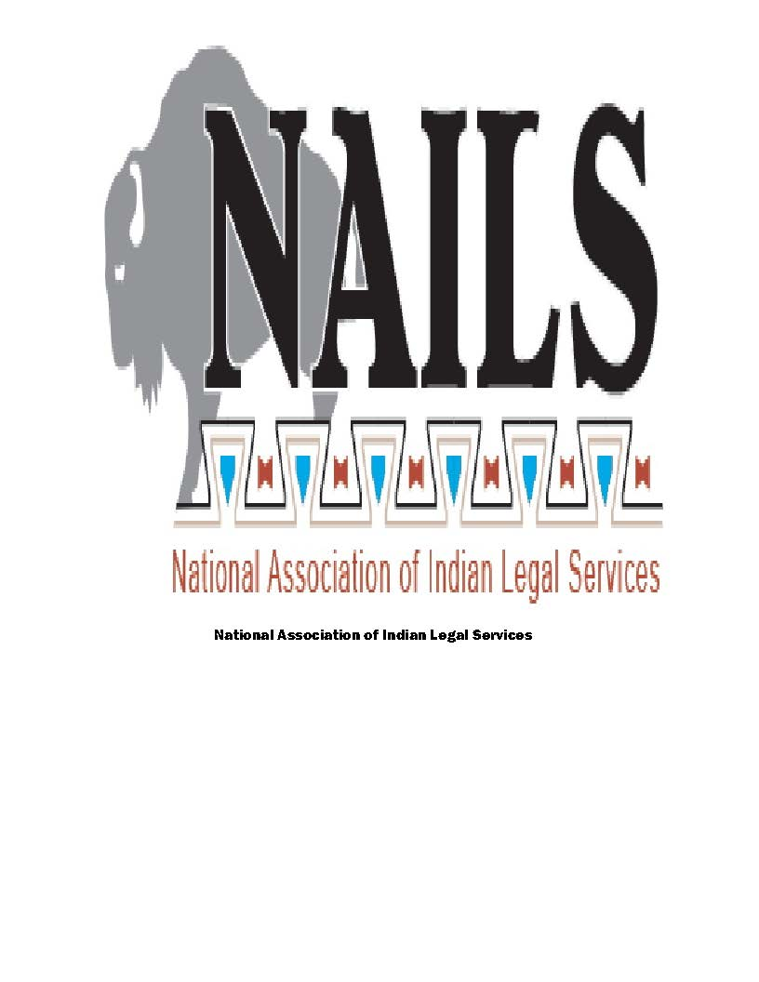
National Association of Indian Legal Services
National Association of Indian Legal Services (NAILS) is a coalition of the 25 Indian Legal Services programs established under the authority of the Legal Services Corporation Act (LSC).
There are 5 stand-alone Indian programs, 6 regional programs with Indian law units, and 19 state-wide programs with Indian law units.
LSC is a nonprofit established by Congress to provide financial support for legal aid to low-income Americans throughout the country.
NAILS programs have been serving Indian Country since the 1960s.
NAILS programs are natural allies and a resource for tribes.
The majority of the NAILS programs have tribal contracts. Generally, these contracts fall into three categories:
1) civil services for tribal members who would not be income eligible for services funded by LSC or allow for civil work for members that LSC will not fund,
2) tribal court and other court public defender services, and
3) tribal or organizational in-house counsel work.

Slide 3
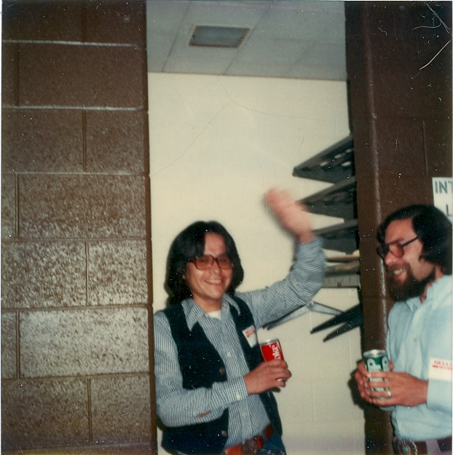
Michigan Indian Legal Services, Inc.
Michigan Indian Legal Services (MILS) was created to address the unmet legal needs documented in a study conducted by the Michigan Governor’s Commission on Indian Affairs in the early 1970s. The study found
“[t]here are not enough attorneys available to Michigan Indians; when available, they are frequently unable to specialize in Indian rights cases because these are not fee-producing in nature; day to day criminal and civil cases are difficult to coordinate without funds to hire good legal help.”
See Annual Report of the Commission on Indian Affairs, 1975.
John Petoskey, then intern, and Barry Levine,
then Executive Director, 1978

Slide 4
Michigan Indian Legal Services
Sources of Funding, 2018
Total revenue of $567,284 in 2018.
MILS is a statewide program
One office with one off-site attorney (SW MI)
12 federally recognized tribes in Michigan, many urban centers
MILS has 4 full-time attorneys, 2 part-time attorneys, 2 full-time support staff members and 1 part-time accountant/bookkeeper
Over the years, MILS has had tribal contracts to provide services to tribes and for tribal members.

Slide 5
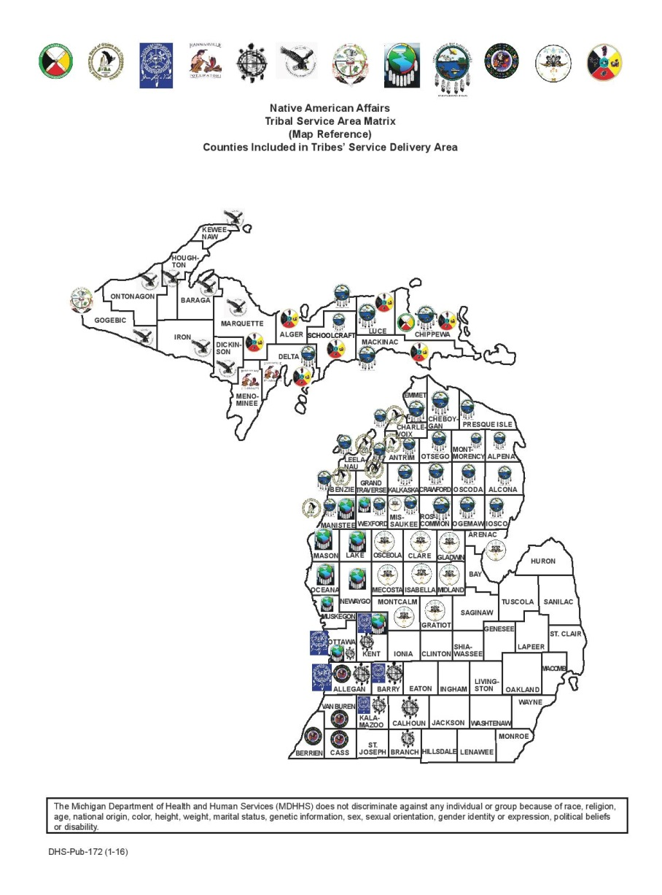
MILS Services Available with LSC & Other Grants Funds
Tribal Court Civil Cases (child welfare, evictions, garnishments, etc)
Tribal Court Criminal Cases
State Appellate ICWA-MIFPA Cases
Simple Estate Planning (Wills, Powers of Attorney, etc)
Loss of Essential Services
Medical-Legal Partnership (LTBB & LRB)
Hotline, Advice Over the Phone (other legal issues)

Slide 6
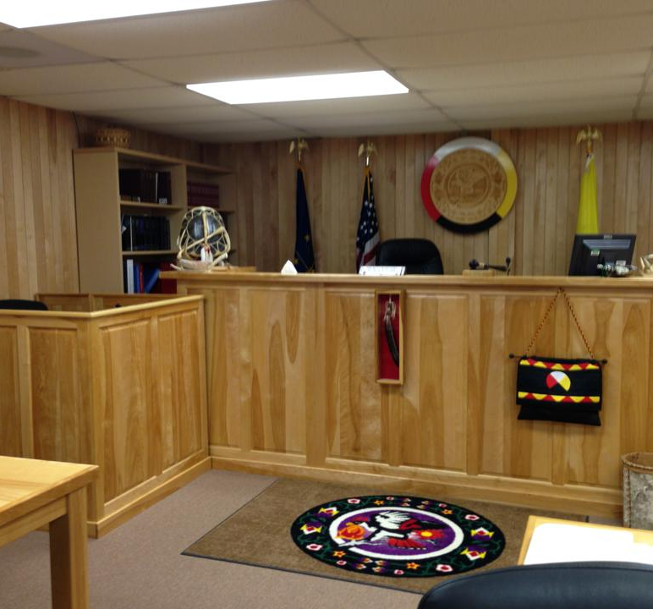
MILS Contracts with Pokagon & Nottawaseppi Huron Band
Primary benefits for Legal Services
Diversify funding
More services for communities
Primary benefits of these contracts for the Tribes:
For five years, had an on-site attorney dedicate to their members and spouses of their members
Can go over the LSC 200% of poverty cut-off
Specific other-types of cases (tribal defined based on needs)

Slide 7
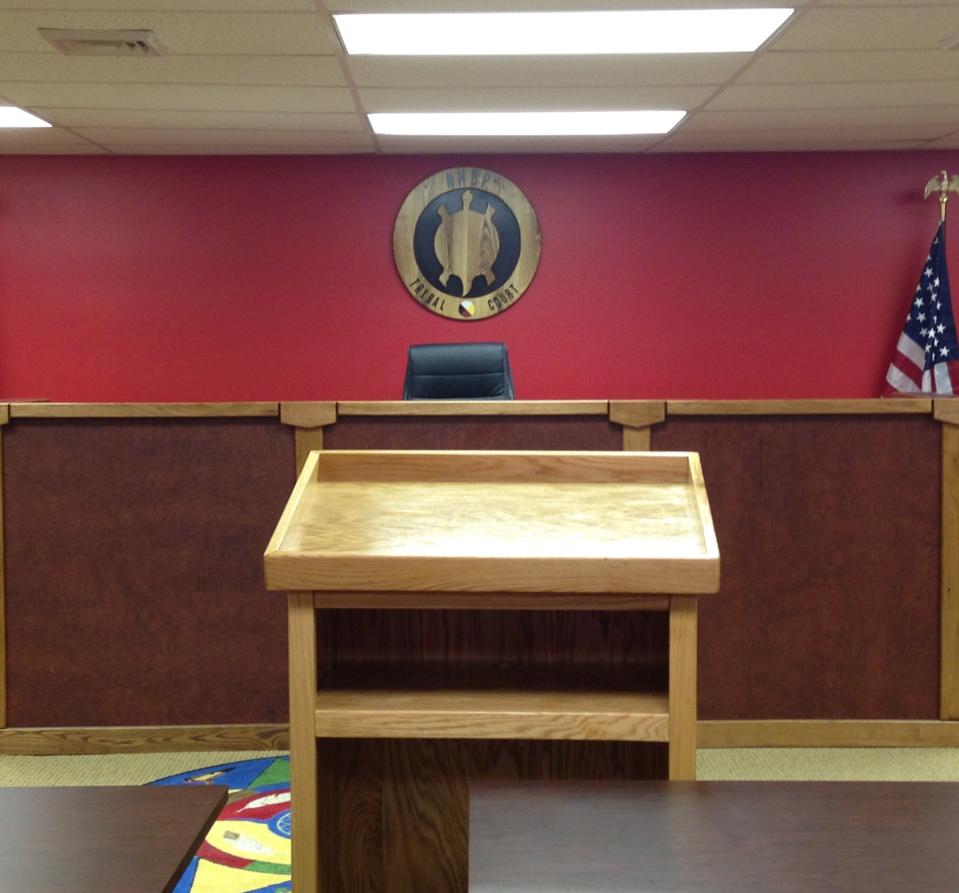
Types of Cases Included Under This MOA
Both tribes lifted LSC 200% income cap
Criminal Defense (VAWA jurisdiction and indigent tribal members)
Band law issues
Estate planning
Probating of estates
Guardianships
Real estate (housing purchases, landlord tenant issues, etc)
Other civil legal issues (advice only)

Slide 8
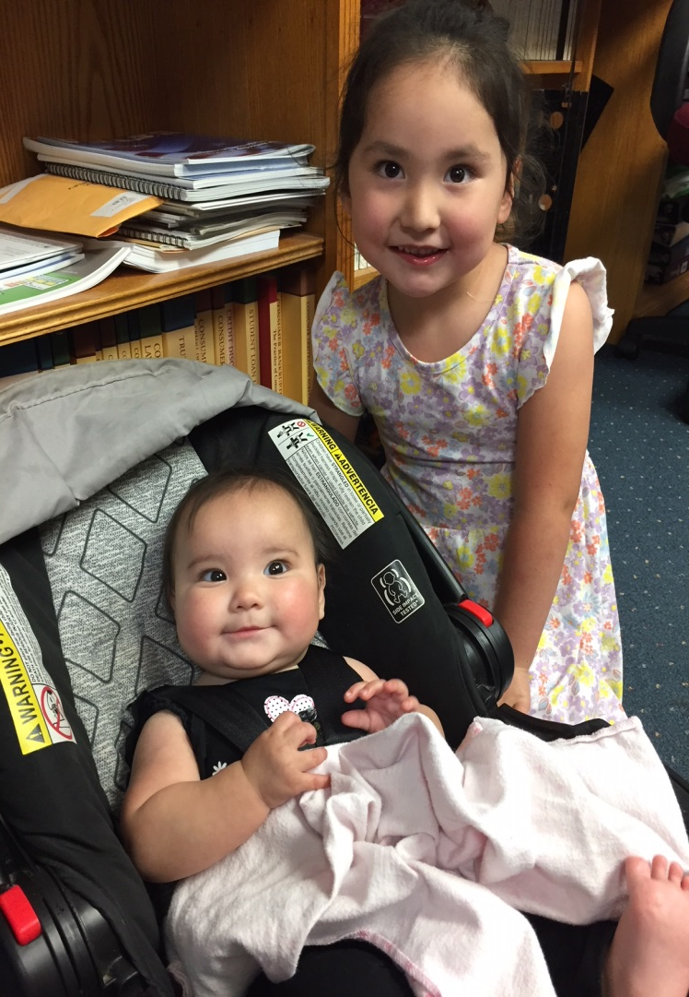
Outcomes and Deliverables
In five years:
Closed 448 cases for people over 200% of poverty or otherwise ineligible for MILS services, 55 of which were extended services cases
Closed an additional 195 cases for income eligible NHBP and Pokagon members, 18 of which were extended services cases

Slide 9
814 S Garfield Ave, Suite A
Traverse City, MI 49686
(231) 947-0122
www.mils3.org

