Slide 1
Providing Legal Services to Tribal Communities in Idaho
Indigenous Law Conference
Indigenous Law and Policy Center
Michigan State University College of Law
East Lansing, MI
October 9, 2019
Howard A. Belodoff
Associate Director
Idaho Legal Aid Services, Inc.
howardbelodoff@idaholegalaid.org

Slide 2
IDAHO LEGAL AID SERVICES
ILAS is a statewide LSC program with eight offices.
ILAS attorneys serve five Reservations from four offices.
ILAS receives a small LSC Native American grant of $73,000 per year.
Supplemental Funding:
  DOJ Office of Justice Programs Tribal Criminal and Civil Legal Assistance Grants for Indian tribes
  Tribal Contracts to provide legal representation to Tribal Members

Slide 3
SIX INDIAN TRIBES
Five Reservations
Kootenai: Members: 149 Current Size 12.5 acres
Coeur d’Alene: Members: 2,190 +/- Current Size 345,000 acres
Nez Perce: Members: 3500 +/- Current Size 750,000 acres
Shoshone & Paiute: Members: 1,200 Current Size 300,000 acres
Shoshone & Bannock: Members: 5,826 Current Size 546,000 acres

Slide 4
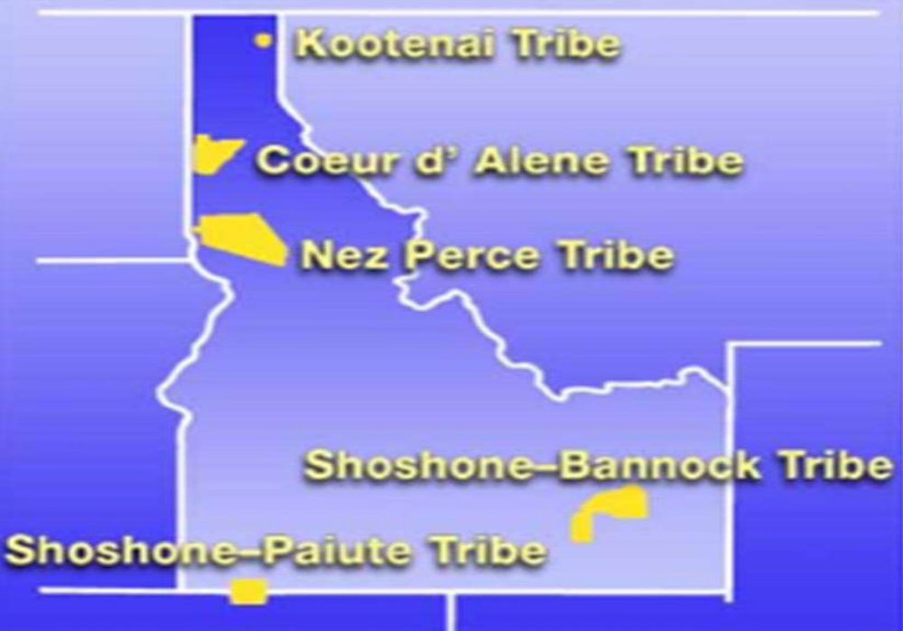

Slide 5
Legal Representation
ILAS has prioritized a good working relationship with the Tribes, Tribal Courts and Tribal Counsels over many years.
ILAS is an integral component of the tribal justice system on Reservations.
Attorneys travel to the Reservations on a weekly basis to meet with and serve tribal members and appear in tribal courts.
In the case of the Duck Valley Reservation, the trip is 165 miles one way and may require the attorney to stay overnight to appear at court hearings.
  ILAS is the only legal assistance available on the Duck Valley Reservation.

Slide 6
Civil and Legal Representation
ILAS provides legal services in civil and criminal cases.
  Public Defender Services on the Nez Perce and Duck Valley Tribal Courts
  Appointed as GAL in juvenile cases for the Fort Hall Tribal Court
  Prepare Indian Wills involving estate issues for trust lands
  Indian Trust Land Management for individual landowners
  Representing victims of Domestic Violence
ILAS has been involved in Tribal Court improvement projects such as drafting and revising Tribal Codes, Judge’s Desk Book, and participating in problem solving courts.
The contract with the Shoshone-Bannock Tribes includes legal representation in state courts for misdemeanors and civil matters.
Education of Tribal Members: Wills and Estate Planning, Consumer & Debt Collection, Agricultural and Resource Issues, & Land Management Issues.

