Slide 1
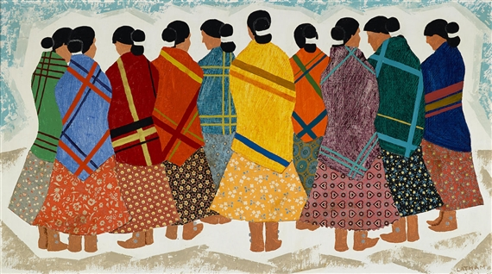
Respect Women,
They Make Our Bread.
Katherine Belzowski, Esq. Navajo Nation Department of Justice
Navajo Nation Council Delegate Amber Kanazbah Crotty
Notes:
My name is Katherine Belzowski and I am a recovering Navajo Nation employment lawyer. For 5 years I worked in the Litigation Unit of the Navajo Nation Department of Justice representing the Nation in employment grievance cases.

Slide 2

Sexual Discrimination Laws on the Navajo Nation
Navajo Nation Bill of Rights § 3.
  ….Equality of rights under the law shall not be denied or abridged by the Navajo Nation on account of sex nor shall any person within its jurisdiction be denied equal protection in accordance with the laws of the Navajo Nation...
Sexual Harassment Policy in the Personal Policy Manual
    Defines sexual harassment
    How to report a complaint of sexual harassment
    No retaliation
    Requires an Investigation be performed

Slide 3
Navajo Preference and Employment Act (NPEA)
Purpose: Provide employment opportunities to the Navajo work force and protect Navajo workers from exploitation.
Applies to all employers doing business within the territorial jurisdiction of the Navajo Nation, near the boundaries of the Navajo Nation, or engaged in a contract with Navajo Nation. 15 N.N.C. § 604
Territorial jurisdiction: “All land within the exterior boundaries of the Navajo Indian Reservation or of the Eastern Navajo Agency, all land within the limits of dependent Navajo Indian communities, all Navajo Indian allotments, all land owned in fee by the Navajo Nation, and all other land held in trust for, owned in fee by, or leased by the United States to the Navajo Nation or any Band of Navajo Indians.” 7 N.N.C. § 254
Notes:
These cases are brought under the NPEA

Slide 4

Paul Spruhan

Slide 5
Harassment in NPEA
“All employers shall maintain a safe and clean working environment and provide employment conditions which are free of prejudice, intimidation and harassment.” 15 N.N.C. § 604(B)(8)
Notes:
Term harassment is not defined in the NPEA

Slide 6
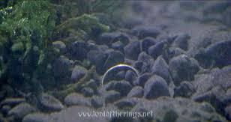
Notes:
Passed in 1985 and amended in 1990 the NPEA went unchanged for 24 years
Darkness crept into the world—plaintiff attorneys realized how to successfully bring claims under Act, resulting in the Nation paying out hundreds and thousands of dollars each year
Between 1990 and 2016 of the six cases involving sex discrimination heard by the Navajo Supreme Court, the court failed to find persuasive evidence of abuse in all but one.

Slide 7
Harassment in the Courts
Encompassing “all forms of conduct that unreasonably interfere with an individual's work performance or create an intimidating, hostile, or offensive working environment.” Kesoli v. Anderson, 8 Nav. R. (Nav. Sup. Ct. 2005)
“To maintain a harmonious work place, employers must prevent hostile activity, especially from a supervisor.”
“Kesoli's position of supervisor, which, in the context of Navajo thinking makes him a naat'áanii.”
“As a naat'áanii he had a responsibility to conduct himself thoughtfully and carefully with respect for his employees under the principle of házhó'ógo…”

Slide 8
Sexual Harassment in the Courts
"The Court holds that in this case the very broad, ambiguous language in Section 604(B)(9) does not authorize an employee to file a claim with the Commission against an employer for sexual harassment." Yazzie v. Navajo Sanitation, 9 Nav. R (Nav. Sup. Ct. 2007).
“Sexual harassment is an emerging issue in Navajo society, and other societies, and what it means and whether it should be an actionable claim are being developed.”
“Given the unsettled nature of what sexual harassment should mean and, absent explicit language in the NPEA that sexual harassment is actionable before the Commission, the Court will not expand the statute to allow for claims against an employer where the Council has not clearly provided for them.”
“If the Council wishes the Commission to hear such claims, it may amend the statute to clearly provide such jurisdiction.”
Notes:
Several years after Kesoli case the Court heard Yazzie v. Navajo Sanitation
Case concerned a subordinate claiming he was sexually harassed by his supervisor

Slide 9

Notes:
- Then in 2014 a Delegate took an interested in changing employment law, and started purposing amendments to the NPEA and the PPM

Slide 10
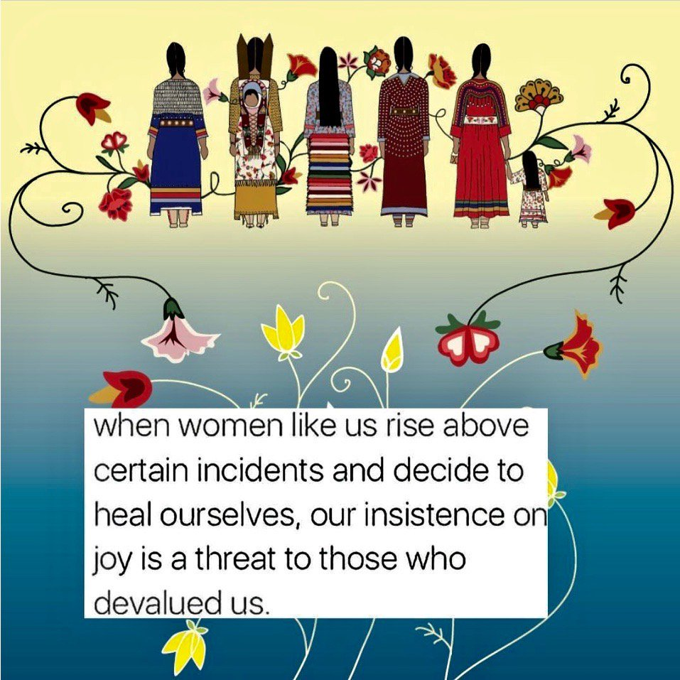
Sexual Harassment on the Nation
Notes:
Historical Context—Sexual harassment on the Nation carries a lot of historical and cultural baggage
Intergenerational Trama

Slide 11
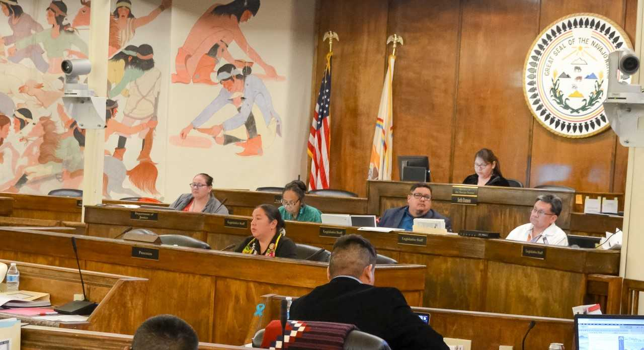
Amending the NPEA

Slide 12
New Sexual Harassment Language
All employers shall maintain a safe and clean working environment and provide employment conditions which are free of prejudice, intimidation and including sexual harassment. The employee alleging a violation of this subsection shall have the burden of proof to show that violation by a preponderance of the evidence. An employee may not file an action under the Domestic Abuse Protection Act, 9 N.N.C. § 1601, et seq., to seek to restrain a supervisor or co-worker for a dispute arising out of the employment relationship. 15 N.N.C. § 604(B)(9).

Slide 13
Post-Amendment Life
https://fronterasdesk.org/content/696370/changing-woman-part-three-leader
Notes:
Executive Orders
Sexual Harassment Trainings
After Effects of Trainings
Moving Forward

