Slide 1

Legal Education & Native American Inclusion in the Legal Profession
Neoshia Roemer
Staff Attorney

Slide 2



INCLUSION is necessary for increasing the number of Native American attorneys practicing law.
Notes:
Define inclusion & differentiate from diversity. It’s about make sure people are present and can contribute/participate in a meaningful way.

Slide 3

Let’s Look at Some Numbers…
According to US Census Bureau (2010): Native Americans make up 1.6% of the U.S. Population
According to NNABA (2015): Native Americans make up 0.3% of the legal profession (as attorneys) in the U.S.

Slide 4
2015 NABA Recommendations
Interest in law school and legal career
Admission into law school
Success in law school
Successful transition from law school to legal profession

Slide 5
How are law schools recruiting and preparing Native American attorneys for the legal profession?

Slide 6
Pipeline to Law Initiative & major goals
Early Outreach
Pre-Law Advising
Mentorship Opportunities

Slide 7
Pipeline to Law Initiative Annual Summer Program
Why go to law school
How to apply
Where to apply
When to apply
Notes:
We provide student travel scholarships with some travel reimbursement for staff. Otherwise, the staff donates their time.

Slide 8

Law school admissions
Making sure students know what law school is
  What is a law degree?
  How do you use a law degree?
Making sure students know how to apply to law school
  What is the LSAT?
  How to shop for law schools?
  When are the applications due?
  How do I pay for it?
Notes:
It’s a holistic process!

Slide 9
Ethical Considerations in Recruitment
Funding
How financial aid works
Locating specific funds available for Native students
Best fit
Encouraging students to be realistic but to also aim high
Encouraging students to find the best programs for them
Notes:
How the Pipeline includes these ethical considerations
This is also what I do in my MSU capacity

Slide 10
The LSAT!!!!
What is the LSAT?
Pipeline spends a lot of time discussing what the LSAT is and how students can prepare realistically
Includes: coupon for discounted, or even free, test prep courses for Pipeline students

Slide 11

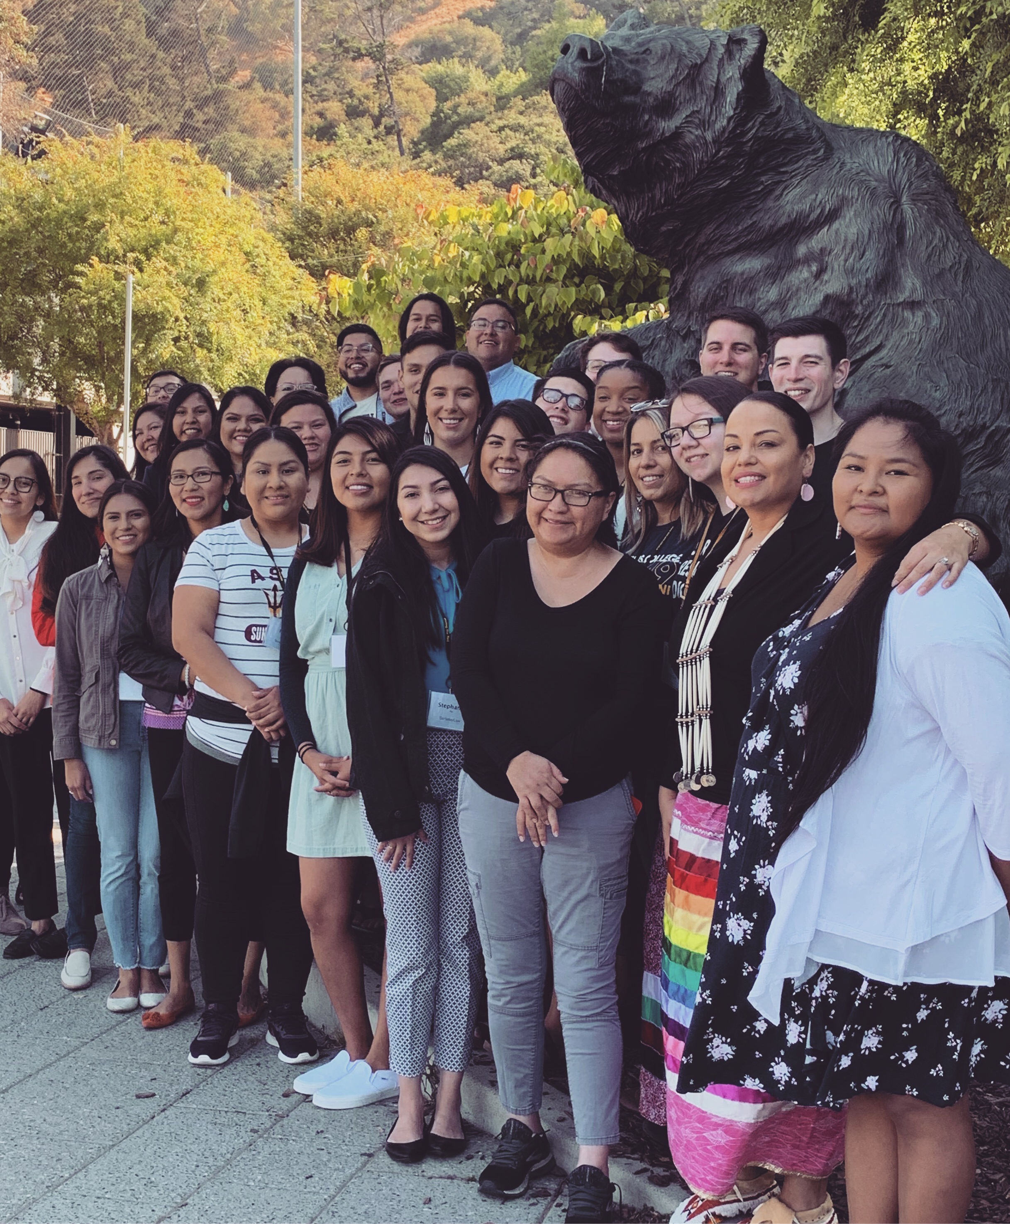
Building a Cohort
Letting students know they’re not alone either in the application process or as a cohort
Connecting prospective students with current Native law students & Native attorneys

Slide 12


Next Pipeline to Law Summer Event
June 17-21, 2020 at Michigan State University in East Lansing, Michigan

Slide 13
Beyond the Pipeline: Recruitment
We encourage students to maintain contact as they move forward
We encourage students to apply to law school and apply for the Pre-Law Summer Institute (PLSI)

Slide 14
Recruitment at the University Level
Advocacy remains key!!
Recruiting within the community
Reaching out and having (difficult) conversations with prospective students
Can we provide the best fit for this student?
Can we provide for this student’s needs?
Can we provide the funding for this student?

Slide 15
Beyond Recruiting: Retention
What we do at MSU:
Academic support
Community support
Networking & career support
Notes:
Because we know academic success is the key to increasing practice!

Slide 16
Pipeline to Law Initiative Pre-Law Advisor’s Conference
Hosted in conjunction with AILC for those who are advising Native students
Topics include
How to identify good candidates
How to work with self-identified candidates
What they need to know about the application process
Notes:
So much misinformation out there!!!

Slide 17

Next Pre-Law Advisors’ Conference
February 4-5, 2020 at the Isleta Resort and Casino in Isleta, NM (just a few minutes south of Albuquerque)

Slide 18
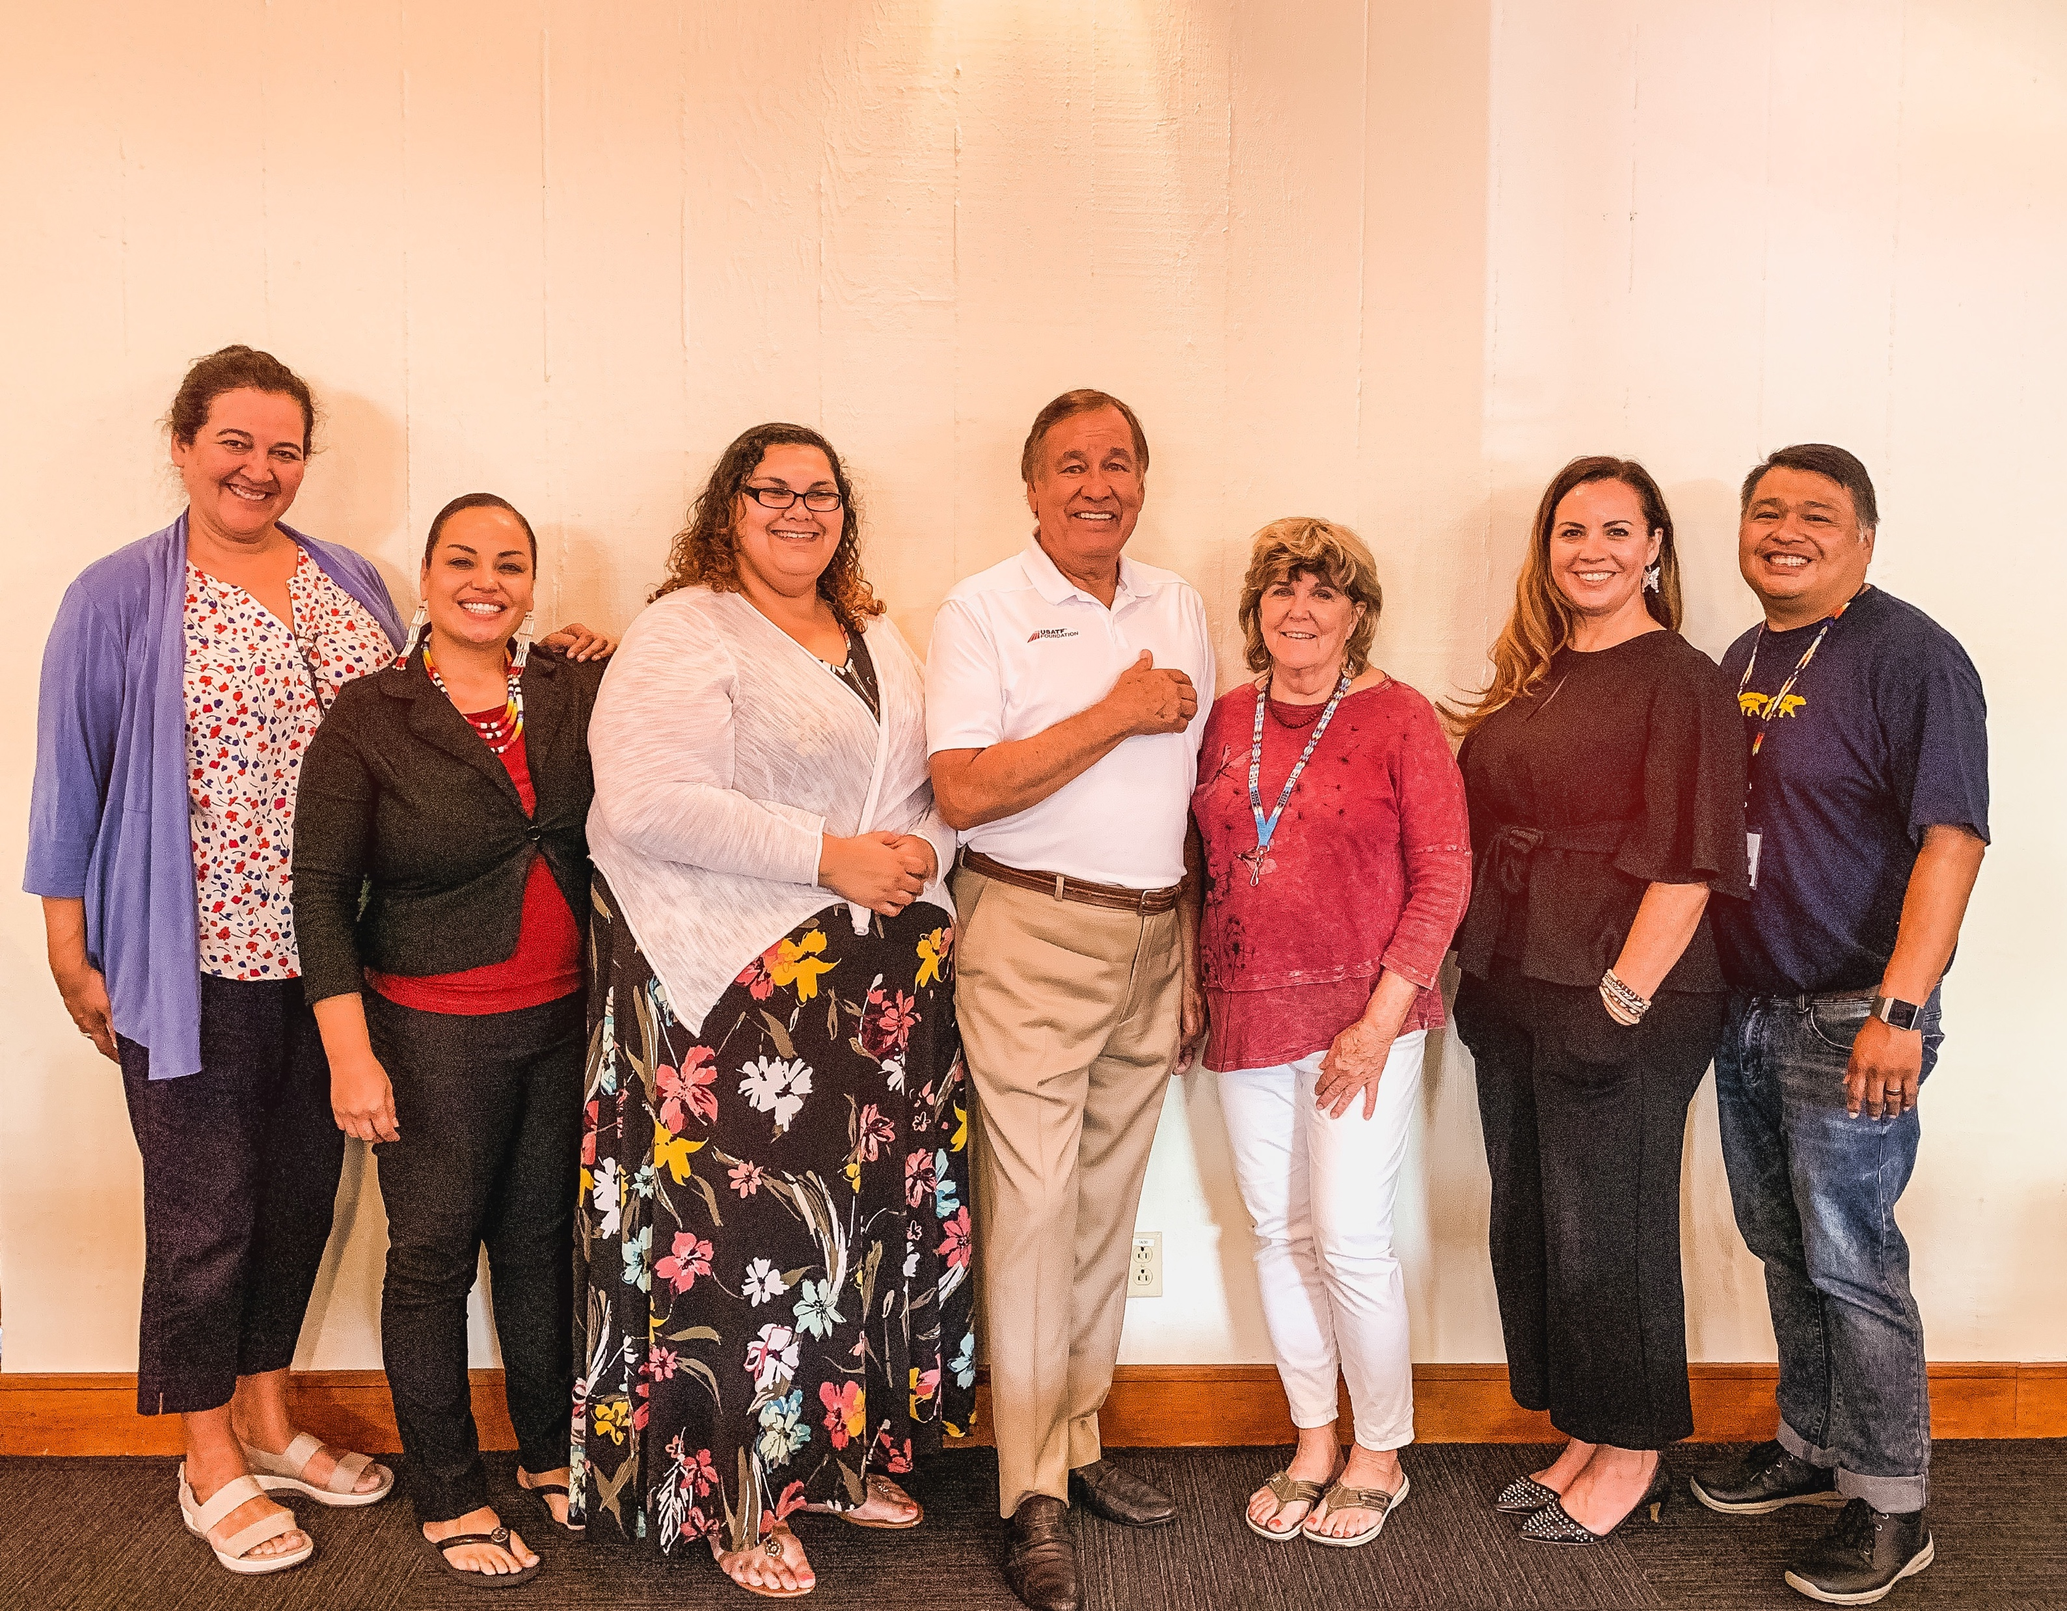
A Quick Request…
Pipeline to Law runs on donations and grants
Please consider donating!
Contact Kate Rosier (kathlene.rosier@asu.edu) for more information on how to contribute
Notes:
There’s a great need for LSAT prep materials & student travel scholarships

Slide 19

Diversifying the legal profession
Lee m. redeye
Associate attorney
Lippes mathias Wexler friedman LLP

Slide 20
ADVANTAGES FOR NATIVE AMERICAN ATTORNEYS WORKING AT LAW FIRMS
SKILL DEVELOPMENT
MENTORSHIP
CONTACTS

Slide 21
ADVANTAGES FOR LAW FIRMS THAT HIRE NATIVE AMERICAN ATTORNEYS
INCREASED CULTURAL AWARENESS
TALENTED ATTORNEYS
DIVERSITY!

