Slide 1
COVID-19 Town Hall:
The Pandemic’s Impact on Michigan Tribes & Economic Development Companies
March 31, 2020

Slide 2
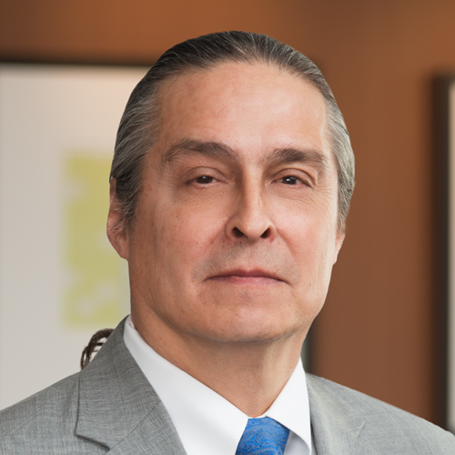
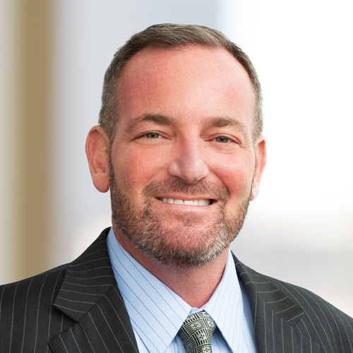
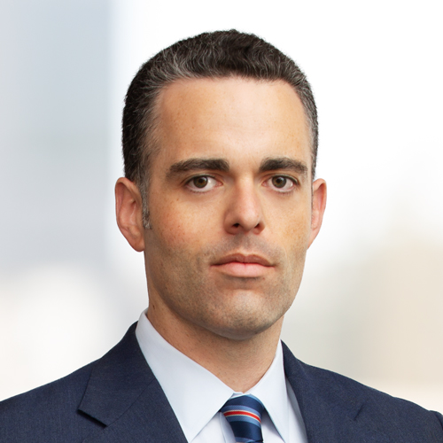
Today’s Speakers
Jeff Davis, Of Counsel
Grand Rapids
Chair, Native American Law & Policy PG
jdavis@btlaw.com
616-742-3984
Lee Kolodny, Partner
Los Angeles
Native American Law & Policy PG
lkolodny@btlaw.com
(310) 284-3829
Matt O’Hanlon, Partner
Los Angeles
Insurance Recovery & Counseling PG
matthew.ohanlon@btlaw.com
(310) 284-3878

Slide 3
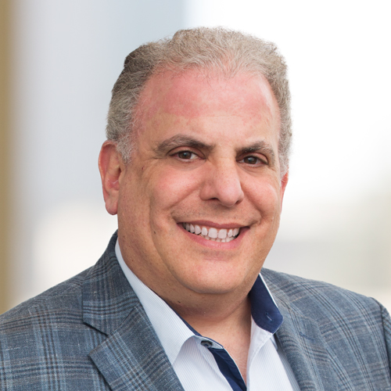
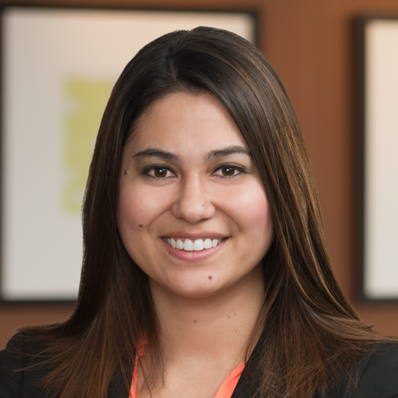
Today’s Speakers
Scott Witlin, Partner
Los Angeles
Labor & Employment Department
scott.witlin@btlaw.com
(310) 284-3777
Erika Weiss, Associate
Grand Rapids
Native American Law & Policy PG
erika.Weiss@btlaw.com
616-742-3984

Slide 4
Topics to be Covered:
Passing of the federal stimulus bill and its application to tribes, as well as their economic development companies (EDCs)
Employer and employee responsibilities at the state and federal level
Insurance coverage under business interruption or other policies

Slide 5
OVERVIEW OF STIMULUS ACTS / CARES ACT

Slide 6
Phase I
For Covid-19 response focused primarily on health - $40 million to CDC to carry out surveillance, epidemiology, lab capacity, infection control, mitigation, etc.
Phase II
$64 million to IHS : primarily to cover diagnostic testing for Covid 19 testing for Indians receiving services through HIS or Urban Indian Health Organization

Slide 7
Phase III: The CARES Act
Broken into six categories:
  Healthcare
  Public Health
  Tribal Governance & Housing/Community Development
  Nutrition
  Education
  Economic Relief
Source: Congressional Native American Caucus
Co-Chairs Tom Cole (Okla-04) & Deb Haaland (NM-01)

Slide 8
Federal Stimulus Bill – Healthcare & Public Health
$1.032 billion for the Indian Health Service (IHS) Services Account
$1.5 billion for CDC grants and cooperative agreements of which Indian Tribes, Tribal Organizations, and Urban Indian Health Organizations are eligible to apply; and
Minimum $125 million for CDC set-aside funding directly to Indian Tribes, Tribal Organizations, and Urban Indian Health Organizations
Minimum $15 million in set-aside funding for Tribes and Tribal organizations under Substance Abuse and Mental Health Services Administration (SAMHSA)
Source: Congressional Native American Caucus
Co-Chairs Tom Cole (Okla-04) & Deb Haaland (NM-01)

Slide 9
Federal Stimulus Bill – Healthcare & Public Health
Minimum $15 million from the Public Health Service and Social Services Emergency Fund
Minimum $15 million telehealth and rural health activities set-aside funding for Tribes, Tribal organizations, urban Indian health organizations, or health service providers under Health Resources and Services Administration (HRSA)
Extension of the Special Diabetes Program for Indians through November 30, 2020
Extension of the Temporary Assistance for Needy Families (TANF) Program through November 30, 2020
Source: Congressional Native American Caucus
Co-Chairs Tom Cole (Okla-04) & Deb Haaland (NM-01)

Slide 10
Tribal Governance & Housing/Community Development
$453 million for Indian Affairs Operation of Indian Programs until September 30, 2021
$300 million under the Native American Housing Assistance and Self-Determination Act (NAHASDA)
$4.5 million for tribal domestic violence shelters through the Family Violence and Prevention Services Act (10 percent tribal set-aside from $45 million)
$900 million for Low Income Home Energy Assistance (LIHEAP) which includes Tribal LIHEAP
Source: Congressional Native American Caucus
Co-Chairs Tom Cole (Okla-04) & Deb Haaland (NM-01)

Slide 11
Nutrition
$100 million for the Food Distribution Program for Indians Reservations (FDPIR)
$20 million for Older American Act, Tribal Nutrition Program. Provides funds for the delivery of nutrition services to American Indians, Alaska Natives, and native Hawaiian elders
$8.8 billion for Child Nutrition Programs
Source: Congressional Native American Caucus
Co-Chairs Tom Cole (Okla-04) & Deb Haaland (NM-01)

Slide 12
Education
$69 million for Operation of Indian Education Program until September 30, 2021
$78,000 for Institute of American Indian and Alaska Native Culture and Arts Development
Over $1.1 billion for Education Stabilization Fund
Access to Institute of Museum Library Services grants
Source: Congressional Native American Caucus
Co-Chairs Tom Cole (Okla-04) & Deb Haaland (NM-01)

Slide 13
Economic Relief
$8 billion set-aside from Coronavirus Relief Fund for Tribal Governments to use for expenditures incurred due to COVID-19 emergency
$454 billion from Coronavirus Economic Stabilization Act of 2020 – used for loans, loan guarantees and investments in support of the Fed Reserve’s lending facilities to eligible businesses, state (Tribes included), and municipalities.
Source: Congressional Native American Caucus
Co-Chairs Tom Cole (Okla-04) & Deb Haaland (NM-01)

Slide 14
Economic Relief
Keeping American Workers Paid and Employed Act
  Makes Tribes eligible for the Small Business Act Section 7(a) Paycheck Protection Program, which provides 100% federal loan guarantees up to $10 million to cover costs like employee salaries, paid sick leave/medical leave, mortgages/rents, and employee health insurance premiums. Includes Tribal businesses
Source: Congressional Native American Caucus
Co-Chairs Tom Cole (Okla-04) & Deb Haaland (NM-01)

Slide 15
Economic Relief
Emergency Unemployment Relief for Governmental Entities and Nonprofit Organizations
  During the period of the national emergency, the federal government would pay a 50 percent reimbursement for the cost of unemployment compensation paid by Indian Tribes that are reimbursement-option employers
Source: Congressional Native American Caucus
Co-Chairs Tom Cole (Okla-04) & Deb Haaland (NM-01)

Slide 16
Economic Relief
Emergency Economic Injury Disaster Loan (EIDL) Grants—Tribal small businesses eligible.
Nursing Workforce Development Amendments—Includes IHS Community Health Aides.
Health Professions Workforce Programs— Qualified Tribes or tribal organizations may be prioritized for awards
Priority for Geriatrics Education and Training Grants for applicants with programs or activities that are expected to serve older adults in Indian Tribes or Tribal Organizations
Extension of the Temporary Assistance for Needy Families (TANF) Program through November 30, 2020
Source: Congressional Native American Caucus
Co-Chairs Tom Cole (Okla-04) & Deb Haaland (NM-01)

Slide 17
INSURANCE COVERAGE UNDER BUSINESS DISRUPTIONS

Slide 18
Insurance Coverage For Business Disruption
Potentially applicable coverages
  Property
  Pollution
  Crisis management
Tribal First property policy (017471589/06 (Dec 15) 9137)
  No virus exclusion
  “direct physical loss or damage” requirement
    Actual exposure to COVID-19?
    Civil authority coverage (10 mile radius)
      Voluntary or involuntary shutdown?

Slide 19
Insurance Coverage For Business Disruption
Separate pollution coverage for “disinfection events”
  includes outbreak or epidemic involving communicable virus
  must be reported to local, state or federal government or public health agency or entity
  Covers reasonable disinfection costs
Importance of giving timely notice

Slide 20
LABOR & EMPLOYMENT ISSUES

Slide 21
Last Week’s News
Families First Coronavirus Response Act
Introduced on March 11 in House
Passed House on March 14
Amended by House on March 16
Passed Senate & Signed by President on March 18

Slide 22
Yesterday’s News
March 19 – California issues Stay at Home Order
March 20-21 – Other states (NY, NJ, IL, CT, OH) Followed Suit
Business Scrambling to Determine If and How to Operate
Learning About Essential Infrastructure Sectors

Slide 23
Today’s News
New Relief Legislation
CARES Act
Lots of Money Being Thrown At Situation –
$2 Trillion Dollars -- $2,000,000,000,000.00
Tomorrow – Phase 4

Slide 24

CARES ACT

Slide 25
Families First Coronavirus Response Act
Introduced on March 11 in House
Passed House on March 14
Amended by House on March 16
Passed Senate & Signed by President on March 18

Slide 26
Families First Coronavirus Response Act
Big Question – Application to Tribes
Fair Labor Standards Act
Family Medical Leave Act
Circuit Split – Sixth Circuit ????

Slide 27
Families First Coronavirus Response Act
Three Main Divisions That Deal With Employers
Emergency Paid Family Medical Leave
Emergency Paid Sick Leave
Refundable Tax Credits to Offset Some of the Costs

Slide 28
Emergency FMLA Leave
Broader Coverage Than Regular FMLA
Covers All Employers with Fewer Than 500 Employees
Covers All Employees Who Have Worked 30 Days
Exempts Employee Health Care Providers & Emergency Responders

Slide 29
What is the leave for …
Where the employee is unable to work (or telework);
Due to a need for leave to care for child under 18 years of age;
If the school or place of care has been closed, or unavailable;
Due to a public health emergency.

Slide 30
How Much Paid Leave …
12 weeks total leave like regular FLMA
First 2 weeks unpaid, but …
Employee can elect to use other accrued leave
Next 10 weeks: 2/3 paid, capped at $200 per day/$10,000 in aggregate

Slide 31
Emergency Paid Sick Leave
Amends Fair Labor Standards Act
Exempts All Private Employers with 500 Employees or More
Covers Most Public Employers
Authorizes Secretary of Labor To Exempt Employee Health Care Providers & Emergency Responders & Employers w/ Fewer than 50 Employees if it Would Jeopardize Business

Slide 32
Paid Sick Leave – How Much?
80 Hours for Full-Time Employees
For Part-Timers The Number of Hours Equal to What That Employee Works in a Two-Week Per
Cannot Force Employees to Take Other Leaves Before Taking This Paid Sick Leave

Slide 33
Paid Sick Leave – What Is It For?
A governmental quarantine or isolation order related to COVID-19
Advice from a health care provider to self-quarantine due to concerns related to COVID-19
The employee experiencing symptoms of coronavirus and seeking a medical diagnosis
A need to care for or assist an individual who:
  Is subject to a governmental quarantine or isolation order related to COVID-19
  Has been advised by a health care provider to self-quarantine due to concerns related to COVID-19.
A need to care for a child whose school or place of childcare is closed or unavailable due to coronavirus

Slide 34
Refundable Tax Credit
Applies to Emergency Sick Leave
Credit Against Old Age, Survivor & Disability Tax &
Some Railroad Retirement Tax
Caps Apply --

Slide 35
Refundable Tax Credit - Caps
A governmental quarantine or isolation order related to COVID-19
Advice from a health care provider to self-quarantine due to concerns related to COVID-19
The employee experiencing symptoms of coronavirus and seeking a medical diagnosis
Cap of $511 per day or $5,110 in the aggregate

Slide 36
Refundable Tax Credit - Caps
Cap of $200 per day or $2,000 in the aggregate
A need to care for or assist an individual who:
  Is subject to a governmental quarantine or isolation order related to COVID-19
  Has been advised by a health care provider to self-quarantine due to concerns related to COVID-19.
A need to care for a child whose school or place of childcare is closed or unavailable due to coronavirus

Slide 37
So Is There a Coherent Scheme?
Looking at Paid FMLA & Paid Sick Together:
12 Weeks in Total (See Next Slide)
First 2 Weeks at Full Pay
Next 10 Weeks at two-thirds pay.

Slide 38
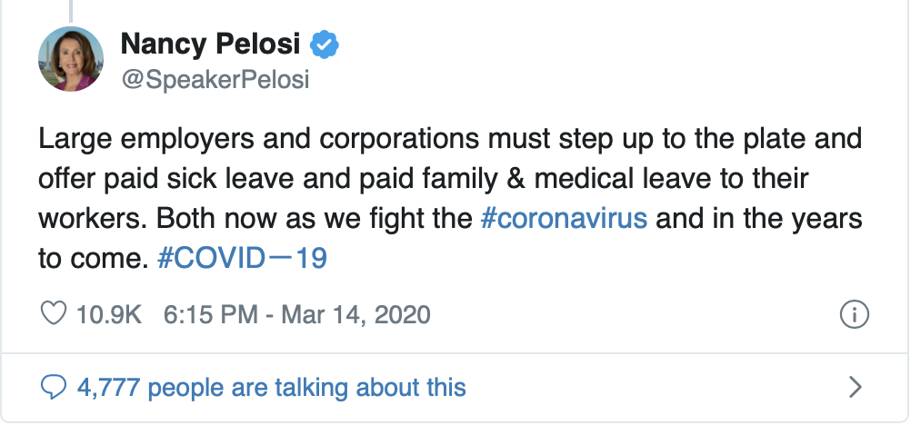
WHY EXEMPT BIG EMPLOYERS ????

Slide 39
SHAME ON YOU!!!!
So Why Exempt Them
Speaker Nancy Pelosi wrote on Twitter during the bill's negotiations:
"I don't support U.S. taxpayer money subsidizing corporations to provide benefits to workers that they should already be providing."

Slide 40
HOW DO YOU GET TO 500?
Look to FMLA
Ironic b/c Employer Historically Wanted to Avoid Aggregation to Stay Below 50 Person Threshold
Four Factor Test

Slide 41
Four Factor Test
Common management
Interrelation between operations
Centralized control of labor relations and personnel
Common ownership and financial control

Slide 42
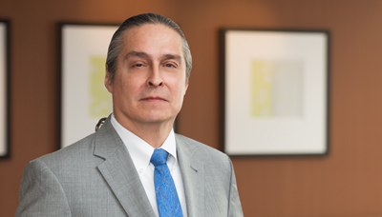


Learn More: Native American Law & Policy
Sophisticated Approach:
Our attorneys are able to provide a full range of services to Native American tribes and we understand the unique environment and issues associated with representation of tribal sovereign nations. We have an established track record with the tribes we have represented in delivering sound guidance on establishing and maintaining quality healthcare services; lobbying the federal government on numerous issues, including federal funding and grants; and assisting with pubic and private financing, tax, real estate and environmental issues.
Jeff Davis, Turtle Mountain Band of Chippewa Indians
Chair, Native American Law & Policy PG
jdavis@btlaw.com | 616-742-3980
Tribal Talks Podcast
Ask us how to subscribe today!
Erika Weiss, Descendant, Little Traverse Band of Odawa Indians
Co-Founder, Native American Law & Policy PG
erika.weiss@btlaw.com | 616-742-3984

Slide 43

COVID-19 Resources at B&T
Visit our Resources Page
Visit the link that sits on the homepage of btlaw.com to get updated information about how the firm is supporting its clients during the pandemic.

Slide 44
QUESTIONS?
Submit through the chat window!

